Slide 1


fostering cooperation between railway stakeholders to improve safety culture
Lessons learned from the Twinning II EU Project
Virginie Papillault, UIC
Manager - Human & Organisational Factors and Safety Culture
The project leading to this application has received funding from the European Commission number MOVE/C4/SUB/2020-62/SI2.862249
ERA SAFETY DAYS - 20 September 2023

Slide 2
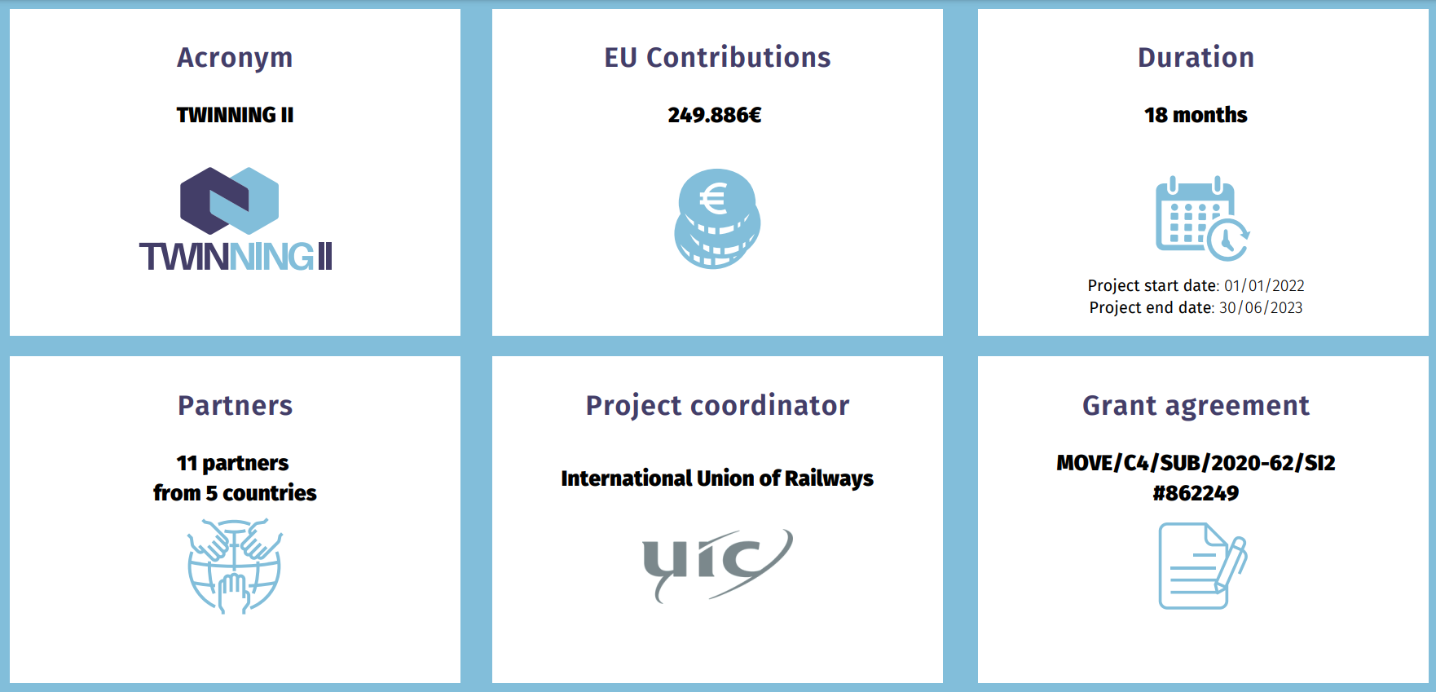

Twinning II European Project: facts and figures

Slide 3
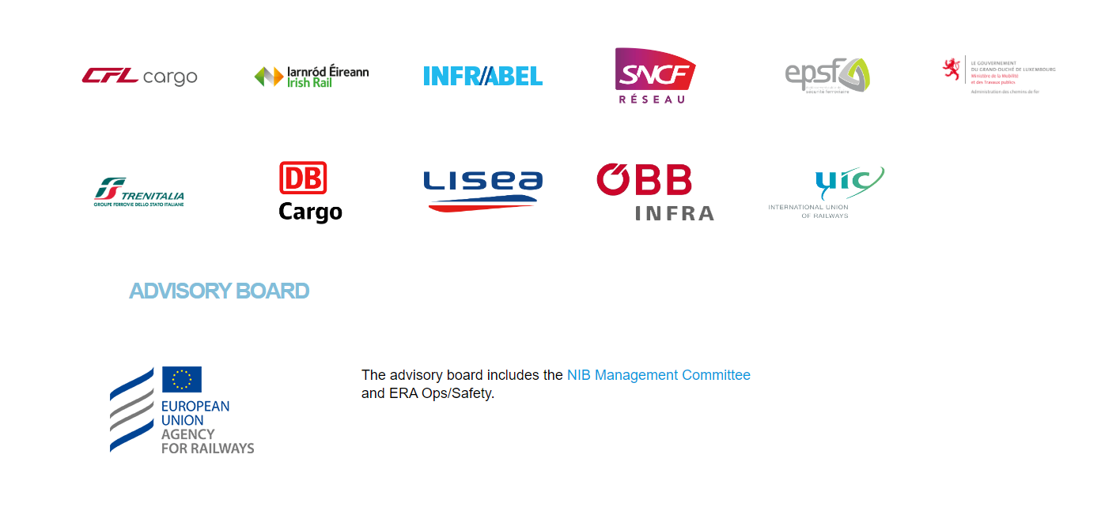
Twinning II Consortium and Advisory Board

Slide 4


Overview of Twinning II European Project
Improvement of the safety culture in the European rail sector:
  Strengths and areas for improvement of safety culture,
  Methods, recommendations and suggestions,
  Practical experience.
  Peer Review exercises,
  Sharing knowledge on safety,
  Development of safety awareness/culture,
  Exchanges of technical failures and organisational aspects

Slide 5
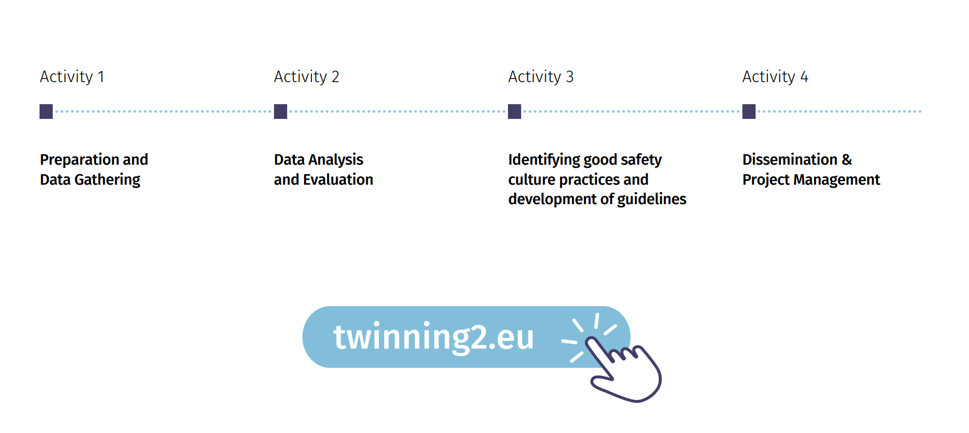
Structure of the Twinning II European Project

Slide 6
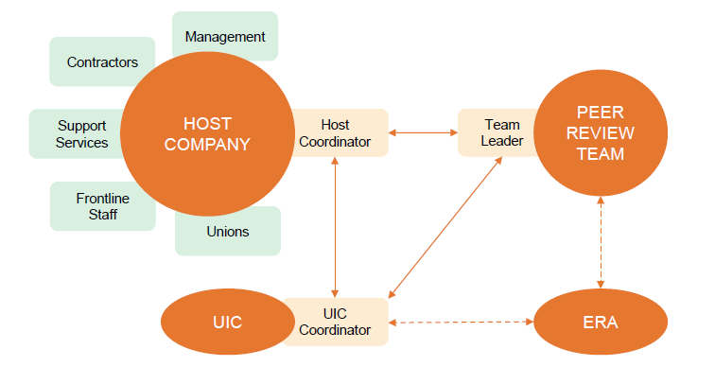
Key actors of the Peer Review

Slide 7
What is a Peer Review in practice?
A major decision for the Host companies, with a core strong commitment
A Tool/Methodology for finding out how staff perceive and feel safety in their daily work
6 days on site at the Host Company;
3 Peer Reviews conducted at ÖBB, CFL and Infrabel,
An experienced Peer Review Team

Slide 8
An example of Peer Review Timeline

Slide 9
Benefits of conducting a Peer Review?
-> Systemic view of safety
-> Positive approach of Safety Culture for Host Company & Team of Reviewers
For Host Companies
  Identify the strengths and areas of improvements
  Inspire from exchanges with Peer Reviewers, on good practices and driving change methods
  Develop a proactive management of safety
  For Team of Reviewers
  Identify good practices on safety in other companies
  Identify good practices in driving change

Slide 10
Feed back experience from Twinning II Peer Review actors
Testimonial by Ludwig Koschutnig - ÖBB Infrastructure (Host Company)
Testimonial by Neil Blakeley - Irish Rail (Team Leader and Reviewer)
Testimonial by Vincent Vanhoutte - Infrabel (Host Company)

Slide 11
Follow up of the Twinning II European project
Words from François Davenne (Director General of UIC)

Slide 12





Follow up of Twinning II European project
Safety Culture Peer Review Handbook
(UIC & ERA)
An experienced Team of Reviewers
How to conduct a Peer Reviews in the future?
Coordination of future Peer Reviews in Europe & internationally (UIC)
Safety Leadership Training and methodology support (ERA)

Slide 13
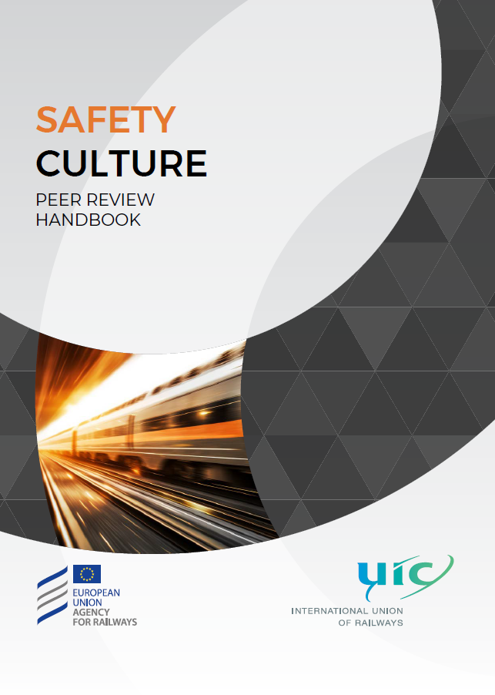
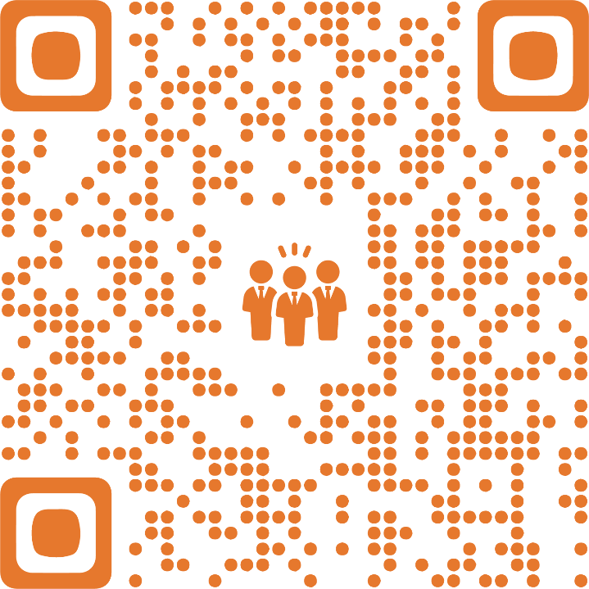

Slide 14


