Slide 1
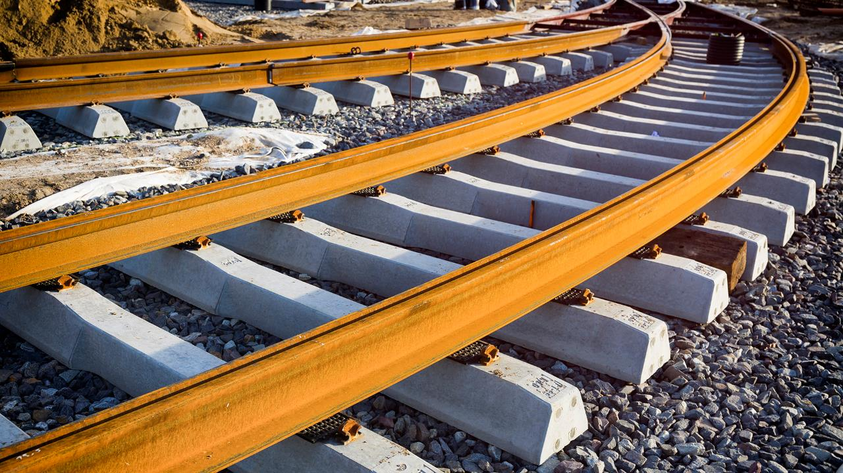

Safety Culture Peer Reviews
- supporting shared learning within the Single European Railway Area
Kim DREWS | ERA Safety & Operations Unit
Safety days| 20 September 2023
kim.drews@era.europa.eu

Slide 2
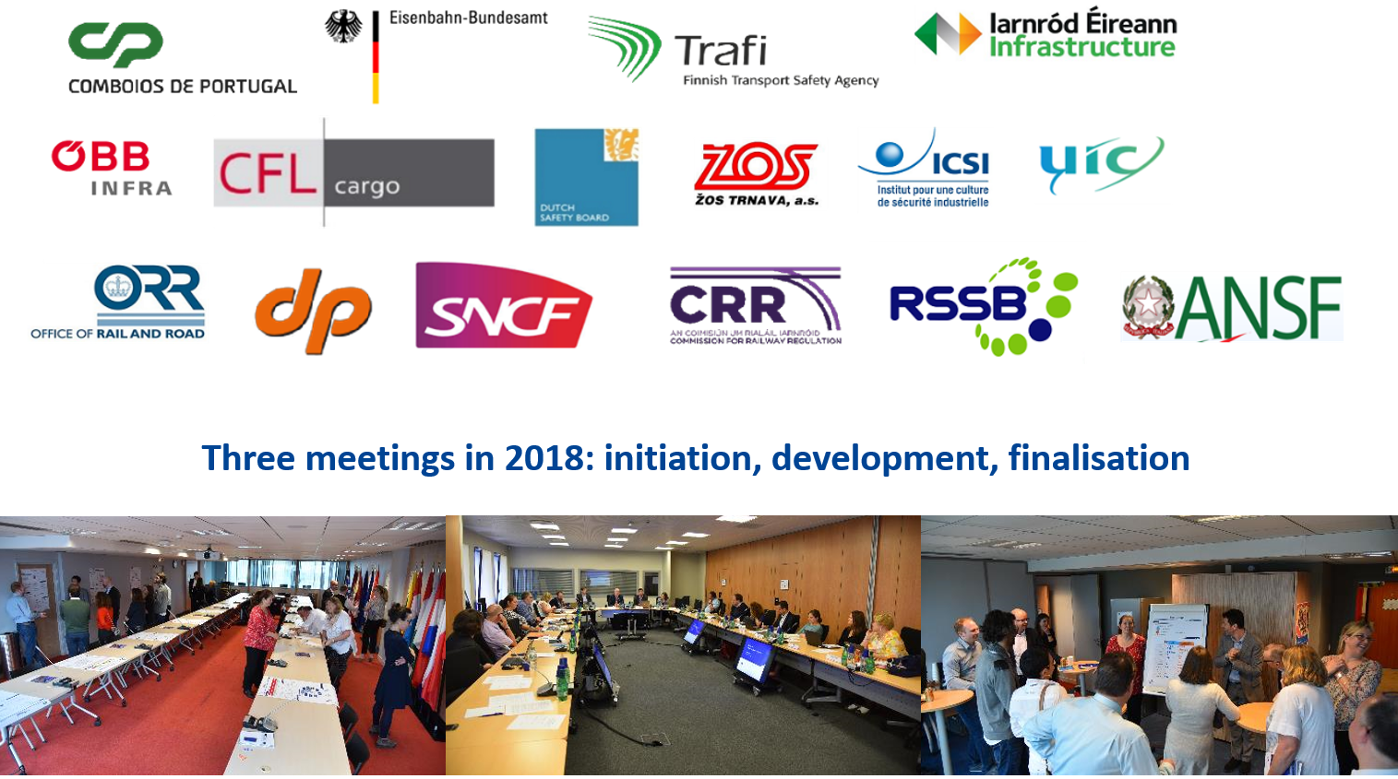
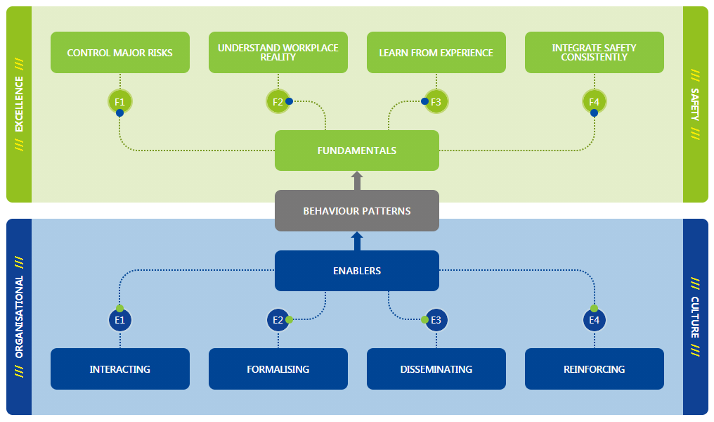
Background
European Railway Safety Culture Model was developed under the ERA HOF Network in 2018
  To raise awareness of safety culture
  A framework to support a shared understanding of safety culture
  A model to support the sector in the development of safety culture
ERA-SCM
Notes:
How can safety culture peer reviews contribute to shared learning - establishing and testing a methodology for European railways
The presentation will outline how the Peer Review came to life and what the process is like. Unfolding the development through the last 4 years from the early testing in 2019, the long wait during Corona lockdown to the training of reviewers and test of the methodology in Peer Review pilots and the Twinning programme.

Slide 3

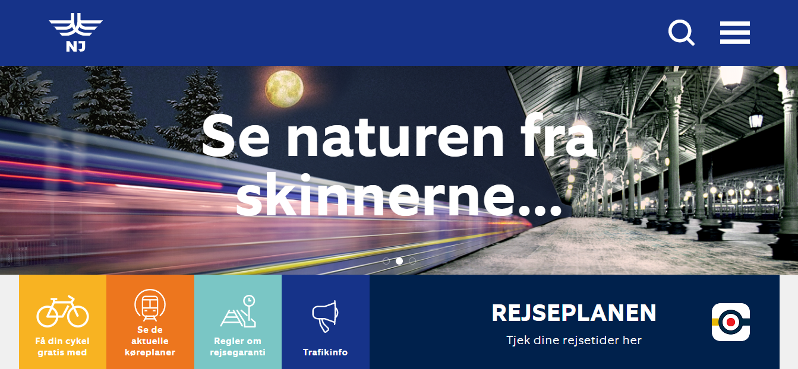
Partnering with NJ
Partnering with NJ in 2019 to test the model as the basis for a full safety culture assessment
  To validate and improve the model
  Develop Safety Culture Review methodology – inspired by WANO
NJ - small IM, RU and ECM with 120 staff
Fast growth
  19 to 70 drivers in few years
  2 to 4 lines in operation
  “Old” staff, DSB staff, BDK staff, new staff
  Strong whish to work on safety culture

Slide 4
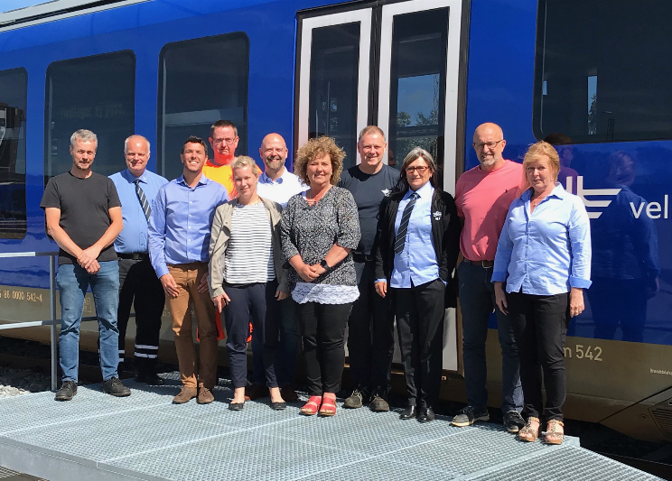
Evaluation of the methodology
The model provided a good basis for discussion and evaluation
Captured many opportunities for NJ improvements – known and unknown
Provided basis for improvements on the SC model and the questions used in the questionnaire
Very positive feedback:
  “we couldn’t have had a better result anywhere”
  “using the model and going through the process means that that we can speak about and structure our SC work better. The SC model has helped us a lot - before doing this, we wanted to do more on SC, but it was very “fluffy””
  “this assessment has given us more learnings than any “normal” supervision”

Slide 5



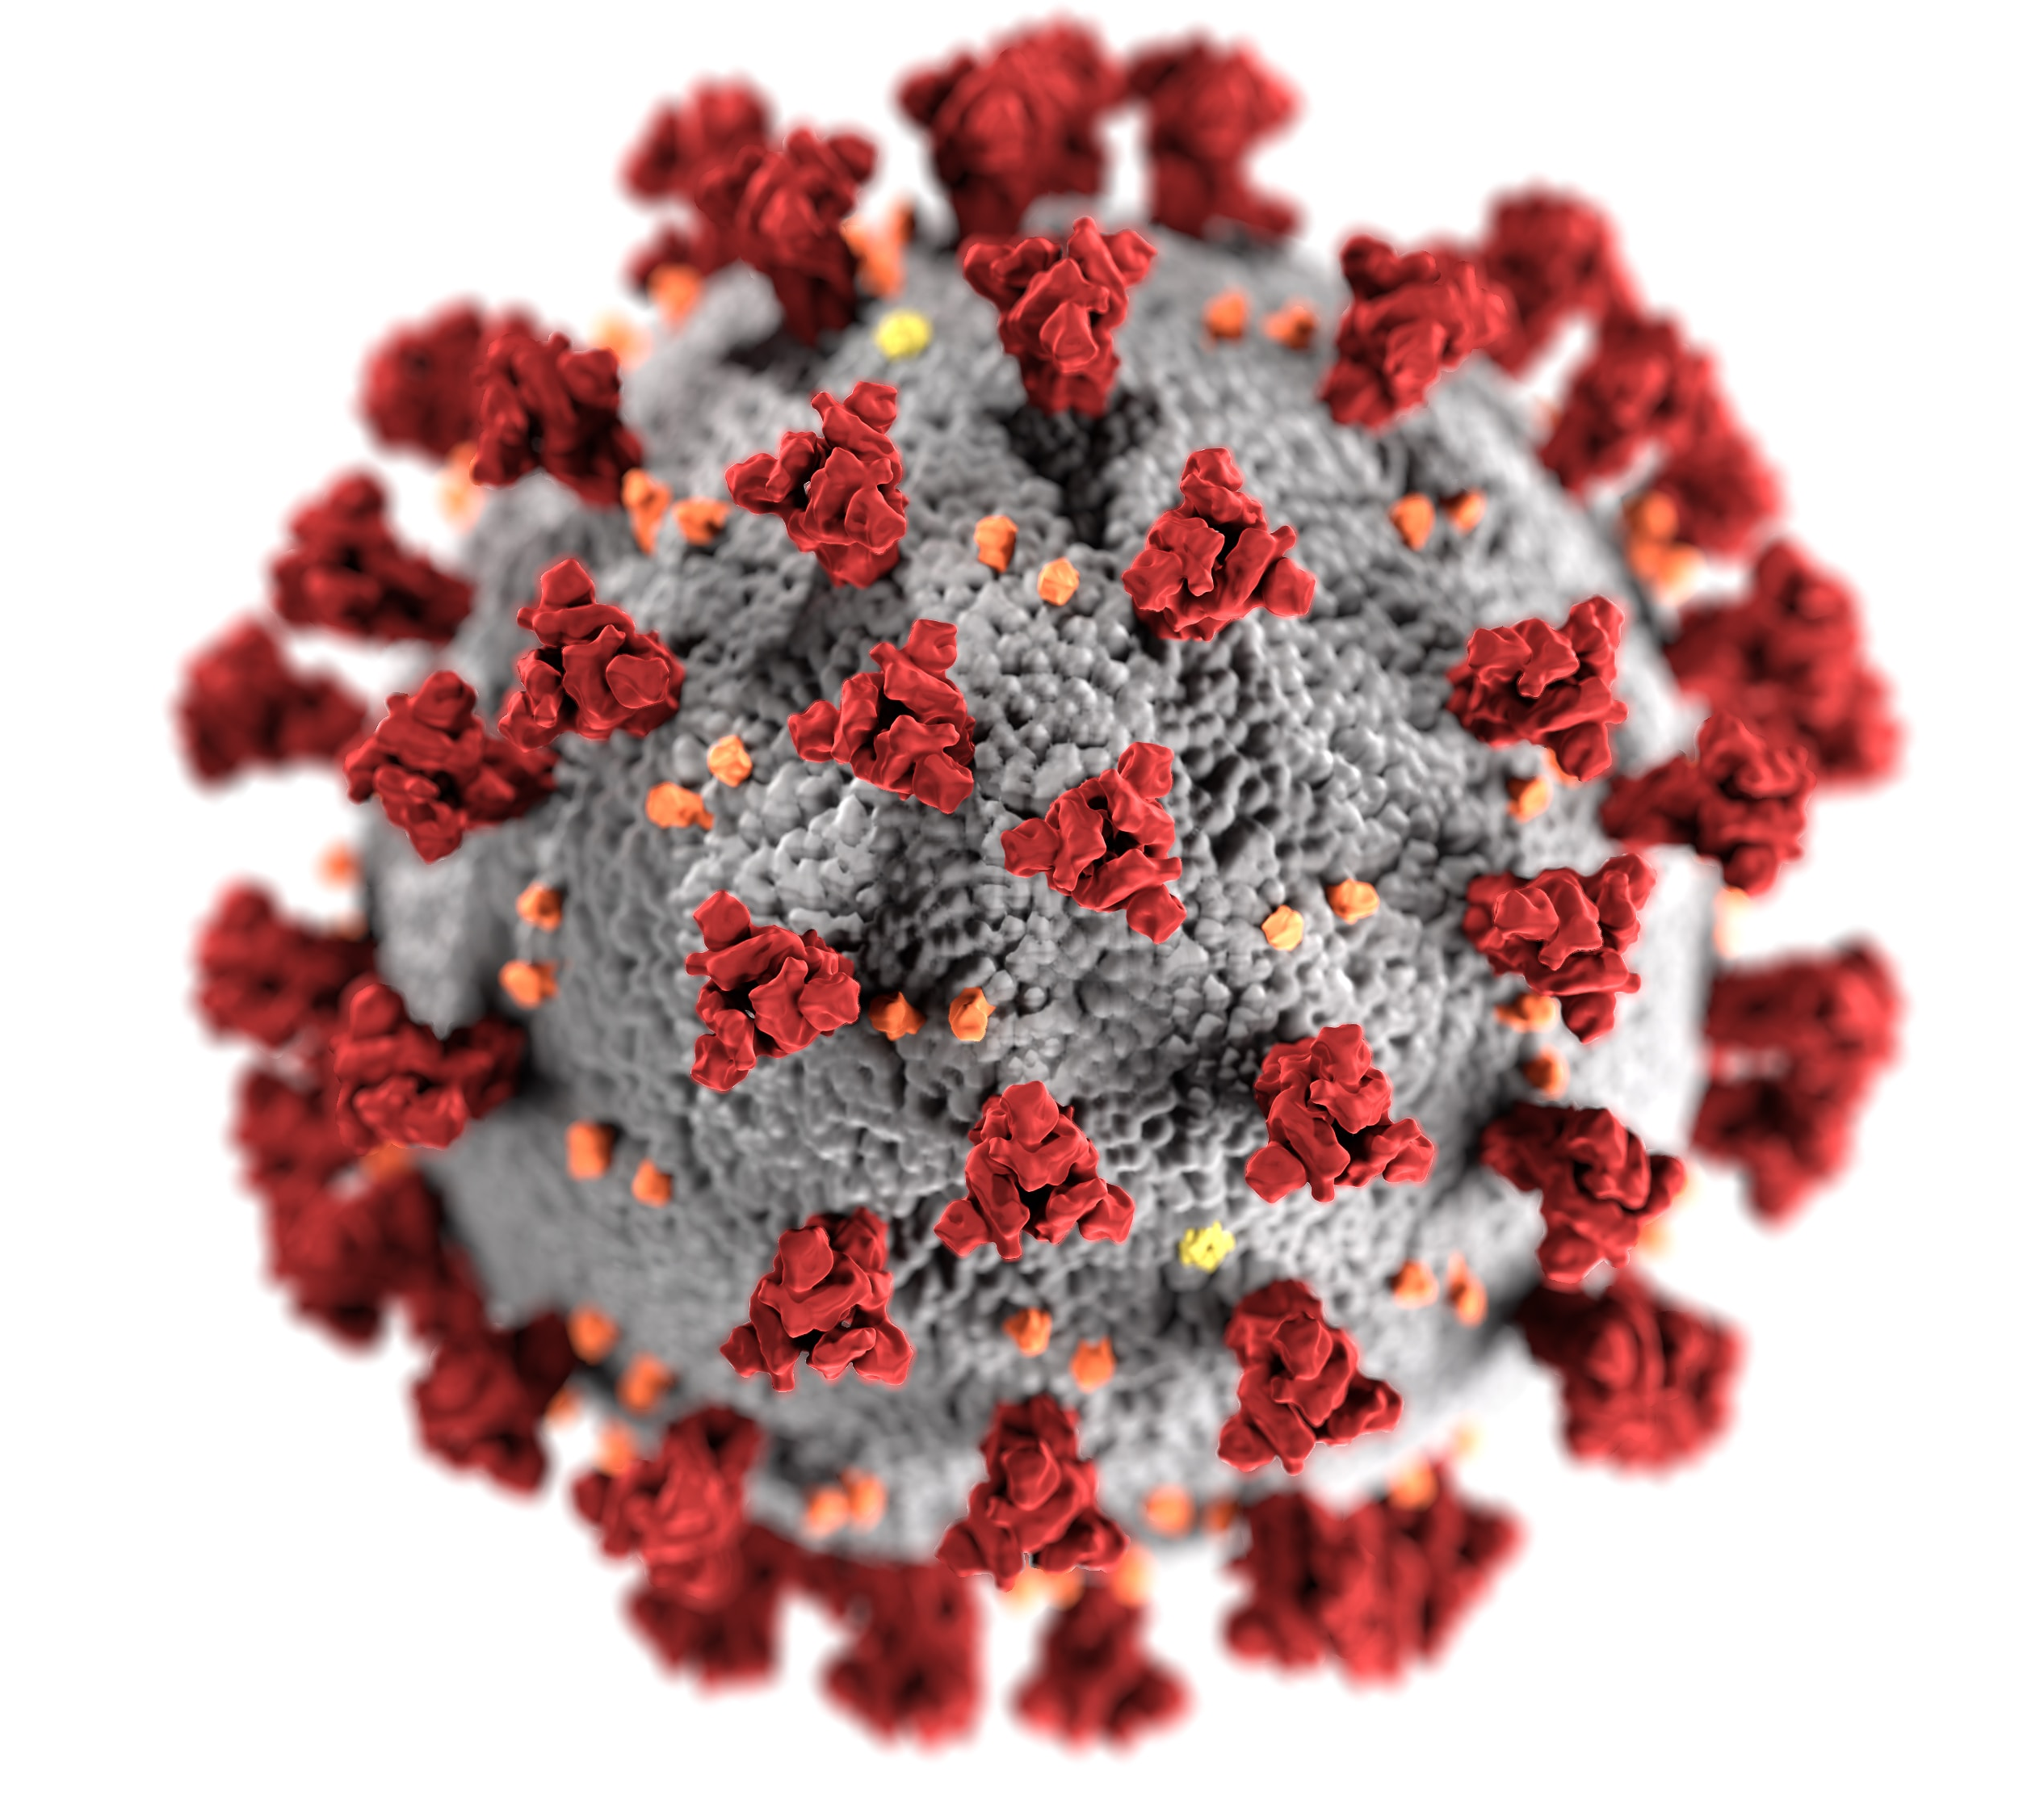

Continued development
  Support from CER and members
  Agreement on four pilot reviews 2020/2021
  Formalising the methodology
  Producing training material for Reviewers and Team Leaders
  Planning of training and Reviews
  Reviews @ Trenitalia and SNCF in 2022

Slide 6

Opportunity to join with TWINNING II
  18 months project granted by the European Commission. (Jan 2022-Jun 2023)
  Aims at improving safety culture in the European rail sector
  Coordinated by UIC
  Obvious to use the ERA Peer Review Methodology
  Improve, validate and formalise the methodology
  ERA provided methodology, training of reviewers and support onsite

Slide 7
Status and next steps
  6 Peer Reviews conducted – NJ, Trenitalia, SNCF, ÖBB Infra, CFL, Infrabel
  Last Review Pilot planned @ ÖBB Produktion 8-13 October 2023
  Collaboration between UIC and ERA to set up a steering board to run and continuously develop the methodology
    UIC to coordinate and participate in future reviews
    ERA to provide training of reviewers, reporting tool and surveys (chargeable service) on request
    Peer Review open to all organisations

Slide 8

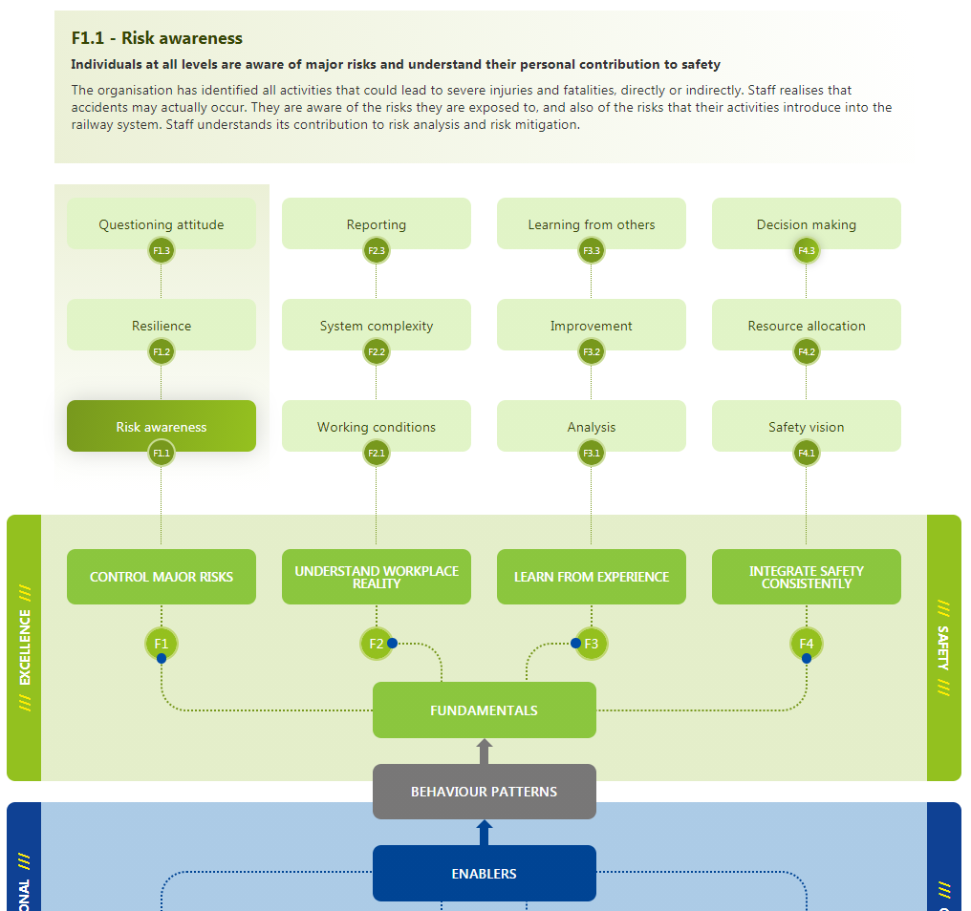
How to…
Data Collection
Document review
Safety climate survey
Individual interviews and focus groups
Observations
Quantitative
Qualitative

Slide 9
How to…
Time​ | SUNDAY​ | MONDAY​ | TUESDAY​ | WEDNESDAY​ | THURSDAY​ | FRIDAY​
Morning​ | ----​ | Opening Meeting​ | Data Collection​ | Data Collection​ | Produce Final Report​ | Closing Meeting​
Midday​ | ----​ | Data Collection​ | Data Collection​ | Data Collection​ |  | Goodbye​
Afternoon​ | Welcome​ | Team debrief​ | Team debrief​ | Team debrief​ | Brief mgm​ | ----​
Evening​ | Document findings and preparation.​ | Optional data collection​ | Optional Data Collection​ | Optional Data Collection​ | ​ ----​ | ​ ----​
Review team:
One Team Leader and 2-3 teams of 2-3 trained reviewers, producing a snapshot in time of STRENGTHS and AREAS FOR IMPROVEMENT within a specified area
Notes:
Dummy report -

Slide 10
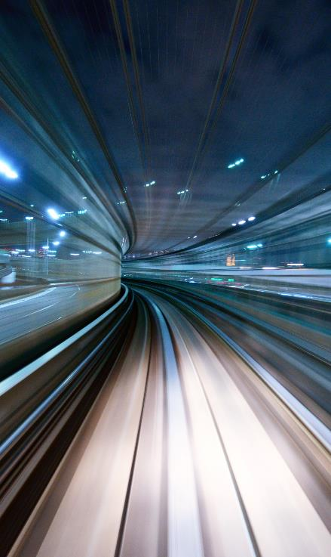
Closing meeting and final report
- Verbal feedback with explanation and discussion of the most important safety culture markers from the review
- Written report with all markers and highlights

Slide 11
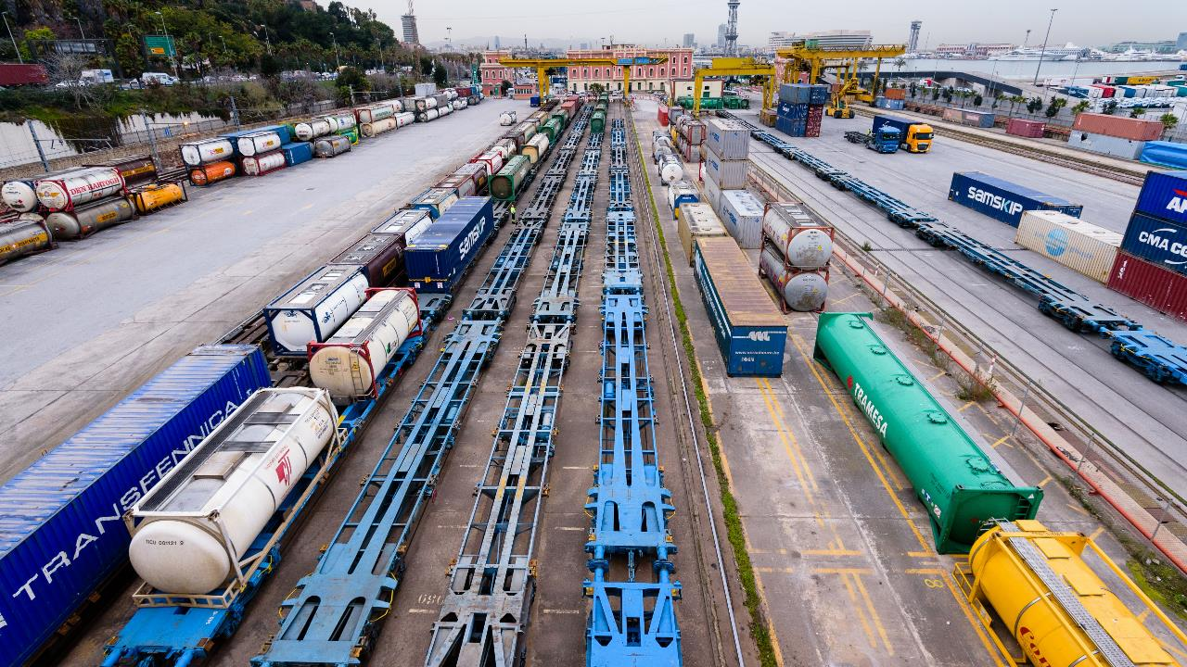
THANK YOU
kim.drews@era.europa.eu
Moving Europe towards a sustainable and safe railway system without frontiers.
Follow us:

