Slide 1


Report, Learn, Improve
Opening of the Safety Days 2023
Josef Doppelbauer | Executive Director
Wednesday 20 September 2023

Slide 2
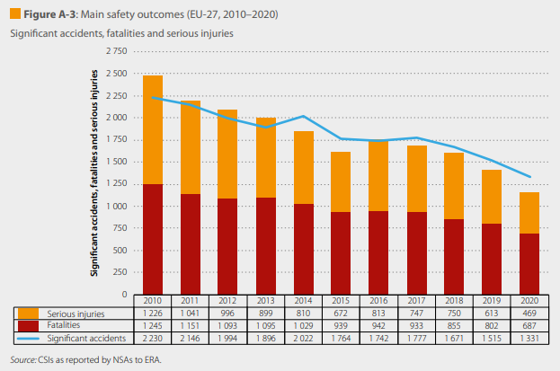
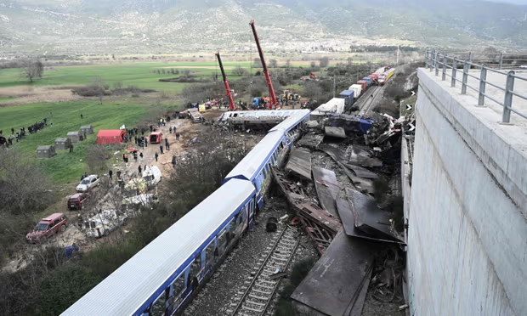
Safest Mode of Transport, BUT
Photograph: Sakis Mitrolidis/AFP/Getty

Slide 3


Learning

Slide 4
Common Safety Method on the Assessment of Safety Levels and Safety Performance (CSM ASLP)
CSM ASLP
(RCM)
Harmonised description of RCMs
Reference list of Risk Control Measures (RCMs)
CSM ASLP
(SP)
Assessment of operator’s maturity on RCMs
RCM performance oversight
Support to definition of performance targets
CSM ASLP
(Scenarios)
Assessment of operators’ safety level
Safety level oversight
Support to definition of safety level targets
CSM ASLP
(ISS)
Group of Analysts (including former JNS)
Production of reference safety knowledge
Safety improvement and development EU actions
Harmonised data sharing
Single point access to safety information
Support to safety monitoring and supervision
CSM ASLP
(GoA)
Harmonised taxonomy
Harmonised description of scenarios
Analysis of accident and incident Causes,
Human and Organisational Factors
CSM ASLP
(SL)
LEARNING
SUPPORT

Slide 5
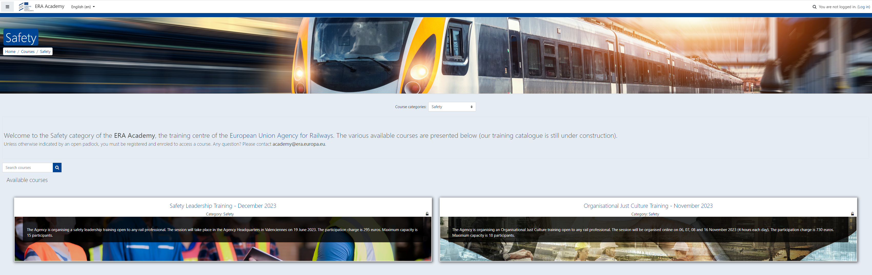
ERA Academy
E-LEARNING

Slide 6



Lessons from other sectors
Peer Review
Learning
Innovative Learning Solutions
Learning from Monitoring
Learning from Investigations
Communication and Safety Culture

Slide 7

THANK YOU
Moving Europe towards a sustainable and safe railway system without frontiers.
Follow us:
Notes:
TSI (Transition, Combined Tr),
Revision of TEN-T Regulation: real opportunity to make Trans-European Transport Network fit for the future, to align the development of the TEN-T network to the European Green Deal objectives and the climate targets of the EU Climate Law. Cutting greenhouse gas emissions from the transport sector by 90%, compared with 1990 levels, by 2050, is key to achieving climate-neutrality by the same date.
New intermediary deadline of 2040 to advance the completion of major parts of the network ahead of the 2050 deadline that applies to the wider, comprehensive network. Core network will also be extended.
New term: 9 European Transport Corridors (ECTs) - integration of Core Network Corridors (CNCs) and Rail Freight Corridors (RFCs).
CT-related infrastructure parameters specified (CT profiles for all types of loading units) and strengthen the concept of network resilience by introducing mandatory interconnections between corridors as well as bypass options, with the aim of improving the reliability of transport services.
More transhipment terminals
High-speed rail network between the main nodes of Europe. The major TEN-T passenger rail lines should allow trains to travel at 160 km/h or faster by 2040.

