Slide 1

Feedback on the ERA-ENISA Conference on Railway Cybersecurity
16 February 2023
Welcome! Webinar to start soon!

Slide 2


Speakers
Josef Doppelbauer
Nathalie Namavar
Oana Gherghinescu
Executive Director | ERA
Project Officer | ERA
Head of CAP Unit | ERA
Anna Gigantino
Head of MARS Unit | ERA
Clio Liégeois
Paloma Iribas Forcat
Chair | ERA Management Board
Alice Consilvio
Spanish representative | ERA Management Board
Researcher | STAFFER Project

Slide 3


Why diversity matters?
Nathalie Namavar

Slide 4
Gender balance – Status
In the Transport sector
In the EU Railway sector
The transport sector is a gendered workspace. The sector is dominated by masculine values and practices making it difficult for women to enter these fields.
Women represent only a little more than 21% of railway companies’ workforce
Although women and girls represent 50% of the passenger rail ridership
Considerably below the economy wide participation rate of women in the labour market (46%)
In leadership positions in the EU
Aim to achieve gender balance in decision-making and politics
Low percentage of women in leading positions
e.g., only 7.5% of Board Chairs and 7.7% of CEOs in the EU largest listed companies
This trends even persists when gender parity exists at the lower levels => top positions exclusively held by men for a long time shape the recruitment pattern for successors (unconscious bias)
32,2% of members of national parliaments in the EU are women

Slide 5
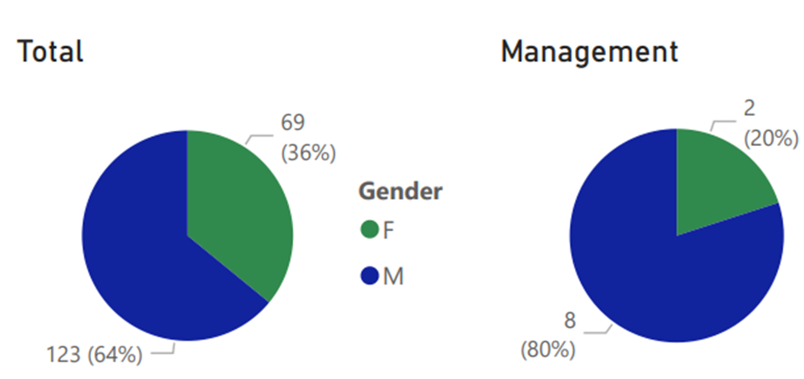
Gender balance – Status
At ERA

Slide 6
Gender equality in the EU is an EU Value
Charter of Fundamental Rights of the European Union – 2012/C 23326/02 - Article 23
“In all its activities, the Union shall aim to eliminate inequalities, and to promote equality, between men and women.”
Treaty on the Functioning of the European Union - Article 8
“Equality between women and men must be ensured in all areas, including employment, work and pay. The principle of equality shall not prevent the maintenance or adoption of measures providing for specific advantages in favour of the under-represented sex.”
“EU institutions and bodies should not be exempt from ensuring gender balance in leadership positions. The Commission will lead by example [...] The Commission will also increase efforts towards reaching a larger share of female managers in EU agencies, and will ensure gender balanced representation among speakers and panellists in the conferences it organises.”
European Commission - 5.3.2020 - A Union of Equality: Gender Equality Strategy 2020-2025

Slide 7



Benefits of diversity -
Why diversity matters
To reflect the society we represent
To align the railway sector with the society in which their customers live
Organisations with a balanced workforce are proven to be 6 times more innovative
Gender diversity in particular facilitates creativity
Diversity improves the information processing and decision-making of the team
Companies committed to diverse leadership are more successful
More diverse companies and institutions are achieving better performance
The relationship between diversity on executive teams and the likelihood of financial outperformance has strengthened over time

Slide 8

On track towards more diversity
Diversity
Inclusion
Is a verb
Does not simply happen
It is best achieved through dedicated programmes that focus on specific goals
The majority needs to work to organise inclusion
To increase diversity and reach true inclusion
Actions should reflect the difference between “equality” and “equity”
Existing, systemic differences should be acknowledged
The principle of “fairness”, implying equal treatment above all, will slow down or stop progress
To change perceptions exactly on this point as the “equal, impartial treatment paradigm” exists within organisations

Slide 9
ERA on track towards more diversity
Creating Agency wide synergies to increase diversity in the most efficient and effective manner
HR STRATEGY 2023-2027
Moving Europe towards a sustainable and safe railway system by ensuring a performant working environment at ERA, marked by high quality, motivated and collaborative staff.
  An attractive workplace for all
  By striving for inclusiveness in our diversity
  Fast and agile selection and engagement meeting ERAs needs
  By Ensuring a balanced, diverse and flexible composition of staff
  A flexible and rewarding career: incentivising professional and personal development
COMMUNICATION STRATEGY
The visuals created by the organisation that are disseminated externally are gender balanced and effort is made to avoid stereotypes.

Slide 10

ERA on track towards more diversity
BETTER TOGETHER PROJECT – Transforming our organisational culture
  Core principles: we look for excellence in our diversity. We value the diversity of our team and encourage a supportive cooperation among all staff without distinction
  Developing Career perspective and mentoring
ERA ACADEMY
  Knowledge and capacity building
  Balanced (technical) representation of ERA during events and webinars
WOMEN IN TRANSPORT PROJECT
  Speednetworking event to foster Women in Transport -
  EU Agencies Network Certificate of Excellence

Slide 11
ERA’s Participatory Gender Audit
Nathalie Namavar

Slide 12
Participatory Gender Audit - Objectives
Assessing and checking the institutionalisation of gender equality into our organisation.
Identifying and understanding gender patterns within their structures, processes, organisational culture and management of human resources, and in the design and delivery of policies and services.
Assessing the impact of organisational performance and its management on gender equality within the organisation.
Gender audits establish a baseline against which progress can be measured:
  Identifying critical gender gaps and challenges.
  Highlighting and sharing among employees good practices within ERA on gender equality promotion and gender mainstreaming.
  Making recommendations for improvements and innovative solutions.

Slide 13
Methodology for the Gender Audit
Lack of internal competence – Training with ILO on Participatory Gender Audit in 2021
Collection of relevant documents and desk review in September 2022
Interviews with selected number of staff based on gender, age and seniority criteria in September 2022
Two workshops organised to consult staff in September 2022

Slide 14
Framework for the Participatory Gender Audit
Knowledge and capacity of employees | Vision, policy and operations | Staffing and organisational culture
Employees’ awareness on gender issues | Gender mainstreaming in multiple organisational dimensions (vision, policies, programmes, communication, budget, etc.) | Numerical gender balance
 | Evaluation and monitoring tools on gender equality | Gender sensitive-transformative human resources policies
 |  | Decisions affecting gender mainstreaming (how and by whom)
Employees’ gender expertise and competence | Selection of partners in promoting gender equality | Gender architecture/network in the organisation, if any
 | Selection of partners in promoting gender equality | Gender friendliness of the organisational culture

Slide 15
Some examples of findings
Recommendations to tackle gaps and foster good practices to improve gender equality within ERA
The visuals created by the organisation that are disseminated externally are gender balanced and effort is made to avoid stereotypes.
No specific attention is given to gender balance or gender equality when selecting partners.
Gender balance in general within ERA is 37% F - 63% M.
Staff members indicate they feel no barrier to ask for parental leave and never experienced any issues.

Slide 16
Endorsing Diversity and Inclusion at ERA
Our Commitment and High-level objectives
Oana Gherghinescu

Slide 17
Fostering change @ERA
AWARENESS
Internal workshops on diversity and gender mainstreaming
Participatory Gender Audit results transparently discussed
Gender representation indicators monitored in the Management Dashboard
Training sessions on diversity related matters
“Speed networking” sessions for female colleagues interested in the ERA work

Slide 18
Fostering change @ERA
INCLUSIVE HIRING AND CAREER PATHS
Further training for the HR experts to guarantee diversity and inclusion during the selection process
Tools to detect gender biases in documents used by the Agency
Re-assess the procedure on the use of the reserve lists to allow for more diversity within the Agency, while respecting the legal requirements
Mentorship program for female staff members, linked to career path development

Slide 19
Fostering change @ERA
WORKPLACE CULTURE
Organisational culture sensitive to diversity; (non)acceptable behaviours clearly identified
Proper conditions for work-life balance
Inclusive language and images reflecting staff and sector diversity
Gender balanced panels of speakers for the ERA-organised events
Fostering ERA female staff attendance as speakers at external events
Attention to gender balance for the membership of the Management Board

Slide 20
Panel discussion
Chair
Clio Liégeois
Participants
Anna Gigantino
Oana Gherghinescu
Paloma Iribas Forcat
Alice Consilvio

Slide 21
The EU project STAFFER,
Skill Training Alliance For the Future European Rail system
Alice Consilvio, University of Genoa
Project Coordination Team

Slide 22
Blueprint for rail supply and transport industries
STAFFER fosters a new strategic approach to rail sectoral cooperation addressing:
skills required for manufacturing of rail products and services
skills required for rail operation, maintenance and infrastructure management
ICT skills related to the use of digital technologies in the manufacturing of rail products and digitalisation in rail transport (such as Internet of Things, data analytics, and cybersecurity)

Slide 23
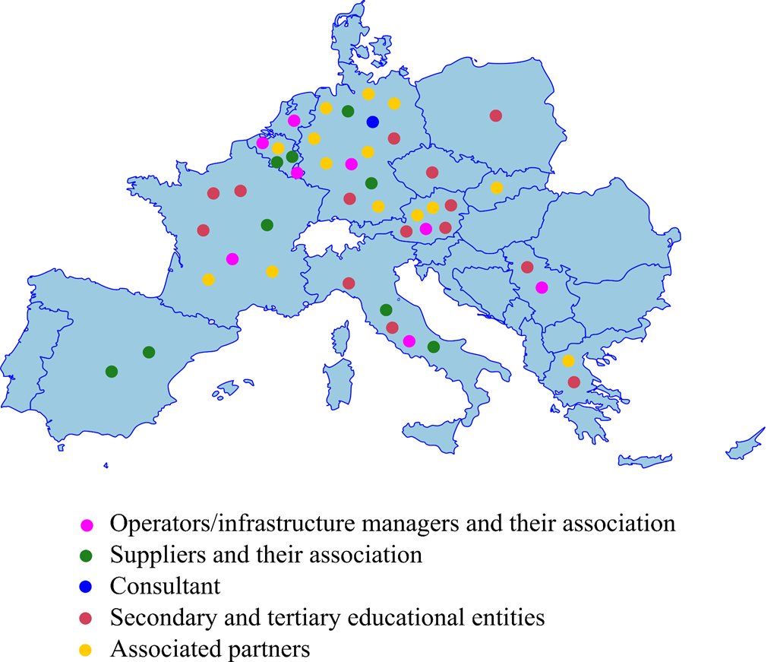
Consortium
The partnership consists of 31 partners:
6 infrastructure managers/operators
8 rail industry suppliers
2 organizations
a consultant
14 educational institutions
and 15 associated partners,
from 12 European Countries:
Austria, Belgium, Czech Republic, France, Germany,
Greece, Italy, Luxembourg, Poland,
Serbia, Slovakia, Spain

Slide 24
Already executed activities
Skill needs identification: this phase was aimed at defining, under a unique methodological umbrella, the view of the future rail sector and the relevant skill needs identification.
  Occupational profiles selection and development of training programmes.
  Current activities
  Mobility and training programmes implementation and validation: this activity is aimed at implementing and validating the mobility and training programmes to cope with the skill needs.
  Definition and implementation of a rail sector strategy: this activity is aimed at developing the long-term rail sector skills strategy.

Slide 25
RESULTS on skills gap and occupational profiles analysis
Identification of skill needs…
WP1
WP2/ WP3
Trends
Occupational/job profiles
Society
Environment and politics
Technical changes
Economics and market
Existing occupational profiles (examples):
  rail operation manager
  infrastructure/network engineer
  automation engineer/technician
  transportation system engineer/technician
  Artificial Intelligence engineer/technician
  dispatcher
  train driver
New occupational profiles (examples)
  BIM project manager
  Big Data analyst in maintenance,
  cybersecurity specialists
…by using an assessment methodology
Occupational groups/job families for Rail Suppliers and Rail Operators
Engineers
Tradesman
Technicians
Operations
Production
Digital/ IT
Corporate
Finances

Slide 26
RESULTS on occupational profiles selection and programmes definition
Step 1. Skills and EQF Levels matching
  Selection of innovative field
  Identification of the subskills
  Subdivision of the subskills in EQF levels
Development of mobility and training programmes..
Step 2. Occupational profiles clustering and programme selection
  Analysis of the relevant occupational profiles for railway infrastructure managers and operators
  Analysis of the relevant occupational profiles for rail suppliers
  Clustering of profiles according to the educational programmes
..considering the definition of innovative contents
Step 3. Skills and programme matching
  The subskills identified for each field in step1are assigned to the selected programmes
  Identification of programmes contents considering T4.4 results
Step 4. Programme finalization
  Identification of the relevant EQF level for each programme
  Programme refinement according to EQF level requirements

Slide 27
RESULTS on programmes validation
Validation of mobility and training programmes..
1
Definitions and identification of measurable indicators
2
Assess employability from operators/infrastructure managers point of view
3
Development of a tool for the validation and continuous evaluation
Assess employability from suppliers point of view
Apply the tool to validate the developed curricula
compare and evaluate adequateness regarding identified skill gaps
…for effectively increasing employability and career opportunities
Ongoing
Notes:
The role and sequence of the tasks from WP 5 are presented here again.
We are in the active phases of Tasks 5.2 and 5.3, which form the starting point for Task 5.4 at the same time.

Slide 28
THANK YOU!
Visit us at: www.railstaffer.eu

Slide 30
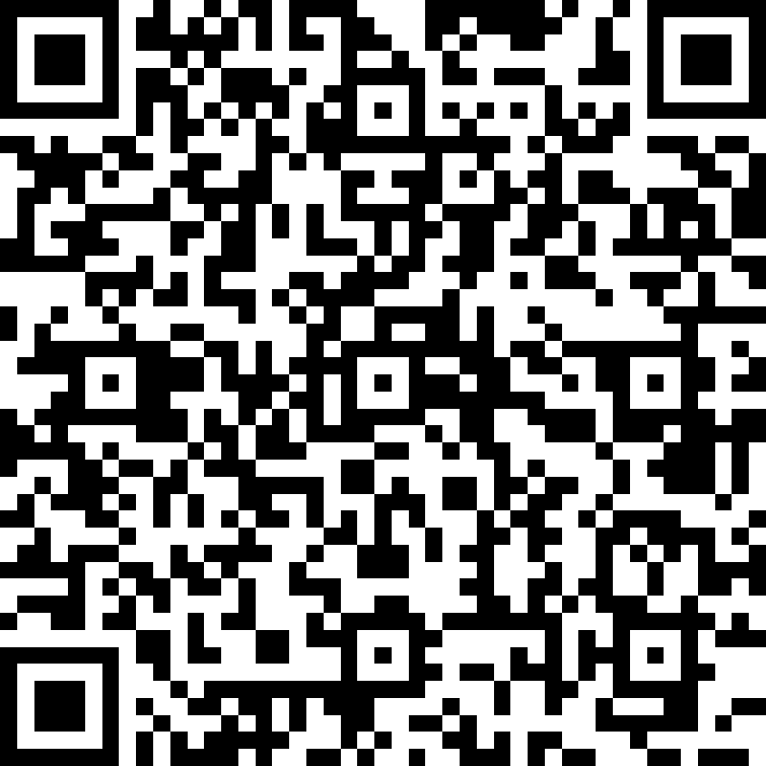
Give us your feedback

Slide 31

Upcoming ERA events
Safety Critical Components Webinar
14.30-16.00 (CEST)
Safety Days 2023
2 June
ETCR Seminar 2023
3-14 July
Bruges, Brussels, Antwerp – Belgium
20-22 September
Tallinn, Estonia
Give us your feedback

Slide 32
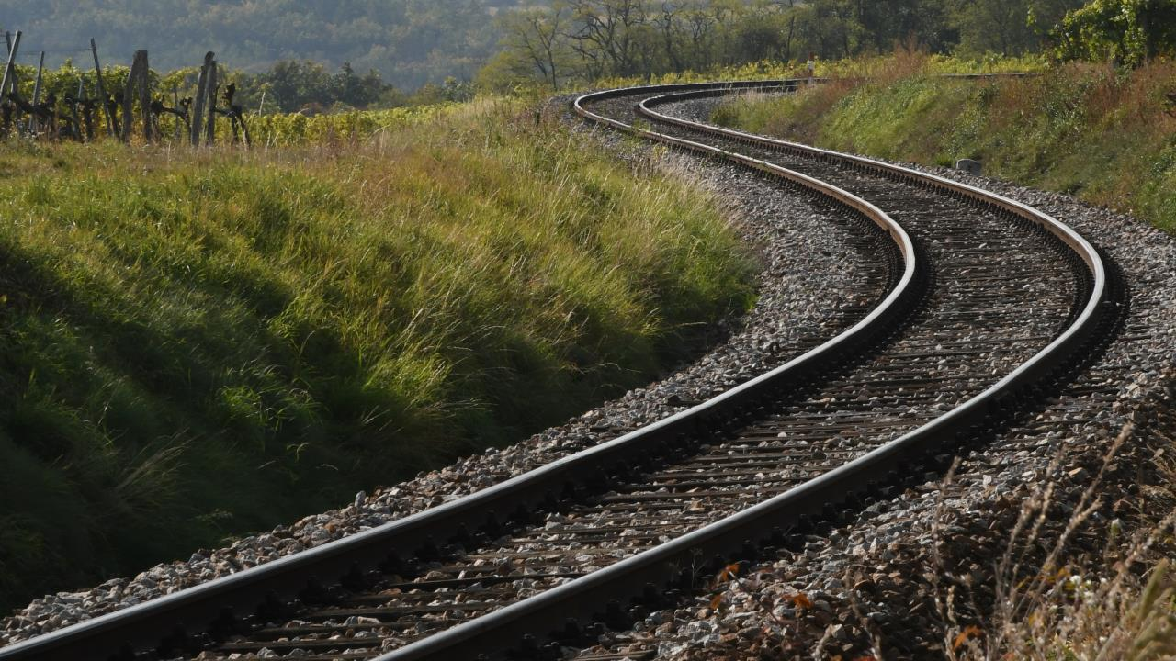
THANK YOU
Moving Europe towards a sustainable and safe railway system without frontiers.
Follow us:
Notes:
TSI (Transition, Combined Tr),
Revision of TEN-T Regulation: real opportunity to make Trans-European Transport Network fit for the future, to align the development of the TEN-T network to the European Green Deal objectives and the climate targets of the EU Climate Law. Cutting greenhouse gas emissions from the transport sector by 90%, compared with 1990 levels, by 2050, is key to achieving climate-neutrality by the same date.
New intermediary deadline of 2040 to advance the completion of major parts of the network ahead of the 2050 deadline that applies to the wider, comprehensive network. Core network will also be extended.
New term: 9 European Transport Corridors (ECTs) - integration of Core Network Corridors (CNCs) and Rail Freight Corridors (RFCs).
CT-related infrastructure parameters specified (CT profiles for all types of loading units) and strengthen the concept of network resilience by introducing mandatory interconnections between corridors as well as bypass options, with the aim of improving the reliability of transport services.
More transhipment terminals
High-speed rail network between the main nodes of Europe. The major TEN-T passenger rail lines should allow trains to travel at 160 km/h or faster by 2040.

