Slide 1
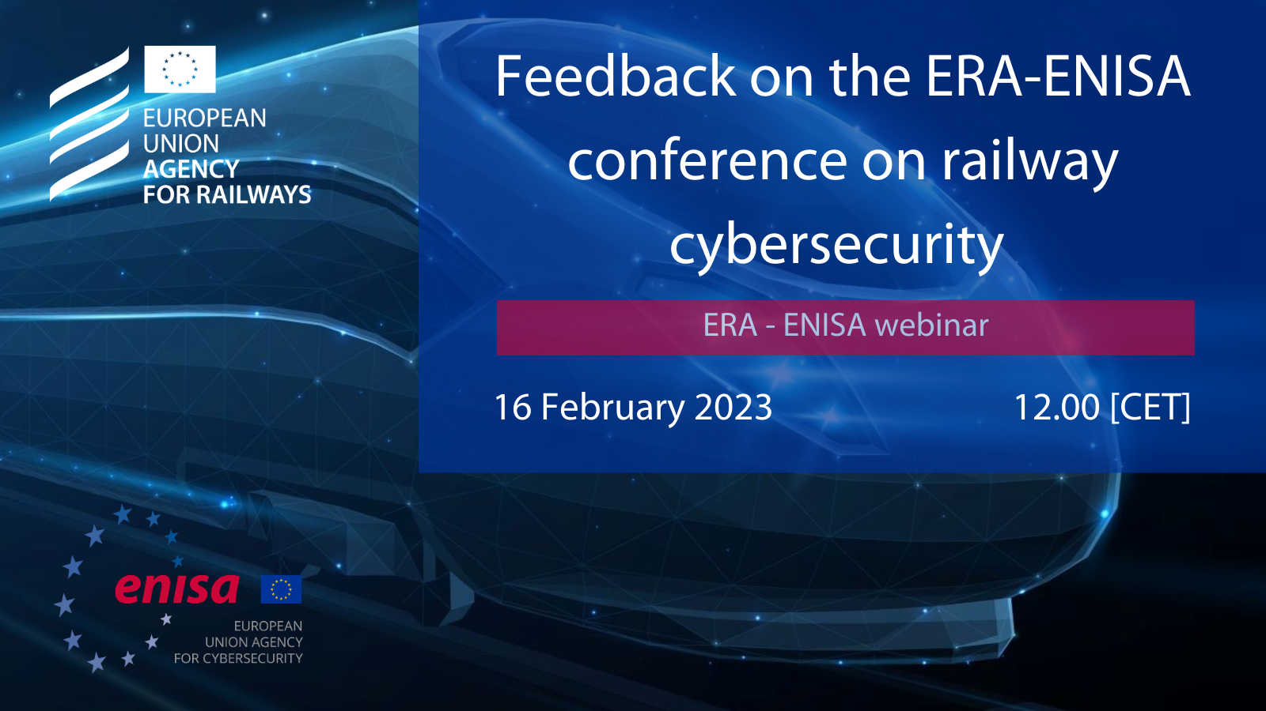
Feedback on the ERA-ENISA Conference on Railway Cybersecurity
16 February 2023
Welcome! Webinar to start soon!

Slide 2


SPEAKERS
Josef Doppelbauer
Thomas Chatelet
Marianthi Theocharidou
Executive Director | ERA
Project Officer | ERA
Cybersecurity Expert | ENISA
Athanasios Drougkas
Cybersecurity Expert | ENISA

Slide 3


Successful ERA-ENISA collaboration

Slide 4
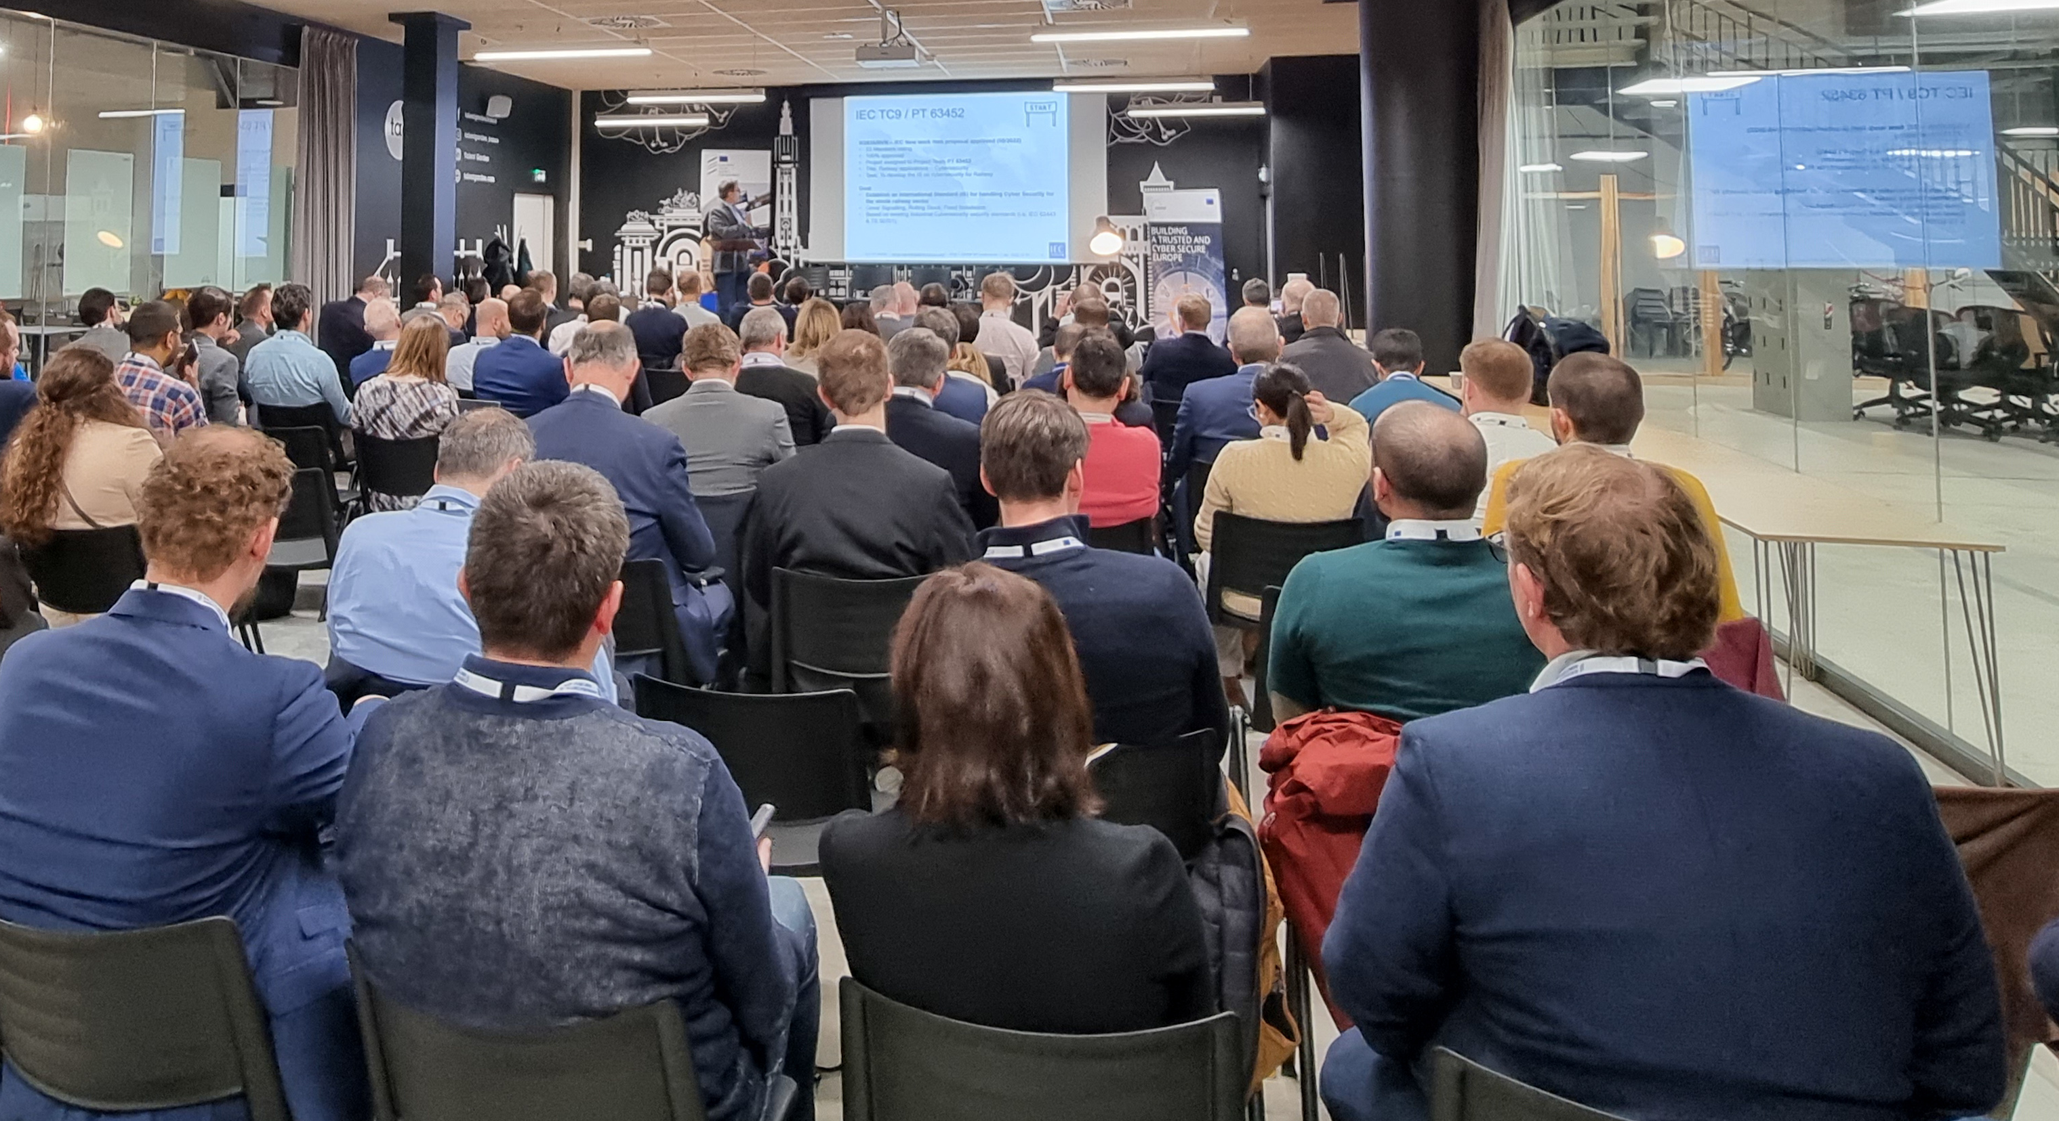
Live conference - Broad audience
More than 100 participants
EU institutions:
EC (MOVE & CNECT), ERA, ENISA, EDA
National Safety Authorities:
FR, DE, FI, BE, IT, CH
Railway stakeholders:
Infrastructure Managers, Railway Undertakings, Industry, Notified/Assessment Bodies, Research
Very high demand
Many requests for attendance could not be answered (conference centre limitation)

Slide 5


Policy update (DG CNECT)
Session 1 - Policy
Cyber Resilience Act
Cybersecurity rules for placing on the market of hardware and software
Based on EU product-related legislative setting
Obligations for manufacturers, distributors and importers
Cybersecurity essential requirements across the life cycle (5 years)
Harmonised standards to follow
Conformity assessment – differentiated by level of risk
Market surveillance and enforcement
NIS 2 Directive: state of play
3 pillars: MS capabilities + Risk management & reporting + Cooperation
More sectors covered, harmonised security requirements & incident reporting
Supply chain security

Slide 6
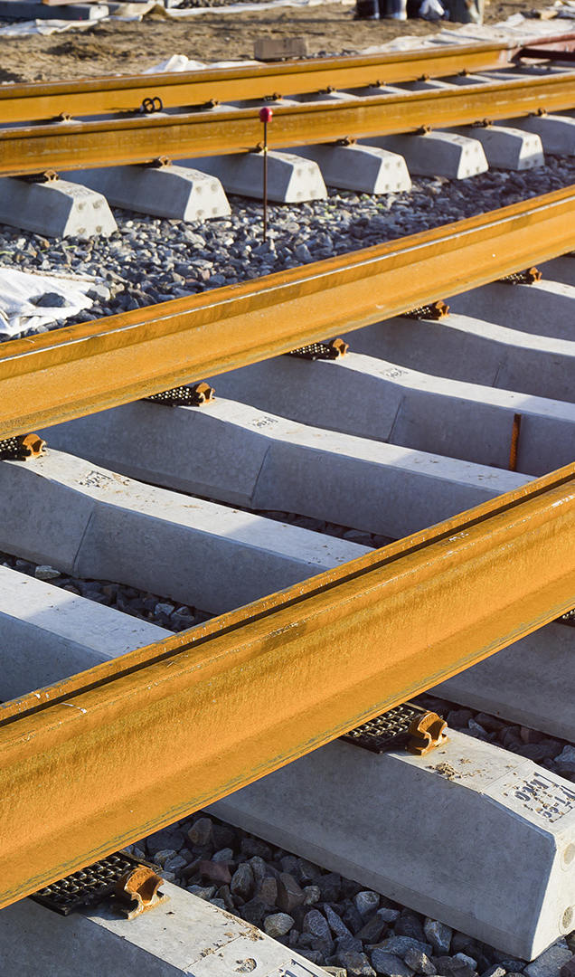





National approaches on Railway cybersecurity
Session 1 - Policy
FR
Main steps of ANSSI/EPSF collaboration
Position paper recommendations
Regulatory questions and challenges
DE
EBA/BSI Comparison of responsibilities
Railway Transport and Critical Infrastructure
Systems where IT Security joins Railway Safety
FI
Traficom: Integrated Agency for Railway Safety and National Cyber Security Centre
Railway cybersecurity by cooperation
Example of Finland’s first railway cybersecurity exercise 2022

Slide 7

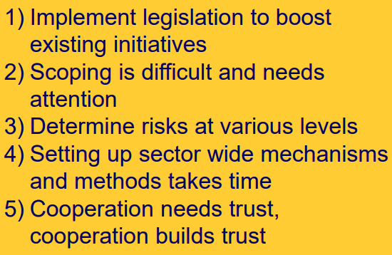
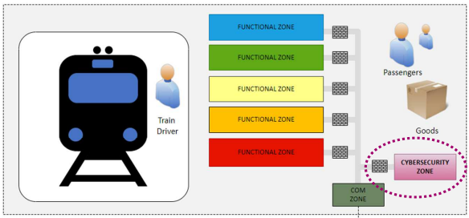
GOOD PRACTISES
Session 2
NS: Becoming an Operator of Essential Services
From threat analysis to risk treatment
Landscape of regulation and co-operation
Lessons learned
SNCF: Experience Sharing on Rolling Stock
Cybersecurity = Safety & Security on IT & OT
Challenges: asset inventory, strategy, Maintain in secure conditions
Penetration tests: internal skills to develop
European Defense Agency: Cross-sector cyber challenges
Varying maturity of cybersecurity within rail supply chain, especially for OT systems
Lack of cybersecurity awareness, security culture and Safety vs. Security
Cooperation with other transport stakeholders essential

Slide 8
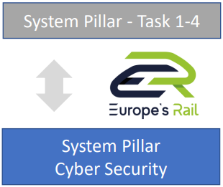


Standards, Research & Innovation, Solutions
Session 3
Update on activities shaping the future railway cybersecurity ecosystem
IEC promotion of CENELEC TS 50701 to international IEC standard
ERJU summary of Shift2Rail findings and insights on System Pillar Cyber Security
UIC Cyber Security Solution Platform review and roadmap
ER JU System Pillar
As-is analysis
Migration concept
Target System Architecture
UIC CSSP
Best Practices chapter
Architecture & project Assessments (FRMCS)
2024: new version of CSSP catalog
PT IEC 63452
Targeted content evolution defined
Committee Draft expected for July 2023
https://projects.shift2rail.org/s2r_ip2_n.aspx?p=X2RAIL-3

Slide 9
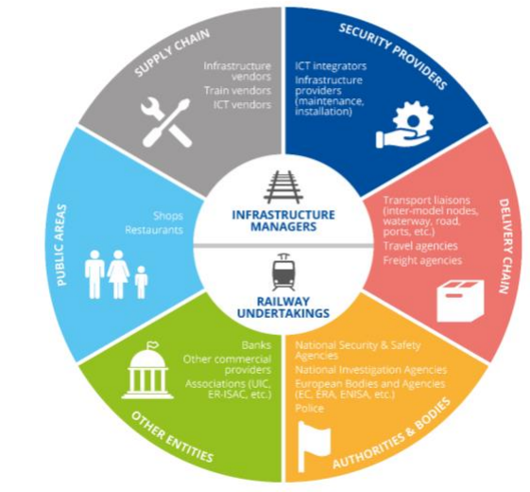
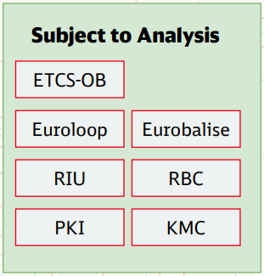



Cybersecurity Challenges for Railway
Session 4
To be considered
Particularities of railway sector
Cyber regulation integrated in the existing European rail regulation
Collaboration is key
Financial impact on the European rail supply industry?
Cyber Risk Management
To be addressed
Relation to existing (railway) legislation
Relation to standardization, including TSIs
Relation to results of European cooperation
Classification of products and components
ERTMS security migration roadmap
Include Guideline to TSI CCS application guide
Transfer guideline requirements into TSI CCS subsets

Slide 10
Summary
Wide scope of discussion – Useful exchange
→ Direct exchange between policy maker, safety manager and railway stakeholder
→ All presentations available:
https://www.era.europa.eu/content/2nd-era-enisa-conference-cybersecurity-railways
Examples of railway cyber collaboration at NSA level for safety aspects (FR, DE, FI)
→ Open discussion on MS approach on Railway Cybersecurity
Session 1
Session 3
Latest developments on standardisation (IEC, ERJU, UIC)
→ Upcoming Standards and specifications for the benefit of railway stakeholders
Stakeholders' perspectives (UNIFE, CER, ERTMS User Group)
→ Challenges in railway cybersecurity: risks, guidelines and adoption
Session 1
NIS2 Directive, Cyber Resilience Act
→ Insights on the applicability of EU policy framework on cybersecurity to railways
Session 2
Good practices from railway users of cybersecurity
→ Return of experience from railway and non-railway on first implementation
Session 4

Slide 11
NIS Investments in the transport sector
Dr. Athanasios Drougkas
  Cybersecurity Expert
  ERA Webinar: Feedback on the ERA-ENISA Conference on Railway Cybersecurity
16
02
2023

Slide 12

2022 NIS Investments Report
251 OES/DSP
5 EU MS
2020
    3rd annual report (>1000 OES/DSP from 27 EU MS) now provides historical datasets
    Sectorial deep dives (Energy & Health) – supported sectorial analyses for NIS CG work streams
    Focus on operational aspects and OES capabilities
    Aligned survey questionnaire to collect data for CRA Impact Assessment
947 OES/DSP
27 EU MS
2021
1080 OES/DSP
27 EU MS
2022

Slide 13
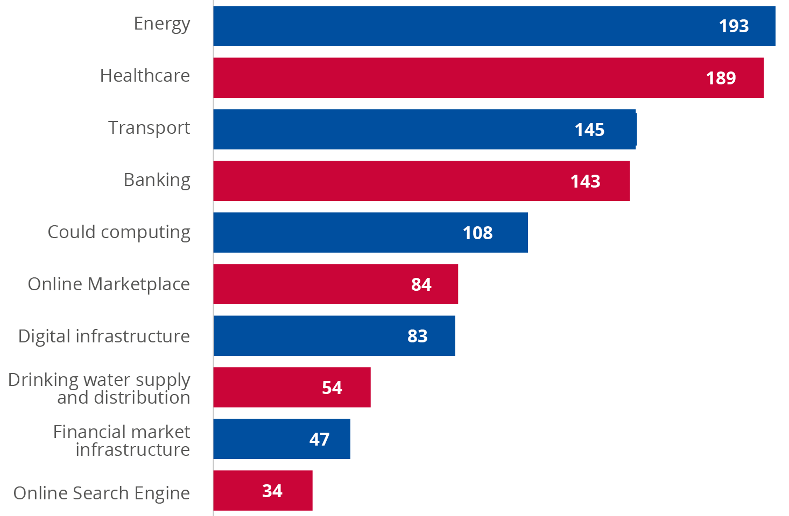
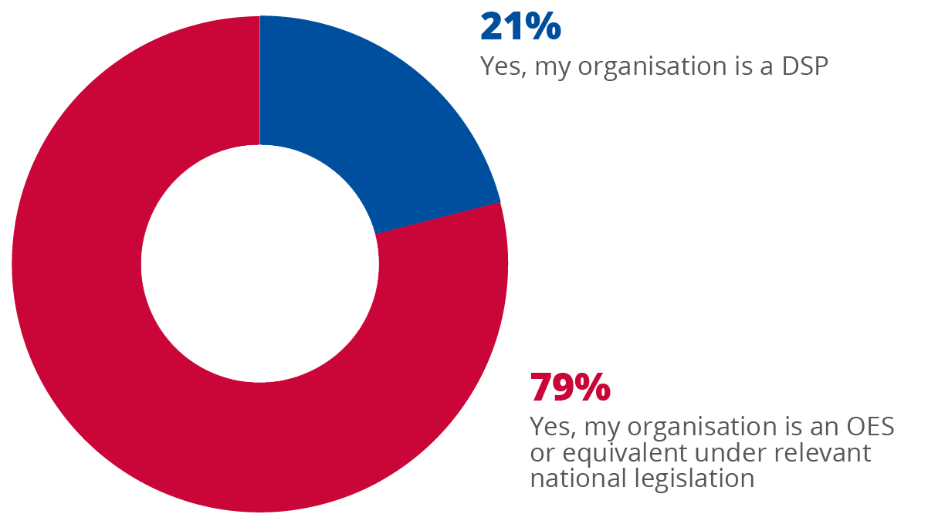
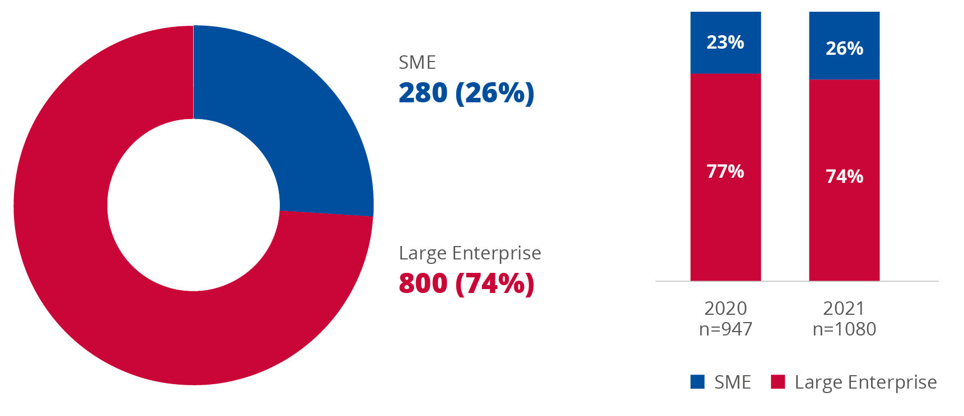
Survey demographics

Slide 14
Key findings
The median percentage of IT budgets spent on IS is 6.7 %, 1 percentage point lower compared to last year's findings.
The NIS Directive and other regulatory obligations, as well as the threat landscape are the main factors influencing IS budgets.
Large operators invest significantly more on CTI compared to smaller ones with the median spend on CTI across OES/DSPs being EUR 50 000. Internal SOC capabilities seem to be very closely correlated with CTI spending -> need to facilitate access to CTI for smaller operators.
The estimated direct cost of a major security incident is EUR 200 000 on median, twice as large as last year. Health / Banking again top the list.
37% of the OESs and DSPs in the EU do not operate a dedicated SOC.
30% of OES/DSPs possessed cyber insurance in 2021, a decrease of 13% compared to 2020, with only 5% of SMEs subscribing to cyber insurance.
86% of OES/DSPs have implemented third-party risks management though only 47% have a dedicated TRM budget and only 24% have a dedicated TRM role.

Slide 15
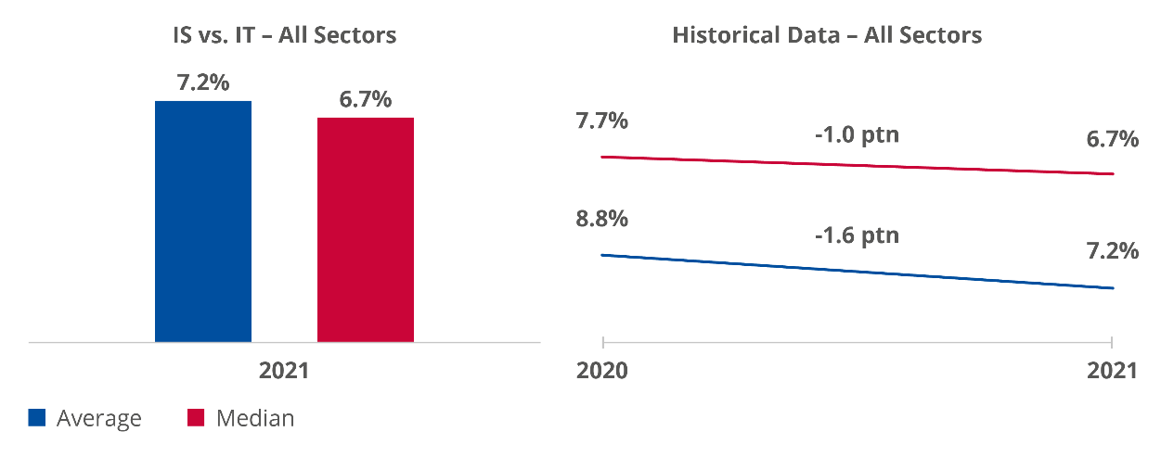
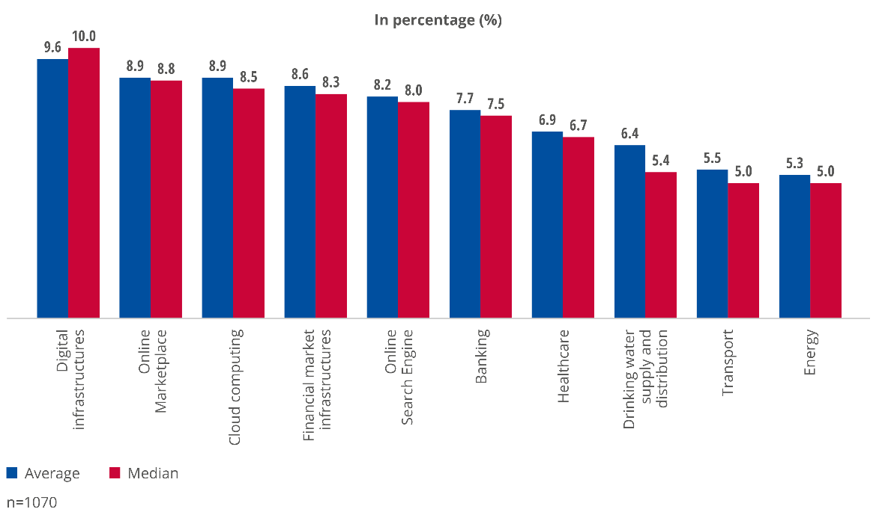
Cybersecurity budgets

Slide 16
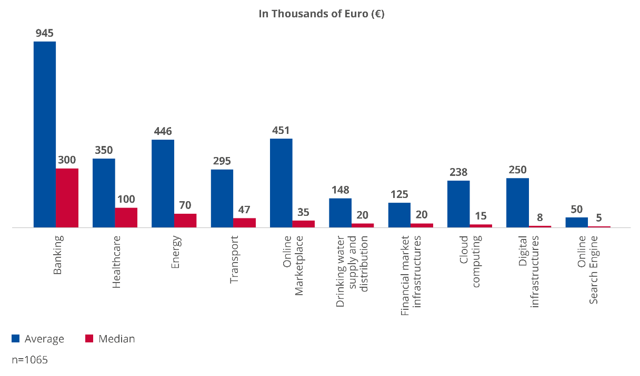
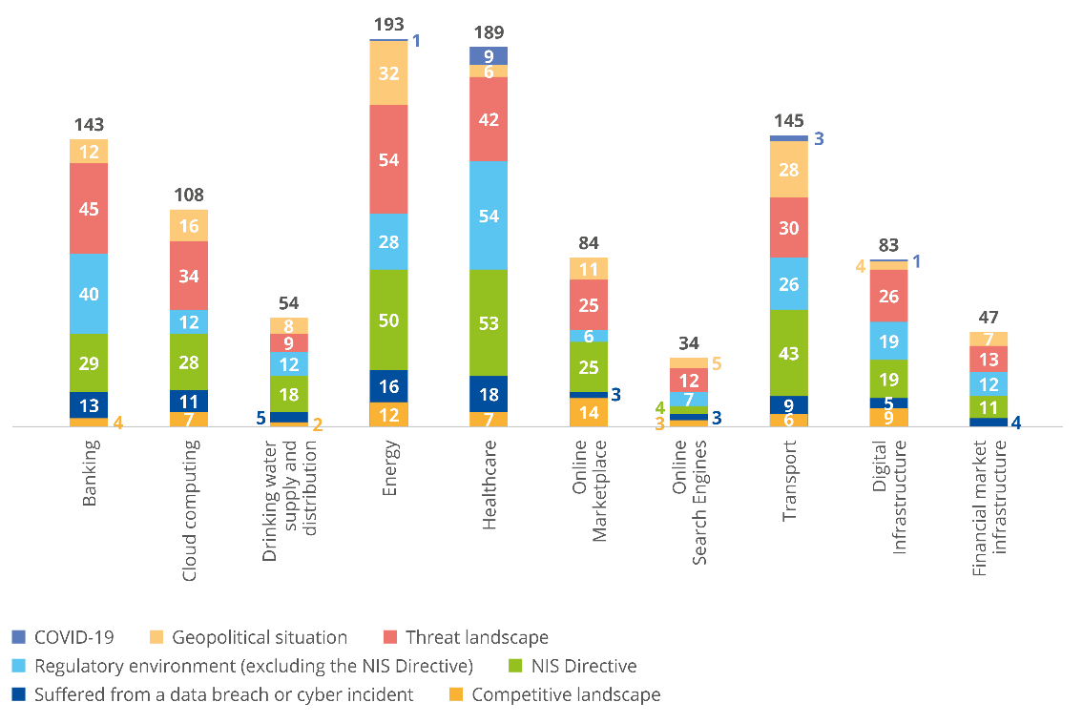
Cybersecurity budgets
CTI Spending
514
80

Slide 17
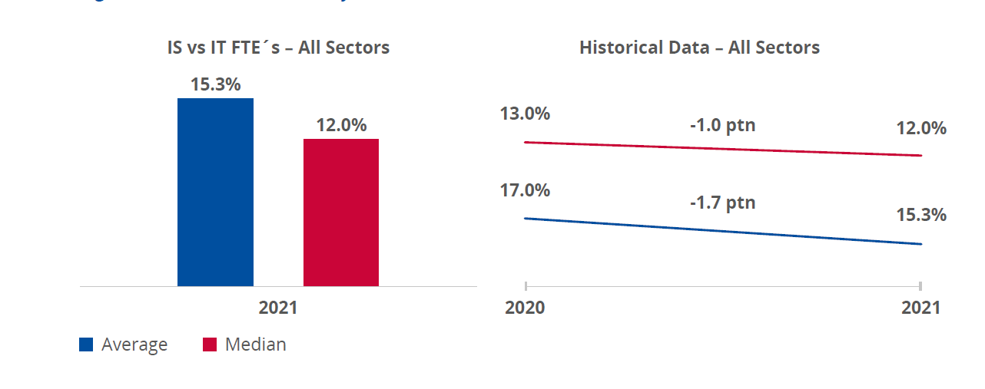
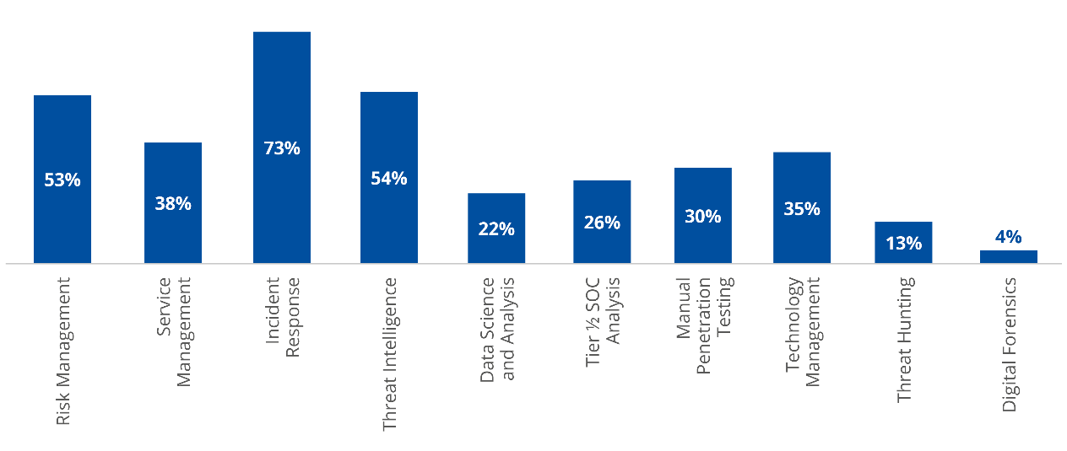
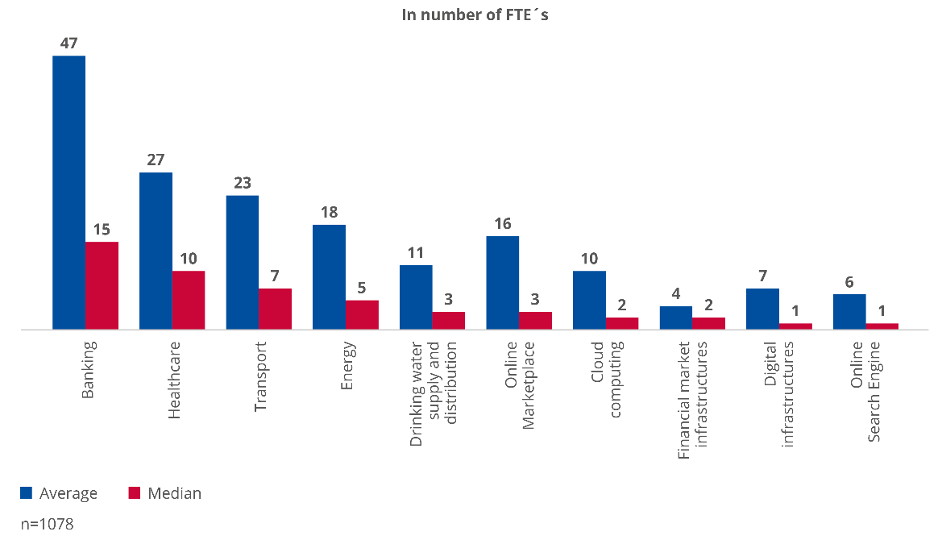
Cybersecurity Resources
Skills prioritized for internal development
IS FTEs per sector

Slide 18
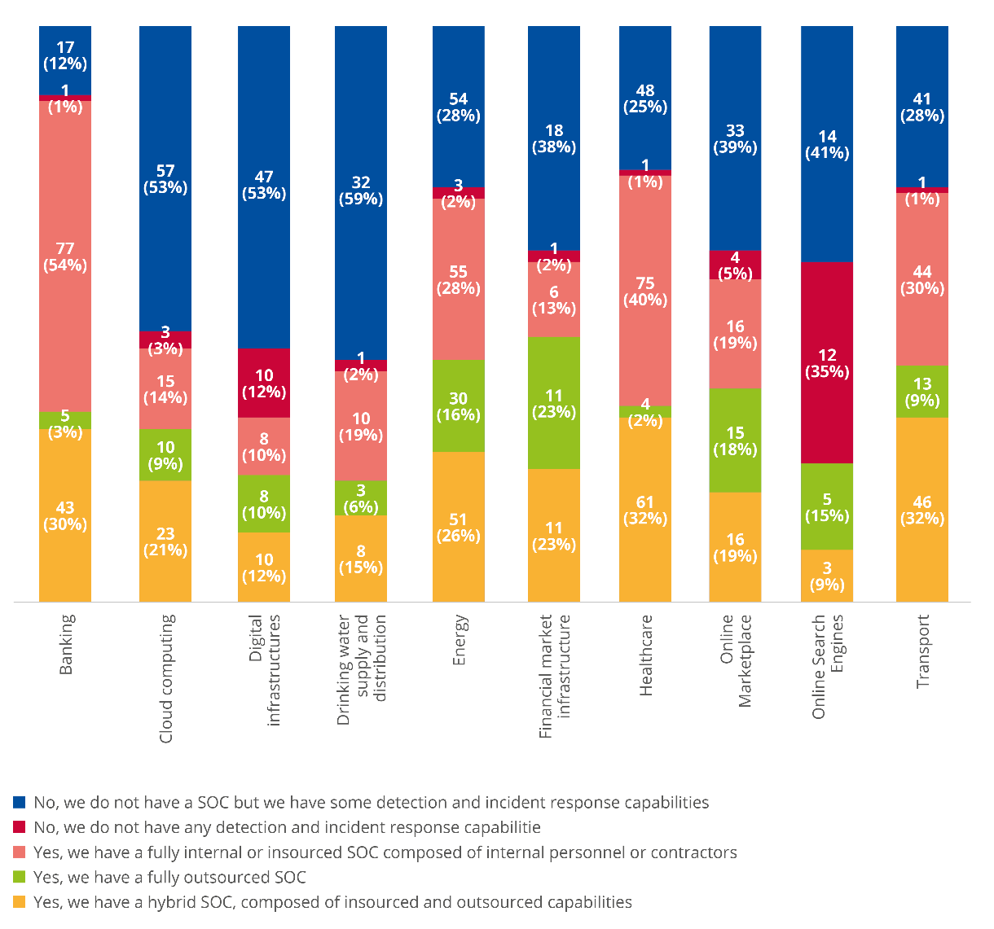
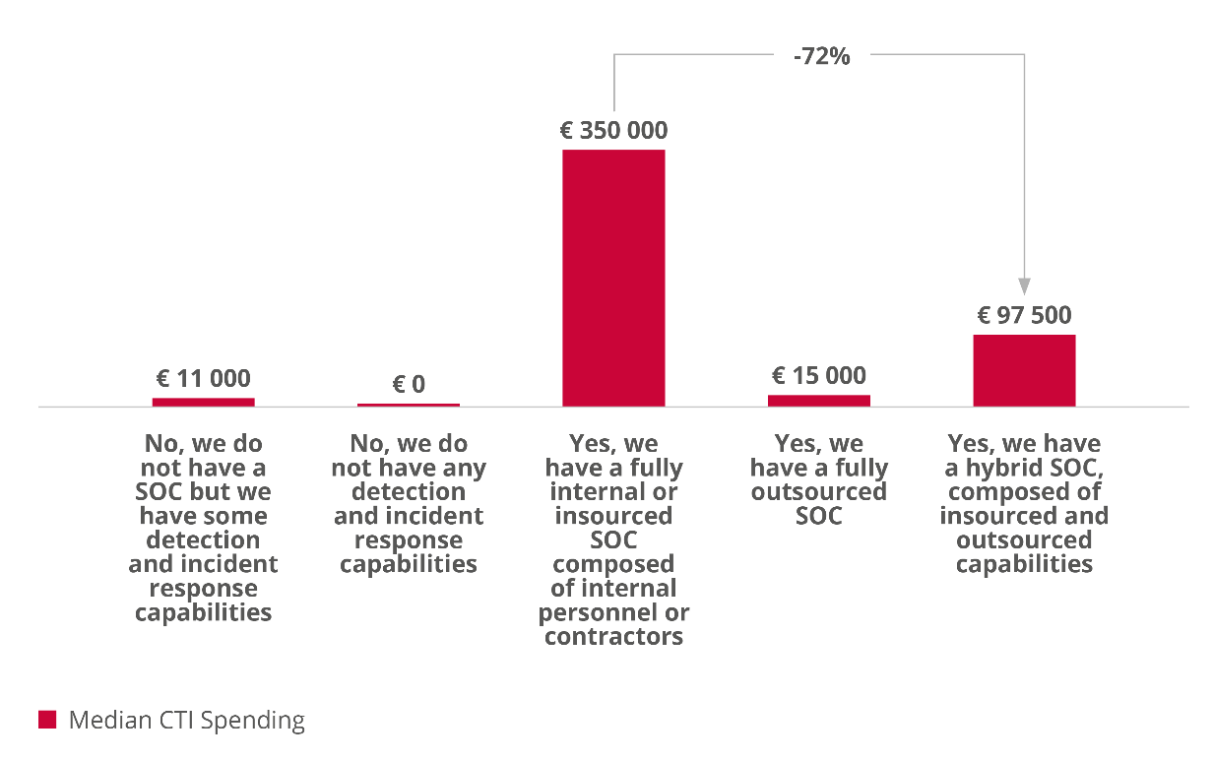
Cybersecurity Capabilities

Slide 19
Third party risk management

Slide 20
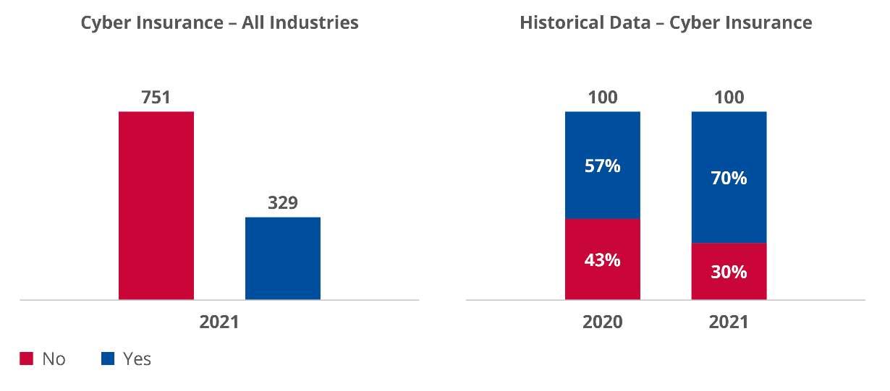
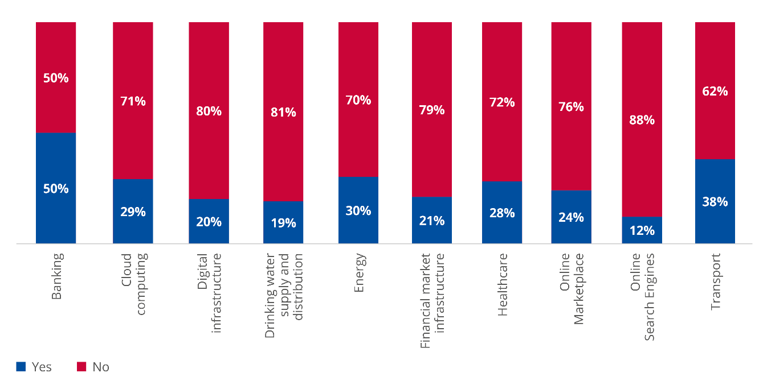
Cyber Insurance
49%
51%
Rail

Slide 21
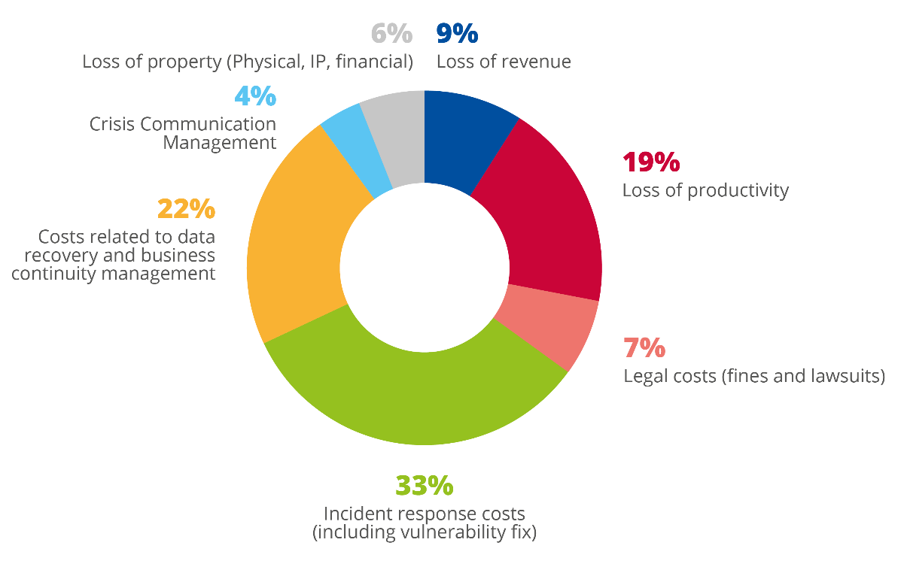
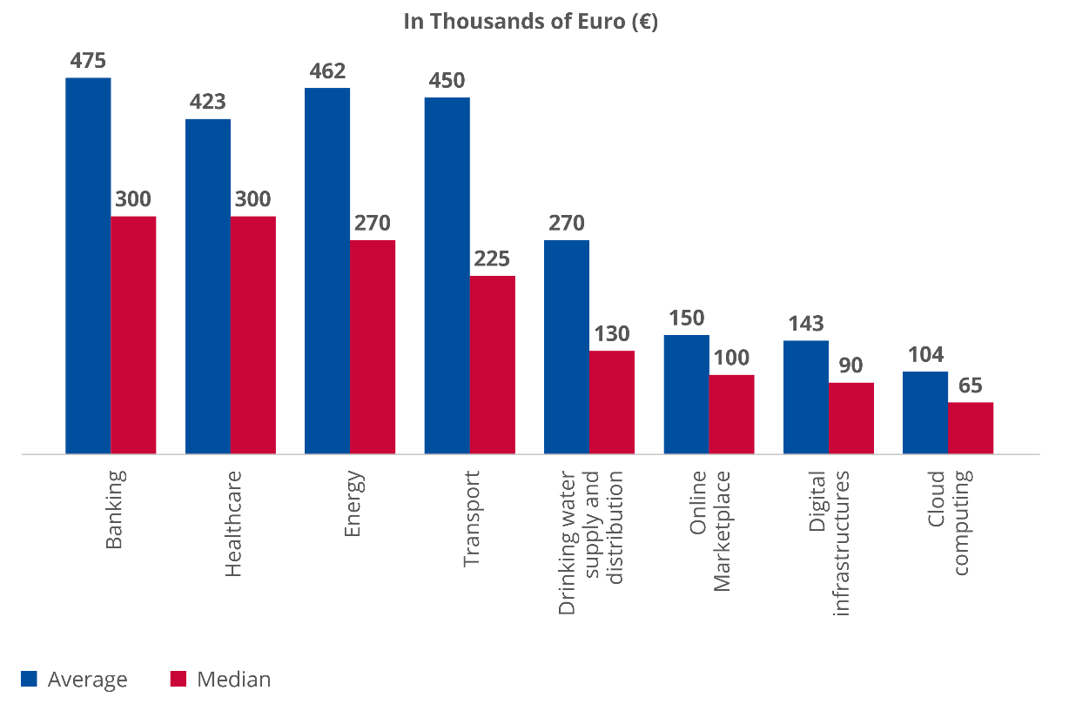
Cost of cybersecurity incidents

Slide 22

GIVE US YOUR FEEDBACK

Slide 23

UPCOMING ERA WEBINARS
March 16
14.30-16.00 (CET)
Maintenance
April 13
12.00-13.00 (CEST)
TSI Revision Package
March 8
12.00-14.00 (CET)
ERA on track towards more diversity
Give us your feedback

Slide 24
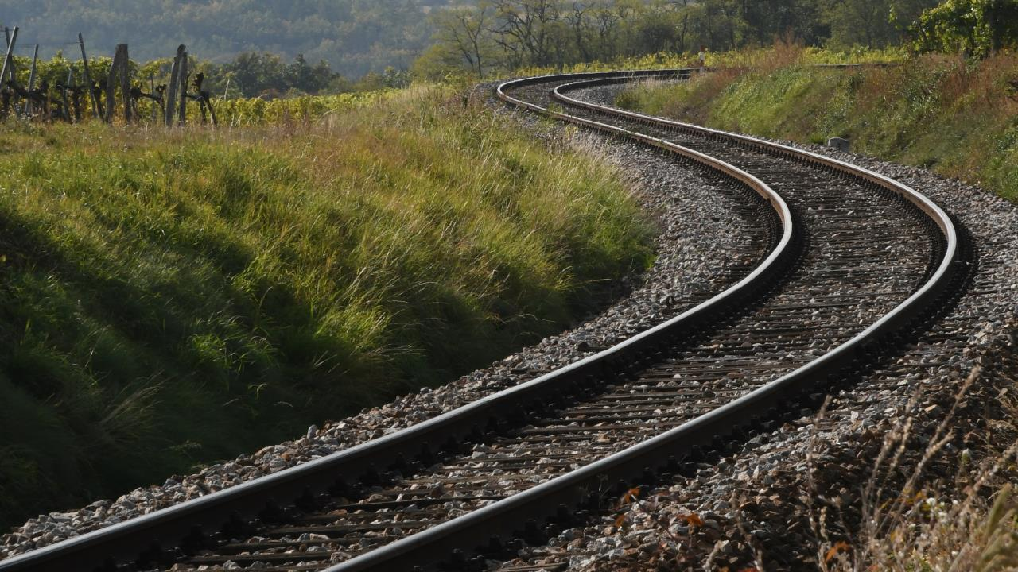
THANK YOU
Moving Europe towards a sustainable and safe railway system without frontiers.
Follow us:
Notes:
TSI (Transition, Combined Tr),
Revision of TEN-T Regulation: real opportunity to make Trans-European Transport Network fit for the future, to align the development of the TEN-T network to the European Green Deal objectives and the climate targets of the EU Climate Law. Cutting greenhouse gas emissions from the transport sector by 90%, compared with 1990 levels, by 2050, is key to achieving climate-neutrality by the same date.
New intermediary deadline of 2040 to advance the completion of major parts of the network ahead of the 2050 deadline that applies to the wider, comprehensive network. Core network will also be extended.
New term: 9 European Transport Corridors (ECTs) - integration of Core Network Corridors (CNCs) and Rail Freight Corridors (RFCs).
CT-related infrastructure parameters specified (CT profiles for all types of loading units) and strengthen the concept of network resilience by introducing mandatory interconnections between corridors as well as bypass options, with the aim of improving the reliability of transport services.
More transhipment terminals
High-speed rail network between the main nodes of Europe. The major TEN-T passenger rail lines should allow trains to travel at 160 km/h or faster by 2040.

