Slide 1
Conference - Integration of Human and Organisational Factors: Managing Workload and Fatigue
6-7 December 2022

Slide 2

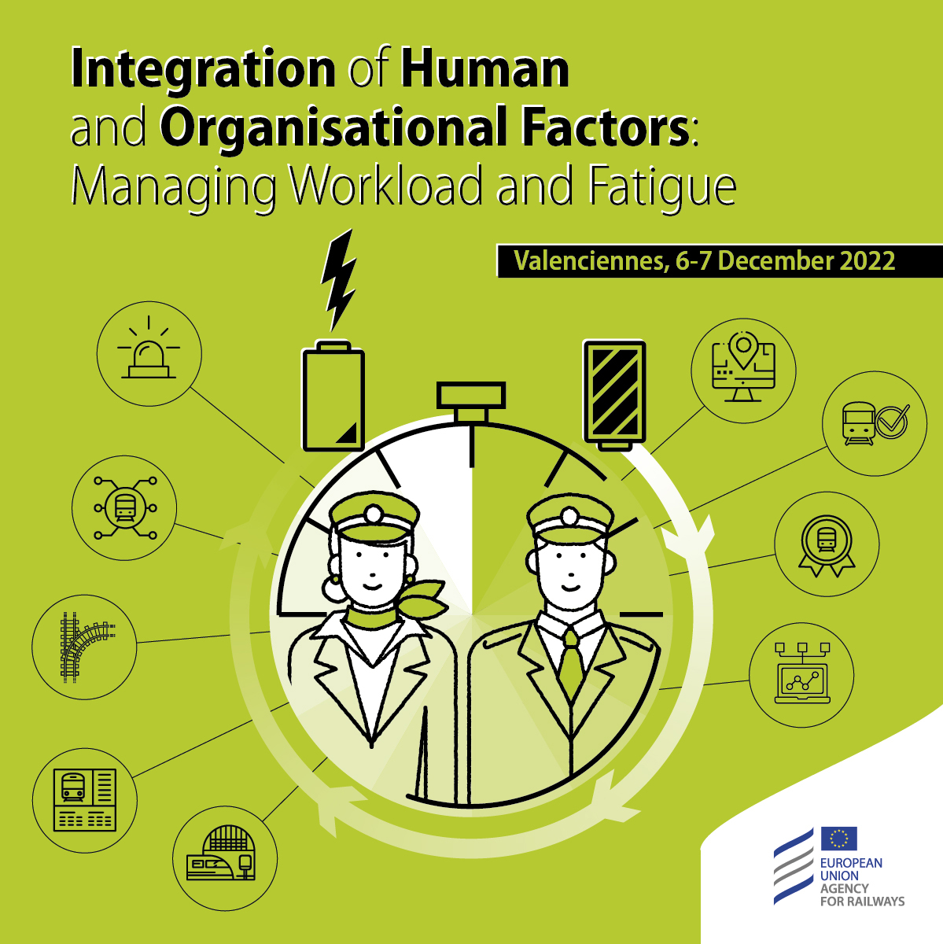






Speakers – 7 December 2022
Cyriel Martin
Communication Officer
Ole Kroczek
Vanessa García Lozano
Deputy Head of Unit of Railway Safety Coordination
Clarisse Lagaize-Davoine
Project Officer
Safety Manager
Geoffrey Tresontani
ECM Manager
Mark Young
Inspector

Slide 3
Conference - Integration of Human and Organisational Factors: Managing Workload and Fatigue
Session 6 - How can workload and fatigue be regulated?

Slide 4
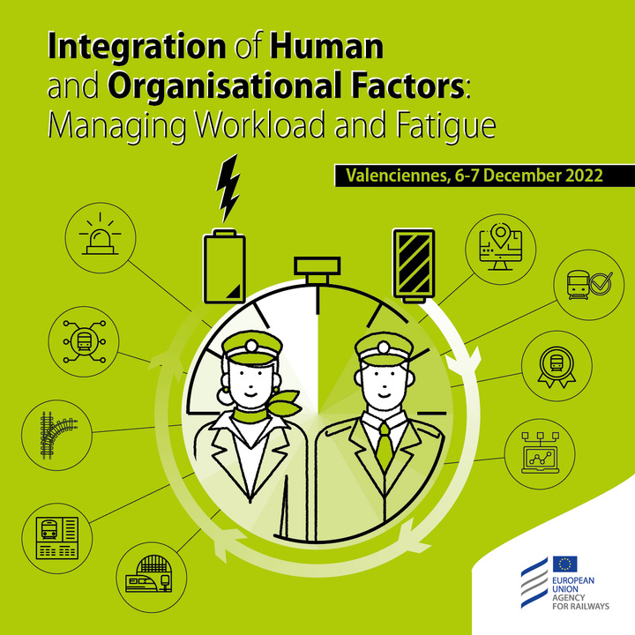
AGENDA | 7 DECEMBER | 11.20- 14.00
Time | Description |  | Speaker
Session 6 | How can workload and fatigue be regulated? | Session 6 | How can workload and fatigue be regulated? |  | Session 6 | How can workload and fatigue be regulated?
11.20 - 12.00 | How are workload and fatigue integrated in accident investigation? | Mark Young | RAIB (UK Rail Accident Investigation Branch) | Mark Young | RAIB (UK Rail Accident Investigation Branch)
12.00 - 12.40 | Supervision of HOF by AESF (Spanish National Safety Authority) | Vanessa García Lozano | AESF | Vanessa GarcíaLozano | AESF
12.40 - 13.20 | Panel Discussion | Speakers from sessions 4 to 6 | Speakers from sessions 4 to 6
13.20 - 13.30 | Close of the conference
13.30 - 14.00 | Light lunch

Slide 5
Speakers – 7 December 2022
Cyriel Martin
Communication Officer
Ole Kroczek
Vanessa García Lozano
Deputy Head of Unit of Railway Safety Coordination
Clarisse Lagaize-Davoine
Project Officer
Safety Manager
Geoffrey Tresontani
ECM Manager
Mark Young
Inspector

Slide 6
Integrating workload and fatigue in accident investigation
Mark Young, Inspector, RAIB
ERA HOF conference, Valenciennes
7 December 2022

Slide 7
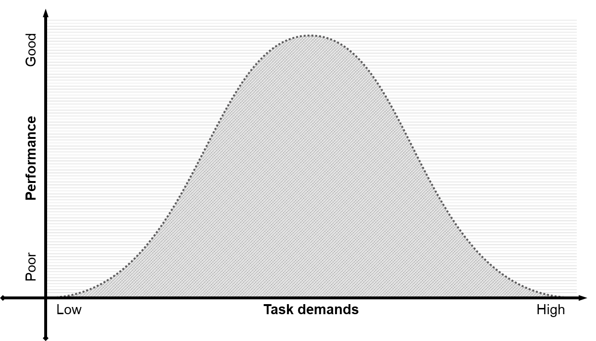
Overload, underload…
Notes:
Plant a seed that overload and underload are two sides of the same coin…

Slide 8
Near miss at Ufton level crossing, 4 September 2011
Notes:
A lot of workload concerns tend to be about overload, and one demonstration of this is in signalling

Slide 9
Workload assessment
Measurement
  Task analyses (eg timeline)
    Activity analysis
  Primary task
  Secondary task
  Subjective ratings
    Integrated Workload Scale (IWS)
  Physiological
No quantitative ‘red line’ for overload or underload
Notes:
But how do we assess that in an investigation – secondary task and physiological are kind of ruled out, so we have some task analysis and subjective techniques

Slide 10
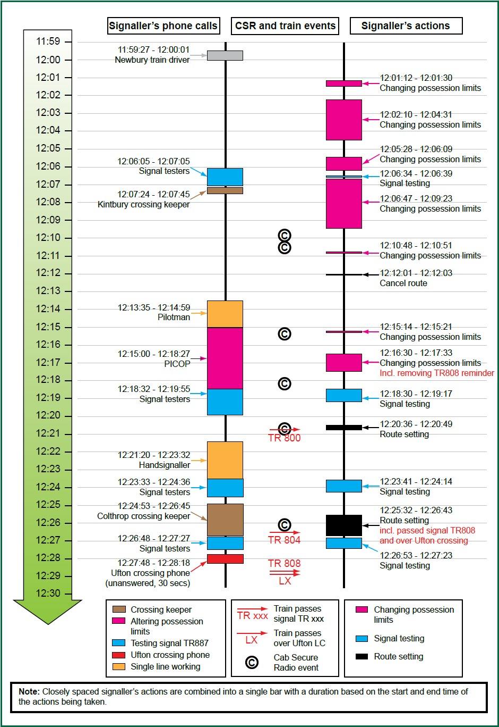
Notes:
Signaller overload was identified as an issue when a train was signalled past a level crossing in Ufton with the barriers raised and the red road traffic signals not flashing (RAIB report 28/2012). An almost continuous stream of tasks in the run-up to the incident, leaving the signaller little spare capacity to review the situation, was probably a factor in his mistakenly setting the route over the crossing.
Near miss incident at Ufton Automatic Half Barrier Crossing, Berkshire, 4 September 2011
Train passed over crossing at 61 mph with barriers raised
Signaller removed reminder on protecting signal along with others associated with the end of possession – but crossing still on local control
Barrier status not displayed adjacent to reminder control
Signaller overload identified as an issue…

Slide 11
Near miss at Dock Lane level crossing, 14 June 2016
Notes:
13:25 hrs, car given permission to cross UWC when a train coming.
Signaller gave automatic response – familiar nature of call / mental fatigue
High number of crossing calls at Saxmundham (~14 per hour)
Mental demands of maintaining awareness of trains in long track sections

Slide 12
Workload assessment – Integrated Workload Scale
Source: Pickup et al. (2005)
Notes:
Use 1-9 numbering for scoring

Slide 13
Workload assessment – Activity Analysis
See Lowe & Pickup (2008)
Time | Snapshot Activities |  |  |  |  |  |  |  |  | No. of Activities | IWS rating | No. trains on panel
17:00 | pap | pap | tel-in | tel-in | route | panel | panel | face | face | 9 | 4 | 2
17:05 | tel-in | tel-in | lx | lx | other |  |  |  |  | 5 | 0 | 3
17:10 | pap | pap | tel-in | tel-in |  |  |  |  |  | 4 | 6 | 3
17:15 | pap | tel-in | tel-in | route | route | panel | other |  |  | 7 | 5 | 3
17:20 | pap | pap | pap | tel-in | tel-in | tel-in |  |  |  | 6 | 5 | 4
17:25 | pap | pap | pap | tel-in | tel-in | tel-in | route | route | panelx2 | 10 | 5 | 4
17:30 | pap | pap | tel-in | tel-in | tel-in | route | panel | panel |  | 8 | 0 | 3
17:35 | pap | pap | tel-in | route | panel |  |  |  |  | 5 | 6 | 2
17:40 | pap | pap | tel-in |  |  |  |  |  |  | 3 | 5 | 2
17:45 | pap | pap | tel-in | tel-in |  |  |  |  |  | 4 | 4 | 2
17:50 | papx4 | tel-inx4 | routex2 | panelx2 | LXx2 |  |  |  |  | 14 | 6 | 2
17:55 | route | panel | panel | lx | lx | face |  |  |  | 6 | 4 | 2

Slide 14
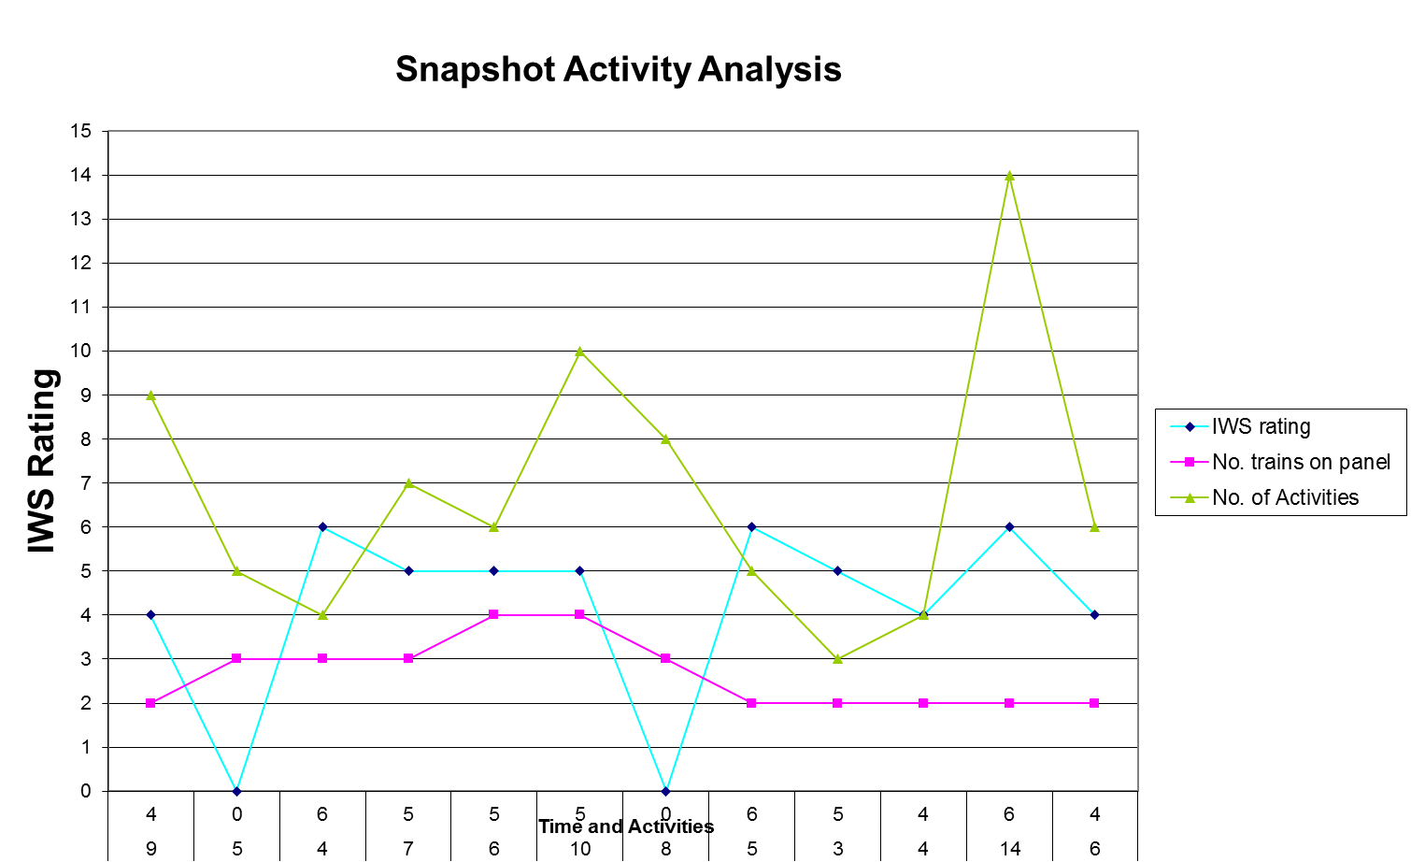
Workload assessment – Activity Analysis
Notes:
Observations helped us understand the nature of the workload – a lot of information being held ‘in the mind’
It became clear that, rather than being an underload issue, this signaller was facing high workload, which led to them becoming mentally fatigued
So there is an interaction between workload and fatigue

Slide 15
Uncontrolled freight train run-back, Shap,
17 August 2010
Notes:
Uncontrolled freight train run-back between Shap and Tebay, Cumbria, 17 August 2010
At 02:04 hrs, train slowed to a stop near Shap summit and ran back for 2.2 miles, reaching a max speed of 51 mph, until driver braked to a stand at 02:09 hrs
Driver was running on single yellows up the hill; cancelled three vigilance warnings and three AWS warnings for (wrong direction) signals while rolling back
Had the driver not braked when he did, the rear of the train would have travelled over a turnout into Tebay sidings at speed, probably derailing and obstructing the adjacent line
Driver on first night shift after five day turns and a rest day
DB Schenker used the HSE’s fatigue and risk index, which implied the driver should be fit to work, but this model under-predicted probability of fatigue on first night shift
Recommendations about fatigue management and mathematical modelling

Slide 16
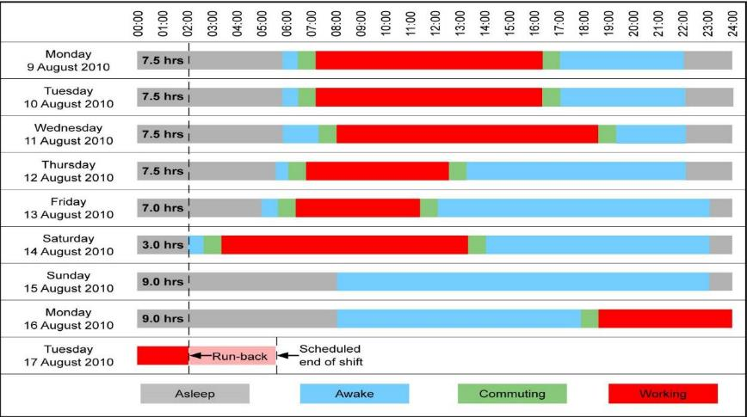
Shap, 17 August 2010
Notes:
Fatigue is as much about sleep as it is about rosters…
He had been awake for 18 hours – could not sleep in the day before first night shift
After about 17 hours awake, performance deteriorates to a similar level to that associated with drink-driving (0.05 BAC)
Progressively earlier start times over last few days probably led to sleep loss

Slide 17
Shap, 17 August 2010
Notes:
Given his previous week’s pattern, he was pretty much at his lowest ebb when the incident occurred
Rec 1: DBS to reduce number of shifts that cause fatigue
Rec 2: ORR should provide guidance on shifts that cause fatigue
Rec 3: ORR to provide information to industry on accuracy of fatigue models

Slide 18
Overturning of a tram at Sandilands junction,
9 November 2016
Notes:
06:07 hrs, 9 November 2016: tram 2551 derailed and overturned on a curve as it approached Sandilands Junction in Croydon
At the time of the accident it was dark and raining heavily
The tram was travelling at approximately 73 km/h (46 mph) as it entered the curve, which had a maximum permitted speed of 20 km/h (13 mph)
Seven people lost their lives in the accident, 19 were seriously injured and 43 had minor injuries

Slide 19
Analysis – workload
The driver lost awareness of the driving task during a period of relatively low workload
This section of the tram network presents the longest duration of continuous driving with minimal active control by the driver, and is one of the lowest workload sections
  49 s from accelerating after the previous tram stop to the braking point
It is probable that underload led to the driver losing awareness of the driving task on the day of the accident
Notes:
Subjective / observational rideout on the network with rudimentary task analysis
Subjective workload ratings of segments of the network from tram operators

Slide 20
Analysis – fatigue
Underload can affect performance on its own, or it can trigger a microsleep in the absence of fatigue, or it can interact with fatigue to exacerbate the effects on performance
There is no evidence that the driver’s shift pattern carried an exceptional risk of fatigue
The driver reported that he went to bed between 21:30 and 22:00 hrs on the night before the accident, slept well, and was awoken by his mobile phone’s alarm around 03:30 hrs

Slide 21
Analysis – fatigue
A technical examination of the driver’s mobile phone showed that a document was manually downloaded at about 23:00 hrs on the night before the accident
It is therefore possible that the driver had less than his reported normal 5.5-6 hrs sleep
This amount of sleep is less than the 7-8 hrs that most people need each night
Notes:
It is not known whether the driver remained awake until 23:00 hrs or woke in the night and checked his mobile phone
Whilst it is possible that the driver needed less than the average amount of sleep, it is also possible that his sleep pattern resulted in him incurring a sleep debt
Other indications of a sleep debt were that he occasionally slept in the afternoon, and on rest days would naturally sleep longer
Consistently sleeping less can build up a sleep debt
Sleep debt cannot just be paid back with extra sleep – need minimum two full nights’ sleep in a row

Slide 22
Analysis – fatigue
Low workload and a lack of associated stimulation can increase the likelihood of a fatigued person microsleeping
It is therefore possible that a microsleep was a factor in the driver’s loss of awareness on the morning of the accident
It is less likely that a microsleep would have happened in a situation where the driver had a relatively high workload

Slide 23
Concluding thoughts – underload again…
Notes:
Difficulty in identifying redlines for workload – can only say that people were ‘probably’ over/underloaded or that demand was ‘high’ or ‘low’
Future of railways – automation – more likely to see underload cases (though task-related underload – as at Sandilands – remains relevant)

Slide 24
Integrating workload and fatigue in accident investigation
Mark Young, Inspector, RAIB
ERA HOF conference, Valenciennes
7 December 2022

Slide 25
Conference - Integration of Human and Organisational Factors: Managing Workload and Fatigue
Session 6 - How can workload and fatigue be regulated?

Slide 26
Speakers – 7 December 2022
Cyriel Martin
Communication Officer
Ole Kroczek
Vanessa García Lozano
Deputy Head of Unit of Railway Safety Coordination
Clarisse Lagaize-Davoine
Project Officer
Safety Manager
Geoffrey Tresontani
ECM Manager
Mark Young
Inspector

Slide 27
Monitoring HOF by AESF
Vanessa Mª García Lozano
07/12/2022

Slide 28



WHY MONITORING HOF?
      Commission Delegated Regulation(EU) 2018/762 of 8 March 2018 establishing common safety methods on SMS requirements
INFORMATION KNOWN OR PROVIDED
OCURRENCES

Slide 29
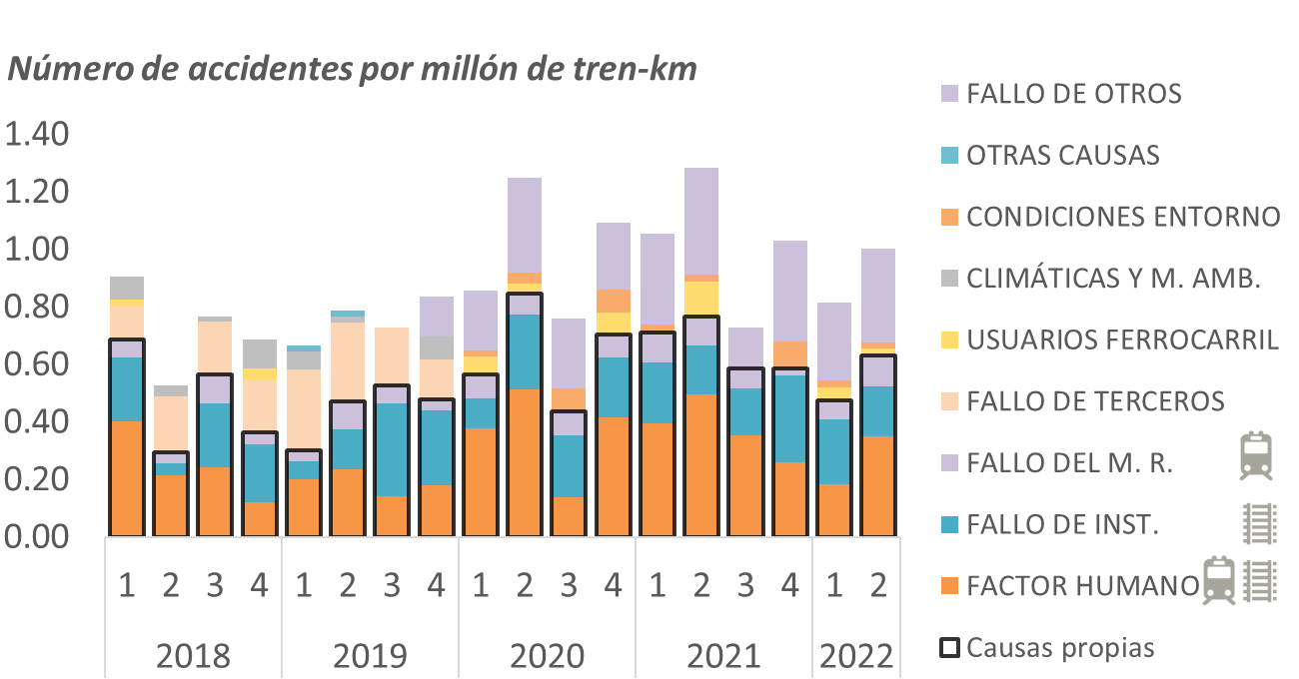
IMPORTANCE OF HOF MONITORING
Accidents by cause in national network in Spain-> mainly human factors and installation failures caused.

Slide 30
IMPORTANCE OF HOF MONITORING
HUMAN FACTOR: In the last two years there are wide variations between consecutive periods.
Notes:
Otros. Los errores o transgresiones no incluidas en las causas restantes, así como los calces de mano mal dispuestos.
Señales. Cualquier error o transgresión relacionada con el Libro Segundo de Señales y el Libro Quinto de Sistemas Auxiliares de detección e Instalaciones de Seguridad del RCF, salvo las que se refieren a la incorrecta realización de Itinerarios.
Conducción. Cualquier error o transgresión reglamentaria en la conducción no incluida en los apartados anteriores.
Arranques o paradas bruscas, exceso de velocidad máxima, accionamiento insuficiente del freno de servicio, etc.
Operaciones de circulación en maniobras. Los errores o transgresiones relacionados con la realización de esta actividad no incluidos en los apartados de Señales, Itinerario y Conducción, tales como la dirección y ejecución de la maniobra, comunicación, prescripciones e inmovilización del material.
Prescripciones de circulación. Cualquier error o transgresión en la coordinación y gestión de la circulación o en las órdenes e informaciones transmitidas al maquinista.
Itinerario. Cualquier error o transgresión relacionada con la realización de los Itinerarios de los trenes y el resto de las Normas Reglamentarias incluidas en el Libro Tercero de Circulación del RCF.
Trabajos en vía o Instalaciones de seguridad. Cualquier error o transgresión relacionada con la realización de estas actividades y la aplicación de la normativa vigente de aplicación.

Slide 31
Index
AESF’s plan and supervision techniques integrating HOF
Examples of HOF supervisión in AESF
A
B

Slide 32
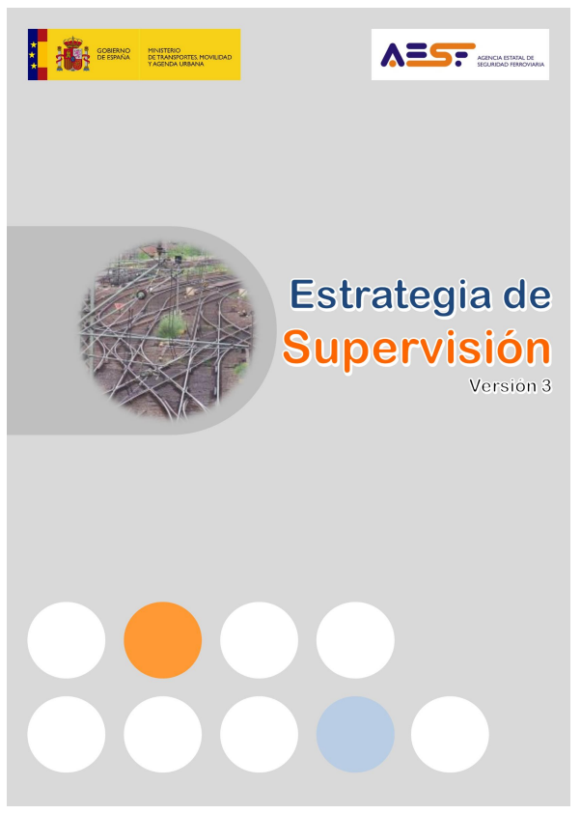
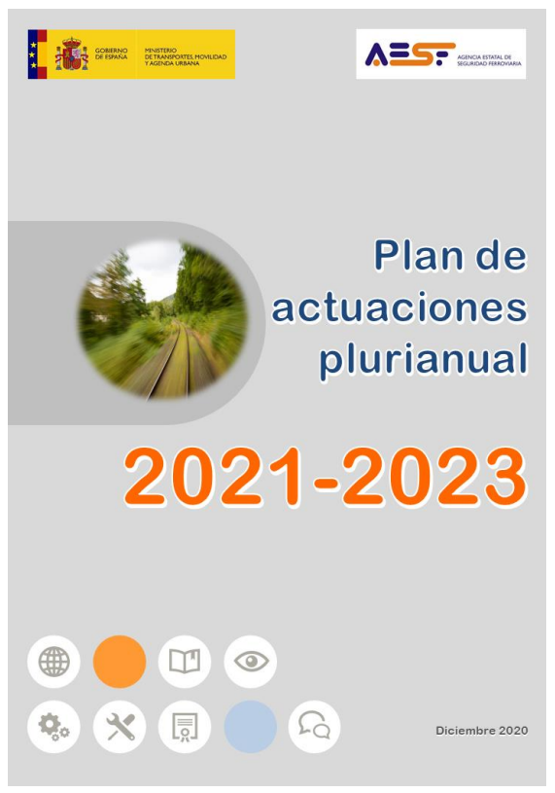
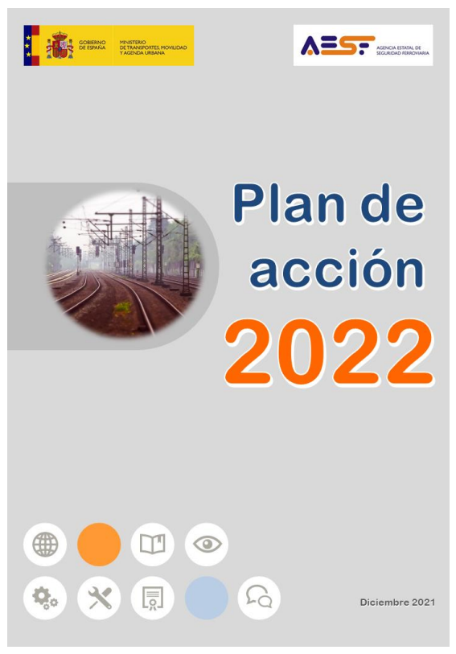
AESF’s plan and supervision techniques integrating HOF
AESF framework for planning
Techniques
  Audits
  Inspections
Types
  Yearly Planned
  Unplanned

Slide 33

AUDITS: characteristics
AESF’s plan and supervision techniques integrating HOF
  Especific or planned.
  Generally based documented and interviews
  Directly addressed to selected staff
  General, based on SMS requirements

Slide 34
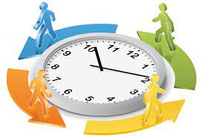




AUDITS: areas and topics for HOF control
AESF’s plan and supervision techniques integrating HOF
  Working shifts. Driving times.
  Soft skills training
  Human factor experts
  Risk management
  Leadership audit

Slide 35
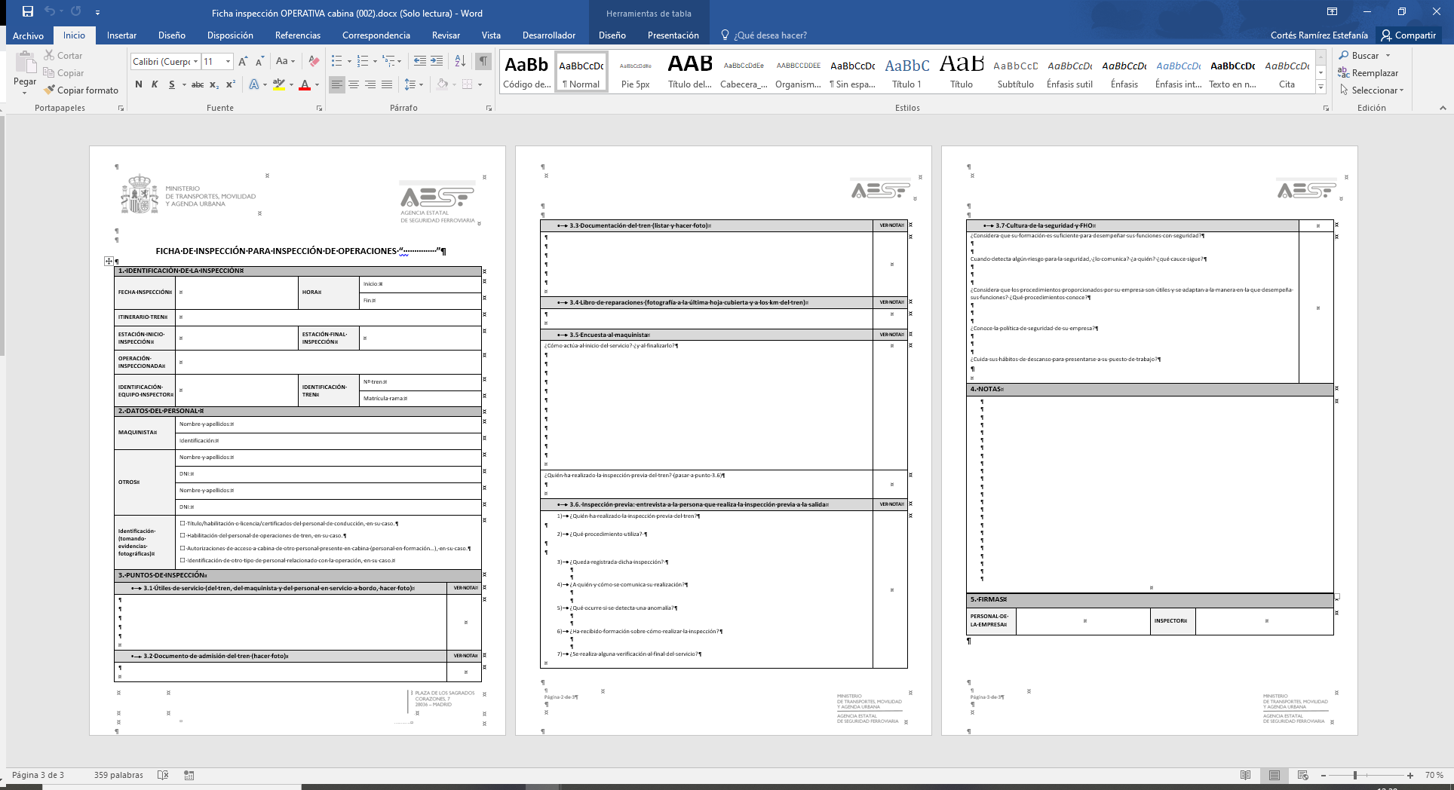
AESF’s plan and supervision techniques integrating HOF
OPERATIONAL INSPECTIONS: characteristics
  On the ground
  With train drivers and/or other railway staff
  Provision of tools for the service. SMS procedures.
  Simple questions designed to assess the integration of the SAFETY culture and the human factor by operational staff.

Slide 36

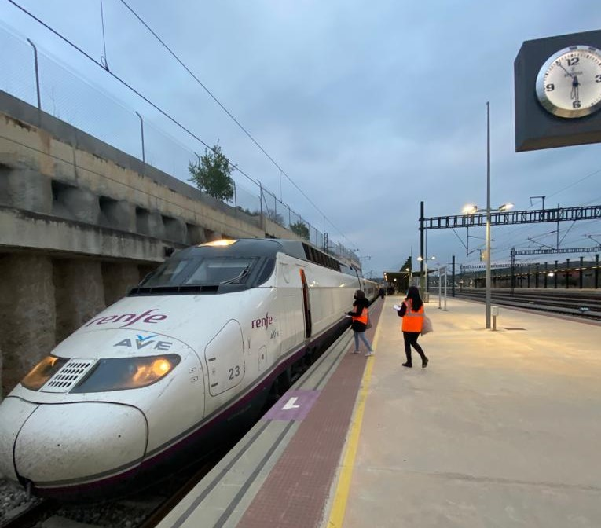
AESF’s plan and supervision techniques integrating HOF
OPERATIONAL INSPECTIONS: example of questions
  Do you consider that your training is sufficient to perform your duties safely?
  When you detect a safety risk, do you report it? to whom? what channels do you follow?
  Do you consider that the procedures provided by your company are useful and adapted to the way you perform your duties? What procedures are you familiar with?
  Are you aware of your company's safety policy?
  Do you take care of your rest habits in order to report to work?

Slide 37
Index
AESF’ plan and supervision techniques integrating HOF
Examples of HOF supervision in AESF
A
B

Slide 38
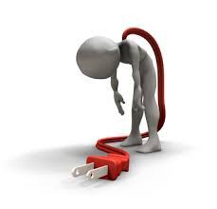
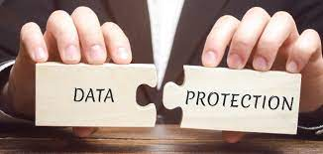
Examples of HOF supervision in AESF
1. GENERAL INSPECTION: design of working shifts and driving times
  Driving times and breaks
  Work days
  Rest periods

Slide 39

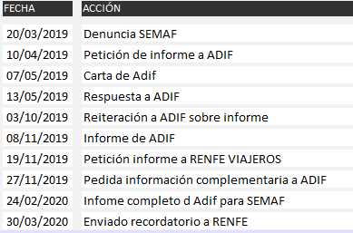

2. SPECIFIC INSPECTION: after a complaint received
Examples of HOF supervision in AESF
Actions taken by AESF: Investigations and request of information

Slide 40
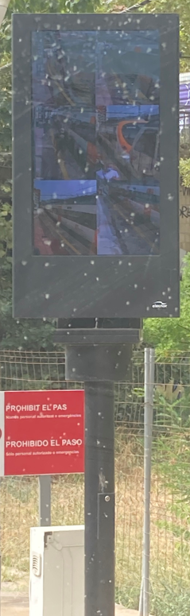
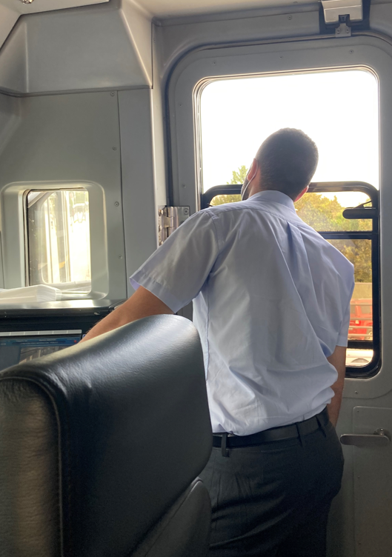
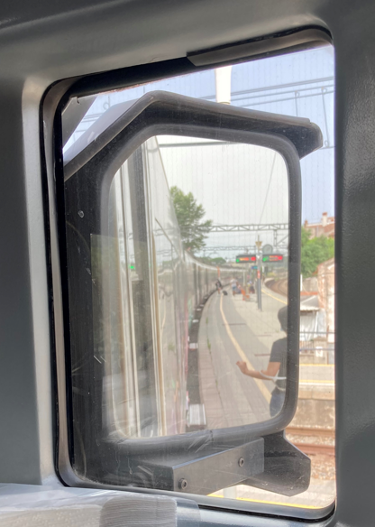
2. SPECIFIC INSPECTION: after a complaint received
Examples of HOF supervision in AESF
Actions taken by AESF: inspection
  In two days, 7 inspections were carried out.
    2 inspections on line R4
    2 inspections on line R1
    1 inspection at France Station
    2 inspections on line R2norte

Slide 41
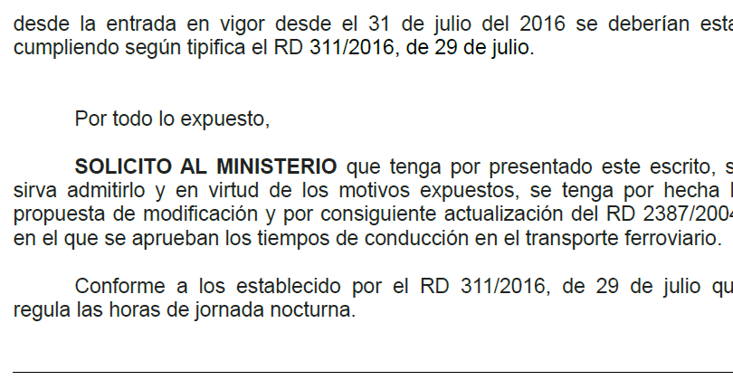
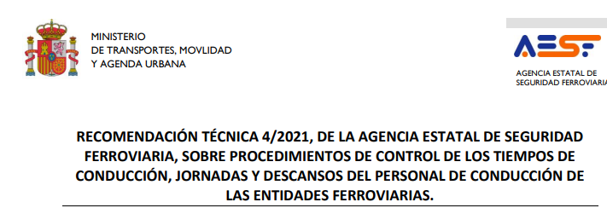

2. SPECIFIC INSPECTION: after a complaint received
Examples of HOF supervision in AESF
Actions taken by AESF: Recommendation for the sector
?

Slide 42
Examples of HOF supervision in AESF
3. SPECIFIC SUPERVISION ACTIVITY: arising from events
2017/07/28 Barcelona Françe Station
Collision with molehill
The direct cause of the accident was the driver's failure to apply the brakes.
  NIB RECOMMENDATIONS
    35/2017 – 5 Promote, in collaboration with the different actors in the industry, an analysis of possible complementary devices to the "dead man" that can detect (and respond to) situations of semi-consciousness.
    35/2017 - 4 Include tests or questionnaires aimed at detecting possible risks of sleep disorders in the regular medical tests carried out on drivers, so that preventive measures can be taken in this respect.

Slide 43

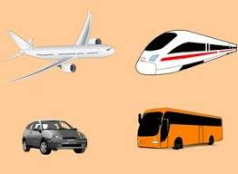
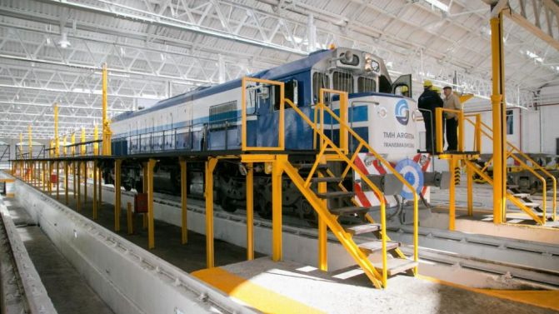

Examples of HOF supervision in AESF
3. SPECIFIC SUPERVISION ACTIVITY: arising from events
Actions taken by AESF
NSA-ES launches a consultation on the NSAs Network
Research on existing options for other means of transport
Consult with industry to see if fatigue detection devices are being developed.
NSAs to monitor companies on the design of drivers' working hours.

Slide 44


Examples of HOF supervision in AESF
3. SPECIFIC SUPERVISION ACTIVITY: arising from events
Actions taken by AESF
Case study and publication of recommendations by the Railway Medicine Committee driven by the NSA ES
Spain starts incorporating more monitoring of sleep pathologies in periodic psychophysical checks.

Slide 45
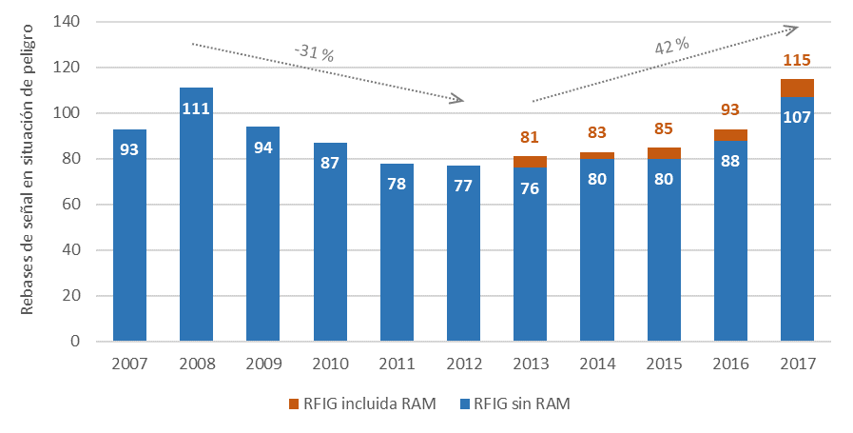
Examples of HOF supervision in AESF
4. SPECIFIC ACTIONS: after data analysis
Spad increased tendency observed in 42% in 5 years

Slide 46
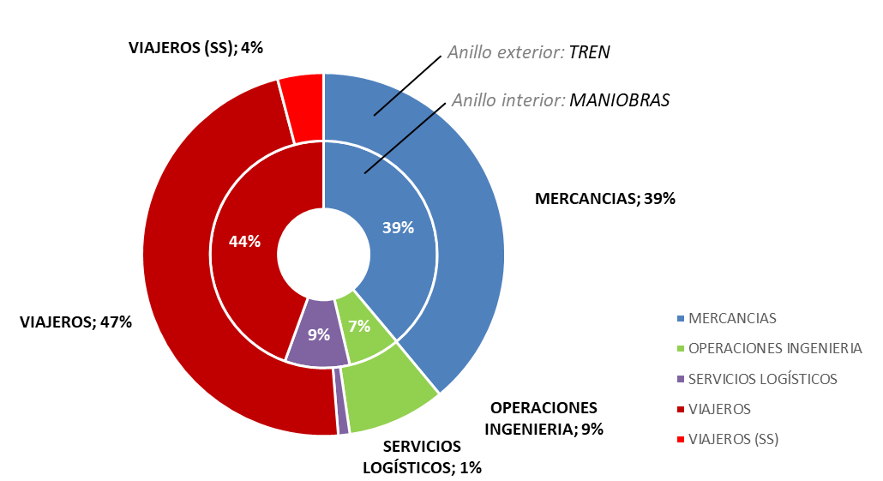
Examples of HOF supervision in AESF
4. SPECIFIC ACTIONS: after data analysis
Spad increased tendency observed in 42% in 5 years
Actions taken by AESF:
Compilation of information
Data analysis
Spad by type of service
Spad by place

Slide 47
Examples of HOF supervision in AESF
4. SPECIFIC ACTIONS: after data analysis
Spad increased tendency observed in 42% in 5 years
Compilation of information
Data análisis
First conclussions
Actions taken by AESF:
  Objective causes were identified (lack of visibility, insufficient distance between signals, etc)
  No possibility to identify HOF due to the data requested and provided
  Need for additional information to correctly address the cause-effect relation (organizational factors, drivers behaviour, etc)
  Extend the investigation to include underlying factors

Slide 48
Examples of HOF supervision in AESF
4. SPECIFIC ACTIONS: after data analysis
Spad increased tendency observed in 42% in 5 years
Compilation of information
Data análisis
First conclussions
Reported system in AESF
Actions taken by AESF:
  Information reported system in AESF on circumstances producing spad.
  Information from all actors involved since the beginning.
  Confidentiality is granted.
  Information based in HF methodology of RSSB or similar.
  General templates for providing information have beendrafted

Slide 49

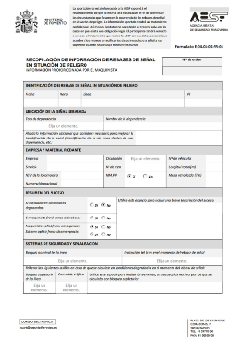
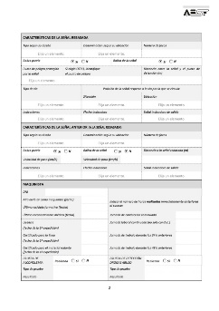



Examples of HOF supervision in AESF
4. SPECIFIC ACTIONS: after data analysis
Spad increased tendency observed in 42% in 5 years
Compilation of information
Data análisis
First conclussions
Reported system in AESF
Actions taken by AESF:
Rebase
Empresa Ferroviaria
Administrador de infraestructuras
Obligación
de cubrir
ficha
Obligación
de cubrir
ficha
Entrega ficha
a su personal
Entrega ficha
a su personal
Modelo Ficha
Maquinista
Personal Circulación
Cauce
confidencial
Cauce
confidencial

Slide 50
Thank you for your attention
¿Questions?
Vanessa mª García Lozano
vmgarcia@seguridadferroviaria.es
Notes:
How considers and guarantee AESf the confidentiality of staff that request it?
What are the actions that AESF starts if an unfulfillment is detected in HOF?
Does AESF has an estimation of HOF integration in the Spanish railway sector?

Slide 51
Conference - Integration of Human and Organisational Factors: Managing Workload and Fatigue
PANEL DISCUSSION day 2

Slide 52
Speakers – 7 December 2022
Cyriel Martin
Communication Officer
Ole Kroczek
Vanessa García Lozano
Assessor
Clarisse Lagaize-Davoine
Project Officer
Safety Manager
Geoffrey Tresontani
ECM Manager
Mark Young
Inspector

