Slide 1
Conference - Integration of Human and Organisational Factors: Managing Workload and Fatigue
6-7 December 2022

Slide 2
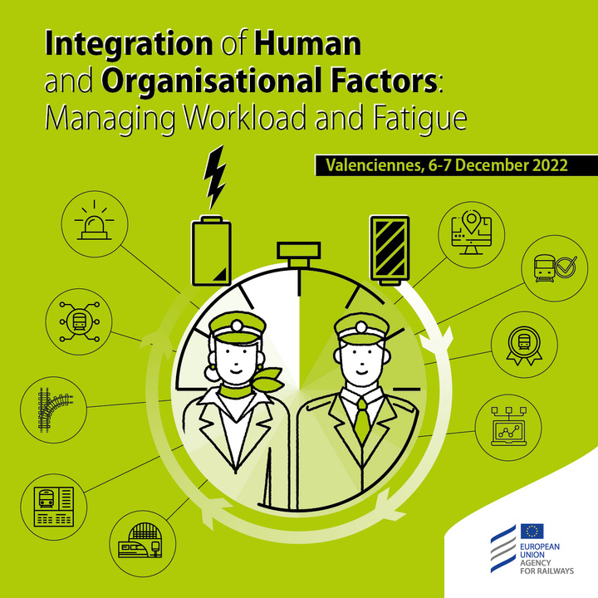
AGENDA | 7 DECEMBER | 09.30- 11.20
Time | Description | Speaker
09.30 - 09.40 | Introduction to the day | ERA
Session 4 | How are workload and Fatigue managed? Railway undertakings’ perspective | Session 4 | How are workload and Fatigue managed? Railway undertakings’ perspective | Session 4 | How are workload and Fatigue managed? Railway undertakings’ perspective
09.40 - 10.20 | Human Factors & Workload management @ DB Regio | Ole Kroczek | DB Regio AG
Session 5 | How are workload and fatigue managed? ECM’s perspective | Session 5 | How are workload and fatigue managed? ECM’s perspective | Session 5 | How are workload and fatigue managed? ECM’s perspective
10.20 - 11.00 | Human and Organisational Factors in Maintenance | Geoffrey Tresontani | CFL Cargo
11.00 - 11.20 | Break

Slide 3

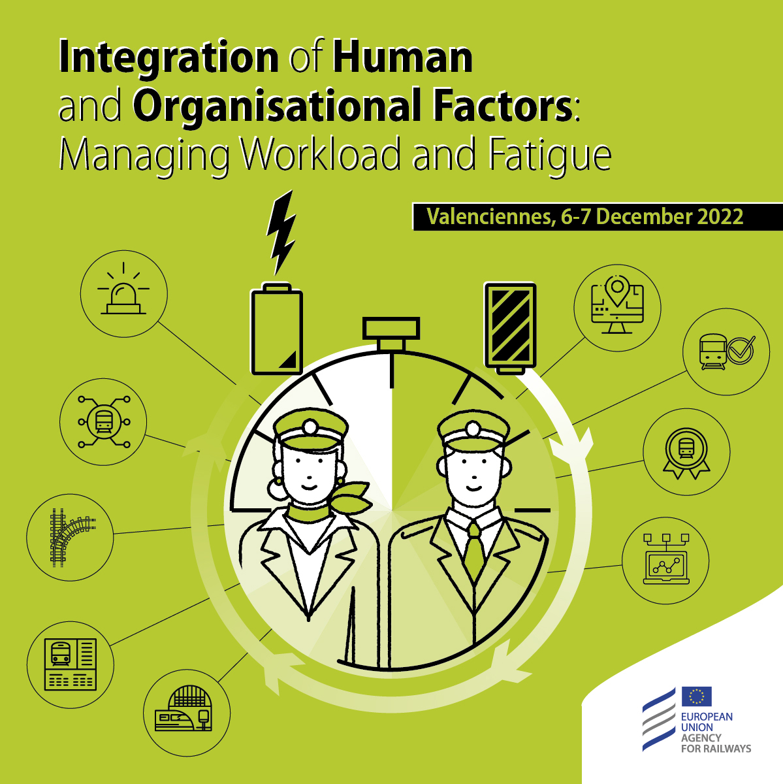






Speakers – 7 December 2022
Cyriel Martin
Communication Officer
Ole Kroczek
Vanessa García Lozano
Deputy Head of Unit of Railway Safety Coordination
Clarisse Lagaize-Davoine
Project Officer
Safety Manager
Geoffrey Tresontani
ECM Manager
Mark Young
Inspector

Slide 4
Speakers – 7 December 2022
Cyriel Martin
Communication Officer
Ole Kroczek
Vanessa García Lozano
Deputy Head of Unit of Railway Safety Coordination
Clarisse Lagaize-Davoine
Project Officer
Safety Manager
Geoffrey Tresontani
ECM Manager
Mark Young
Inspector

Slide 5
Conference - Integration of Human and Organisational Factors: Managing Workload and Fatigue
Session 4 – How are workload and Fatigue managed? Railway undertakings’ perspective

Slide 6
Speakers – 7 December 2022
Cyriel Martin
Communication Officer
Ole Kroczek
Vanessa García Lozano
Deputy Head of Unit of Railway Safety Coordination
Clarisse Lagaize-Davoine
Project Officer
Safety Manager
Geoffrey Tresontani
ECM Manager
Mark Young
Inspector

Slide 7
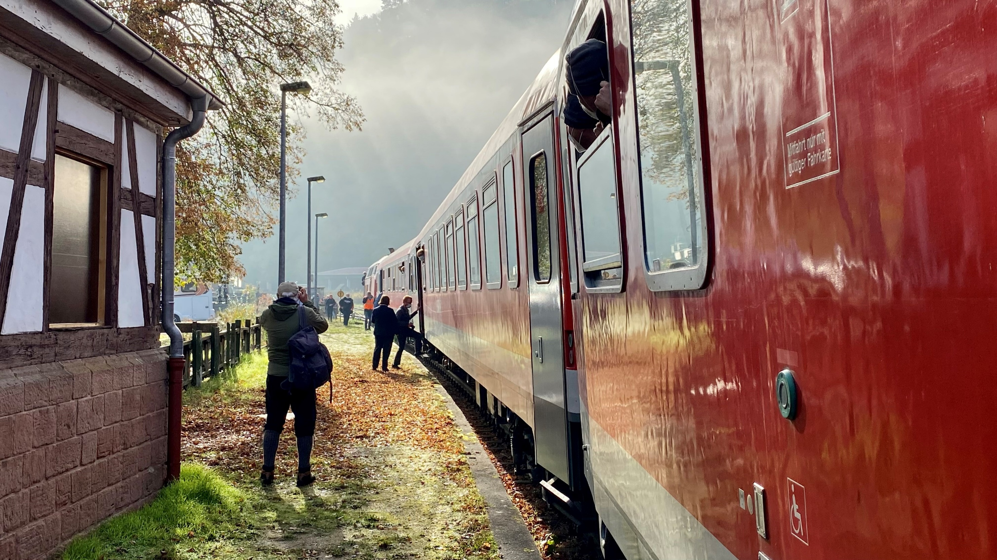
Human Factors & Workload management @ Regio
«Human and Organisational Factors conference 2022»
07.12.2022 | DB Regio AG R.RBE | Ole Kroczek

Slide 8
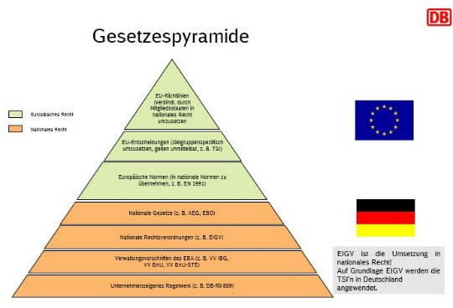



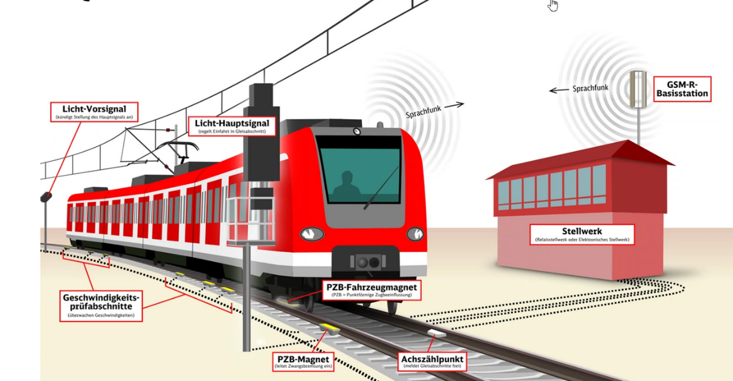

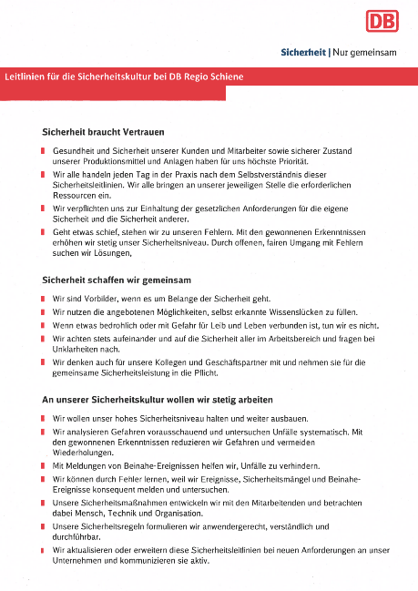
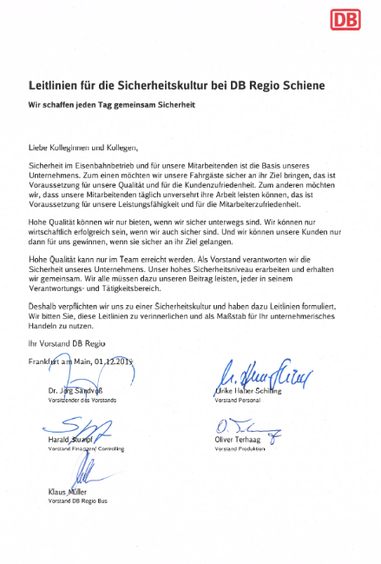



Building the strong safety culture by way of an action plan at DB Regio
  Operational rules
  Planning premises
  Work environment and equipment
Optimization
Normative Specifications
Safetyculture action plan
1
Confidential reporting system
2
Safety guidelines
Fairness guide and fault culture
3
Strengthening safety, focus executive and dialog
  If something goes wrong, we stand to our faults. With the won knowledge we increase steadily our level of safety. By open, fair dealing with faults we are looking for solutions.
  We develop our safety procedures with collaboration and look at human, technical & organizational factors.
4
Human organisational factors
Culture, confidence, responsibility and establishing risk knowledge herself / himself
5
Further development education formats

Slide 9

Safety culture in everyday life: Attentiveness towards one's own performance
Being prepared starts before the shift. Be fit and rested. Be aware that a whole range of factors influence your performance at work. Let's look at the following scale!
GREEN
No known problems or stresses at home or at work, you can concentrate well on work-related tasks. You are well rested.
YELLOW
Minor problems or stresses that distract you during periods of underloaded activity, such as driving along without restrictive signals. If breaks have not allowed you to recover sufficiently, monitor your performance and take action.
RED
Severe fatigue (unable to stay awake) or serious problems that stress you and distract you constantly, even during periods of demanding activity such as braking towards station stops or buffer stops.

Slide 10
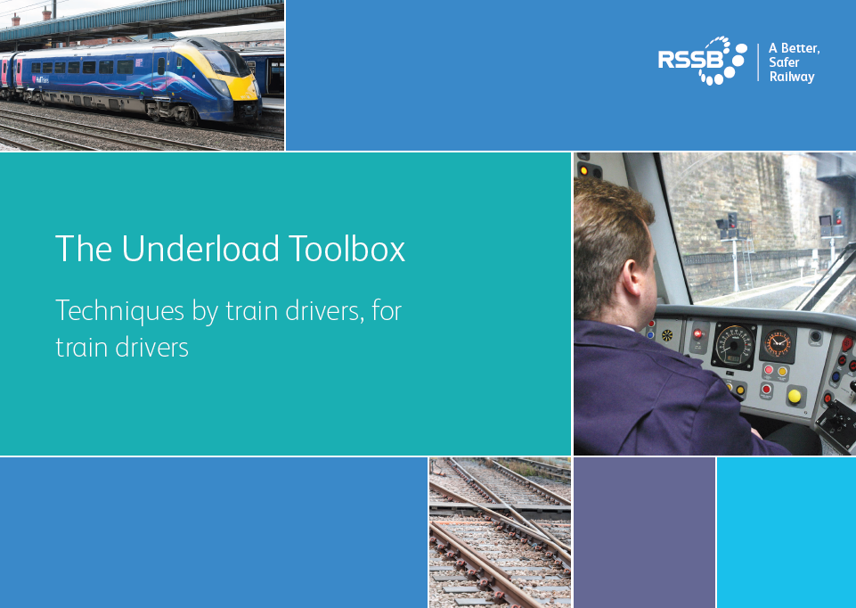




Picking up the RSSB Underload Toolbox in the UIC Human Factors Working Group and adapting it for use at DB Regio in a German context
Additional tasks relating to driving
Being active in the cab
Alertness booster techniques
Cab environment
Unusual techniques
Self-test on track characteristics
Short journey concept
Scanning available view and checking other trains
Energy-conscious driving
Announcements to passengers
Risk Triggered Commentary (RTC)
Use none driving situations for movement
Standing up whilst driving
Changing seat positions
Caffeinated drinks
Chewing gum
Drink enough water
Eat small meals
Adjust temperature
Open window
Speaking aloud in different voices
Talking to yourself/ singing
Rubber band on the wrist
Cooling down with water

Slide 11
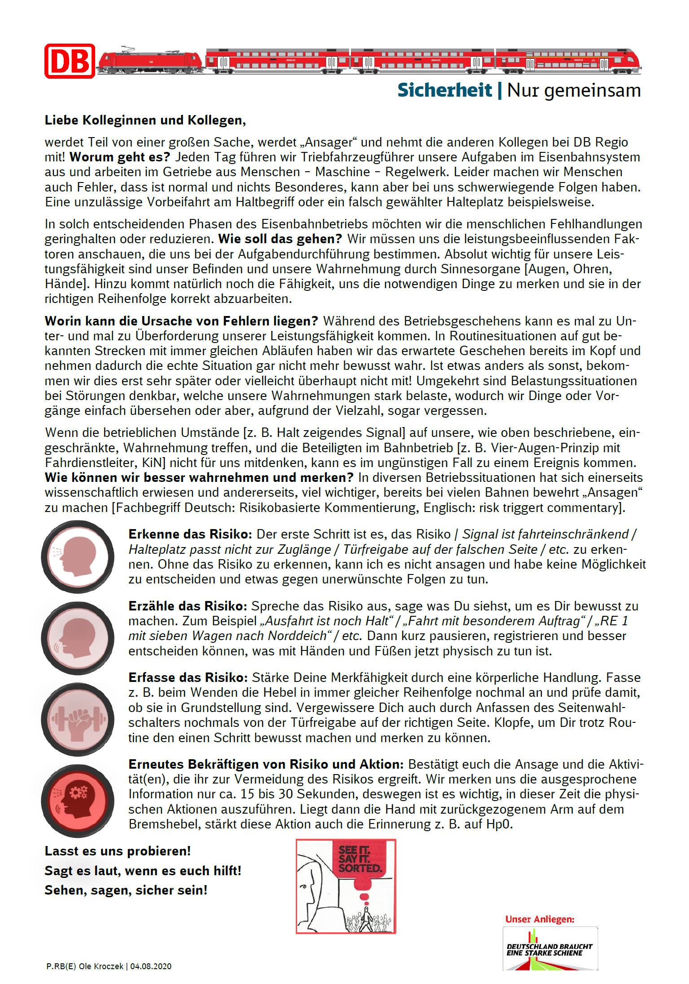


Onepager for drivers: Increase your attention through risk triggered commentary!
Without recognising the risk, I cannot announce it and have no possibility to decide and do something against undesired consequences.
Then pause briefly, register and be better able to decide what to do physically with hands and feet now.
Tap to make yourself aware of the one step and remember it better, despite the routine.
If the hand is then on the brake lever when braking with the arm pulled back, this action also strengthens the memory, approaching a signal stop.

Slide 12
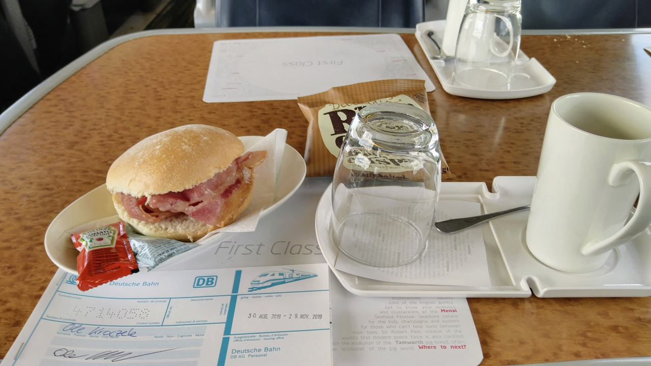

A very well liked drink on the railway or any other shift based industry is coffee
Drinking caffeinated drinks
What is it and how does it work?
Why do drivers find it effective?
What are the risks?
  Drinking caffeinated beverages can help you counteract the effects of fatigue.
  Coffee and tea (e.g. black tea, green tea) can be used for this purpose. Energy drinks can also boost your concentration, but are not recommended due to the high sugar and caffeine content.
  Caffeine increases alertness and attention levels by blocking fatiguing neurotransmitters in the brain.
  The effect occurs about 30 minutes after consumption and decreases over time.
  It is not advisable to consume more than 400 mg (3-4 cups) per day. Also, caffeine should not be used regularly as a wake-up aid.
  In order not to disturb recovery, no more caffeine should be consumed in the 6 hours before going to bed.

Slide 13
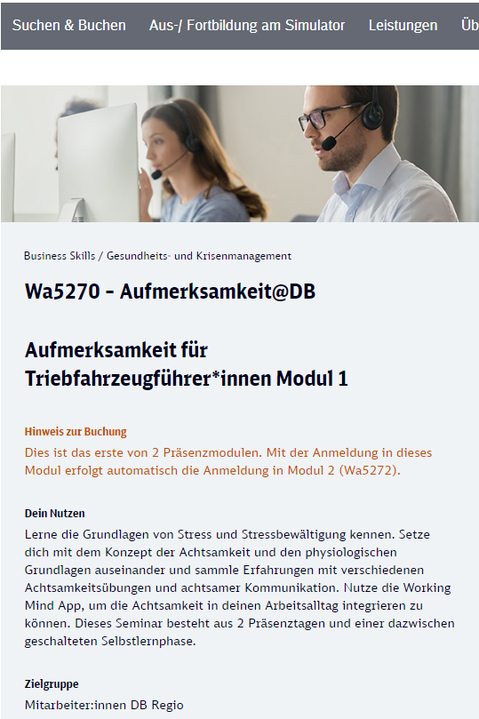
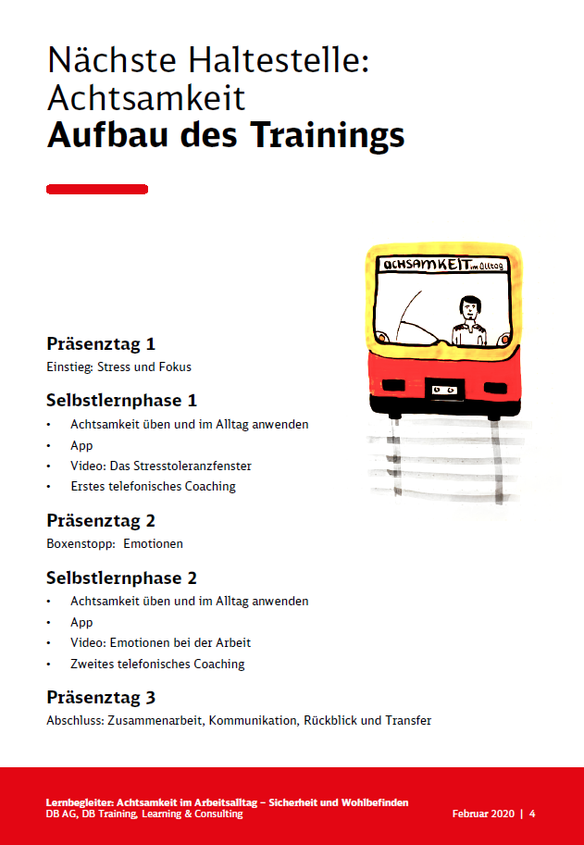

Attention@DB: The training works by promoting crucial psychological skills
  Strengthening self-efficiacy
  Focusing on individual degrees of freedom:
  Self-control
  Emotional regulation
  Focus and concentration (presence)
  Possibilities of targeted regeneration in leisure time
  Personal satisfaction (professional and private)
  The participant's perception is directed towards what can be influenced instead of concentrating on what is unchangeable.
Actors who take responsibility for their own actions, in combination with rules and regulations, strengthen the safety culture.
Sicherheit | Nur gemeinsam

Slide 14


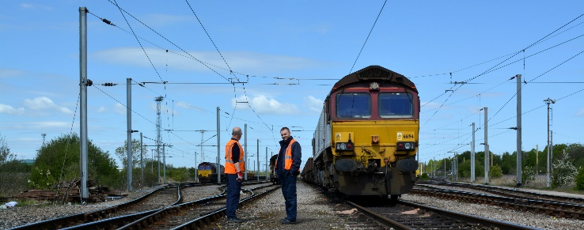
Fair communication at DB Cargo UK: we have professional driving standards, looked at by indicators and open feedback to drivers
Wöchentliche Email an Tf DB Cargo UK North East & Cumbria:
Weekly Email to drivers in North East & Cumbria:
Aim: DB Cargo UK drivers have a high standard of professionelism
  Safe, punctual and eco friendly.
  DB Regio has a training modul for all its drivers setting down professionel driving techniques.
  DB Cargo UK has set down ist Professional Driving Policy as part of its SMS
On board unit sends driving data preindicators
  This automated weekly report shows the number of QTRON exceptions by highlighting 11 violations of the DB Cargo UK professional drivers policy.
  It identifies the precursor events that we believe contribute towards major incidents.
    Dragging Brake
    Emergency Brake Operated
    Final approach to potential red aspect over 15mph
    …
Feedback about safety level from Safety Assurance Manager
  It is rare to see any violations from NE and Cumbria drivers. The standard of driving and adherence to rules and policies is very high in our area.
  The high standard of driving is also reflected in the downloads analysed for the driver assessment process.
  This high standard of driving means we have a low number of incidents and a good safety record something that is recognised @ DB.

Slide 15
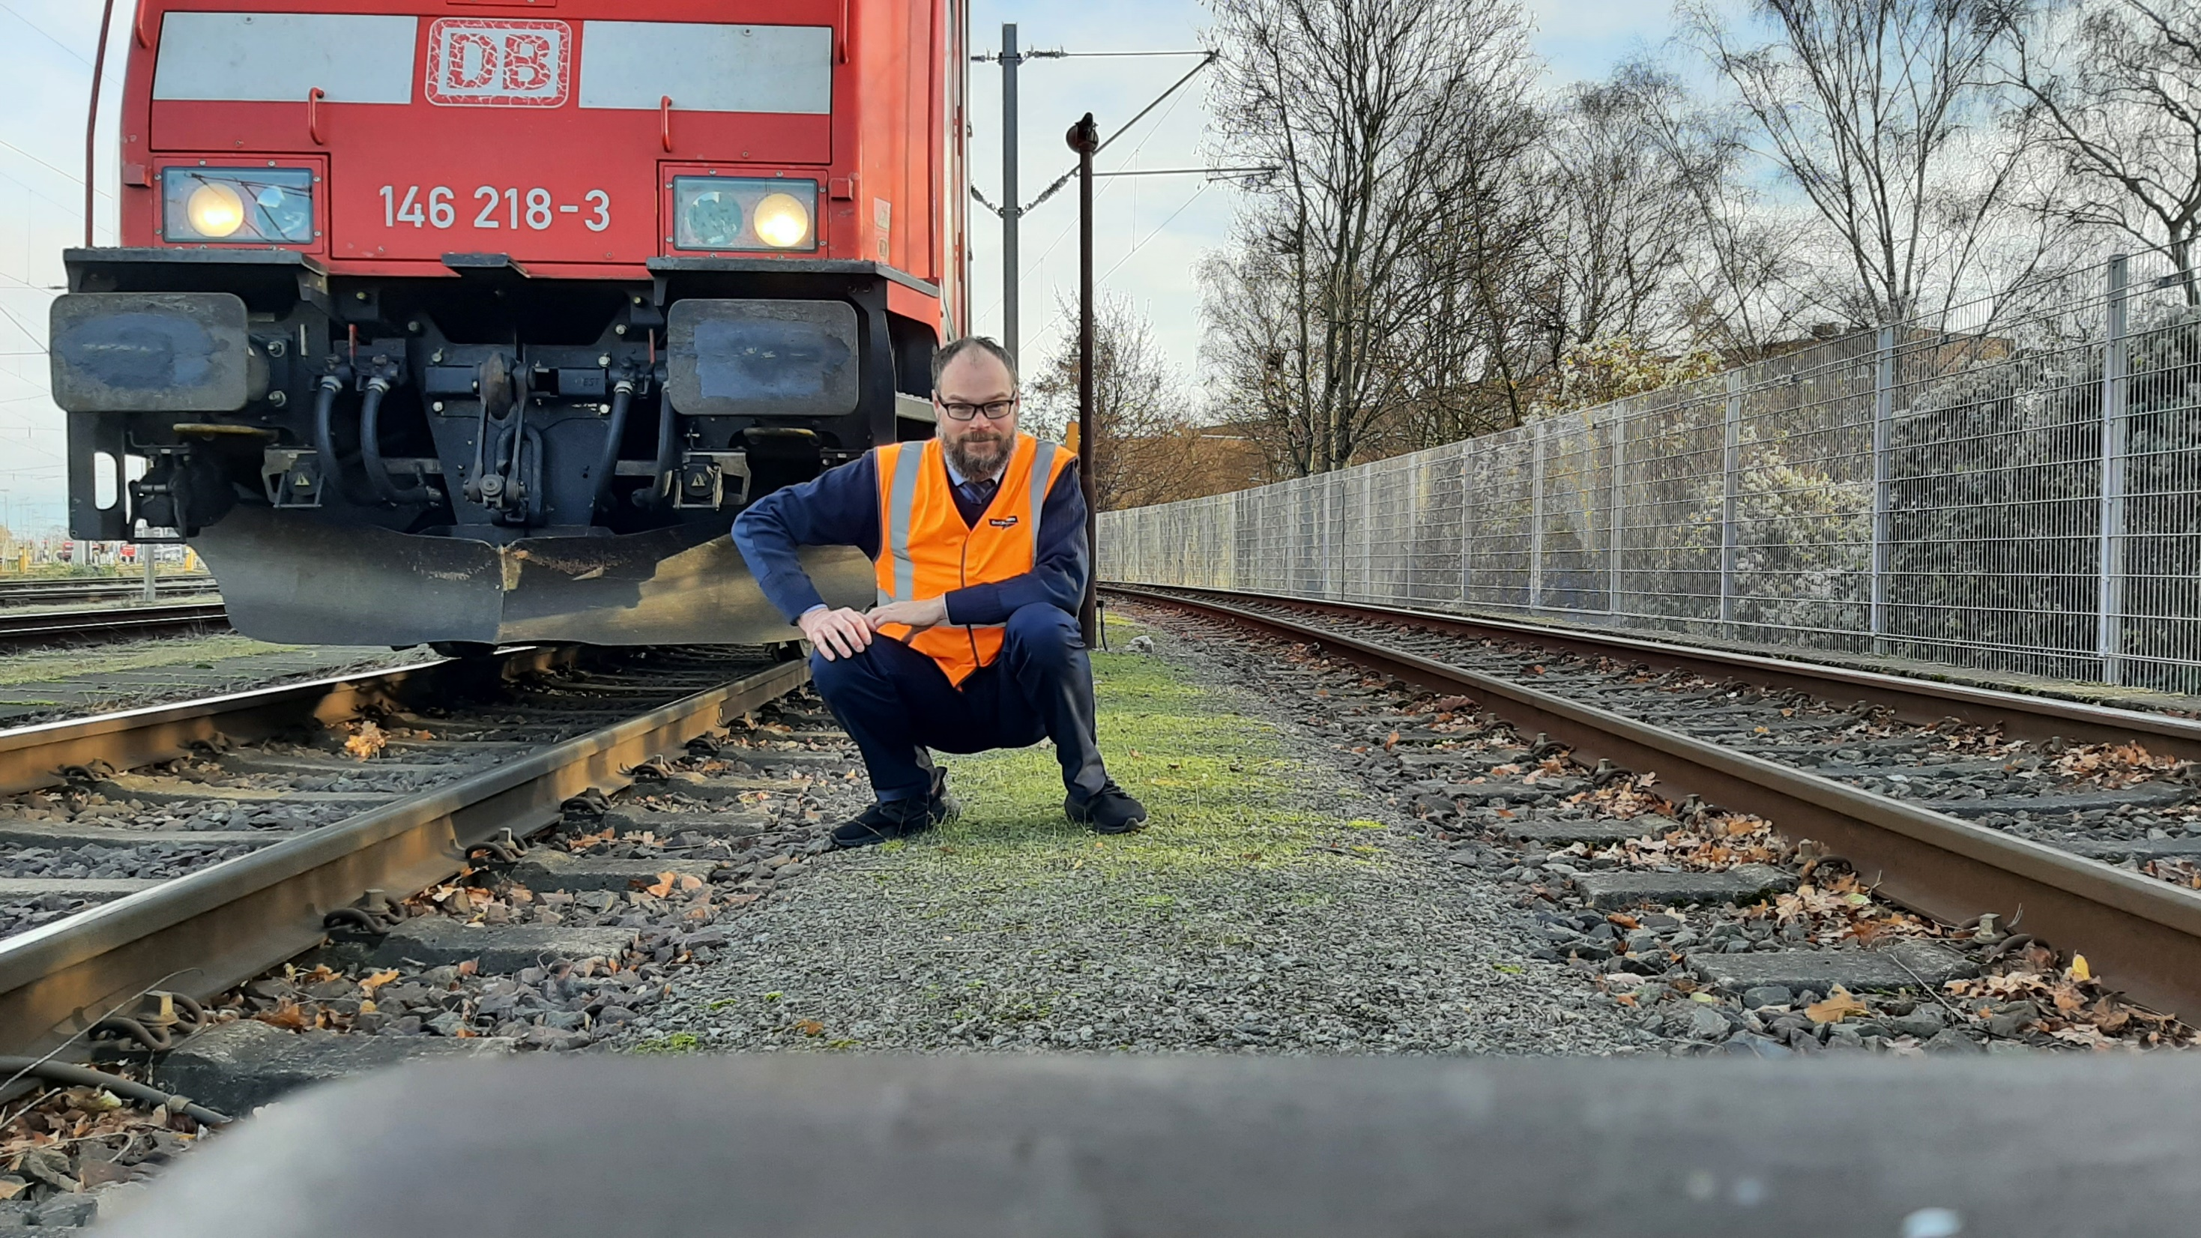

Thank you for your attention.
Any questions?

Slide 16
Conference - Integration of Human and Organisational Factors: Managing Workload and Fatigue
Session 5 – How are workload and fatigue managed? ECM’s perspective

Slide 17
Speakers – 7 December 2022
Cyriel Martin
Communication Officer
Ole Kroczek
Vanessa García Lozano
Deputy Head of Unit of Railway Safety Coordination
Clarisse Lagaize-Davoine
Project Officer
Safety Manager
Geoffrey Tresontani
ECM Manager
Mark Young
Inspector

Slide 18
Human and Organisational Factors in Maintenance
Geoffrey TRESONTANI / CFL cargo
ERA HOF conference 2022

Slide 19


Our company
CFL cargo : Fully integrated railway service provider https://www.cfl-mm.lu/fr-fr/organisation/cfl-cargo/

Slide 20
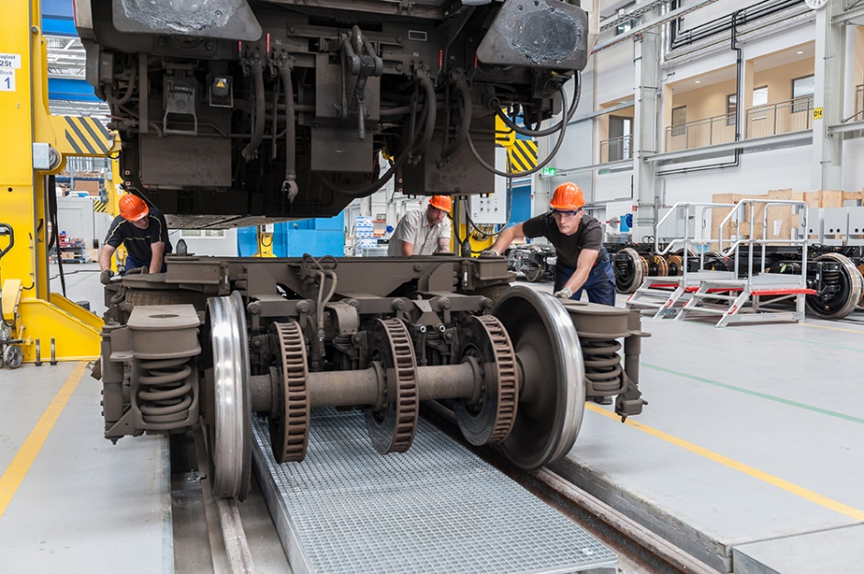
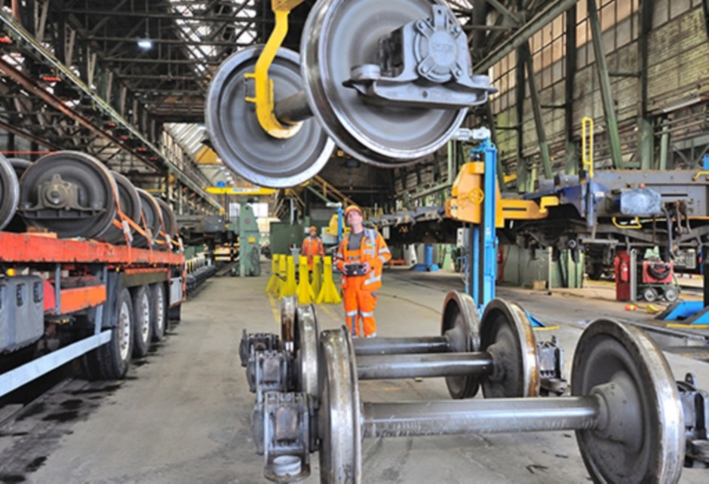
Human and Organisational Factors in Maintenance
Content
CFL cargo ‘s ROLLING STOCK ORGANISATION
MAINTENANCE SYSTEM … HEAD AND ARMS
MAINTENANCE SYSTEM INTERACTIONS
MAINTENANCE SYSTEM PERFORMANCE
MAINTENANCE ORGANISATION and HOF
FATIGUE and STRESS PRECURSORS
FATIGUE and STRESS IMPACTS
FATIGUE and WORKLOAD MANAGEMENT

Slide 21
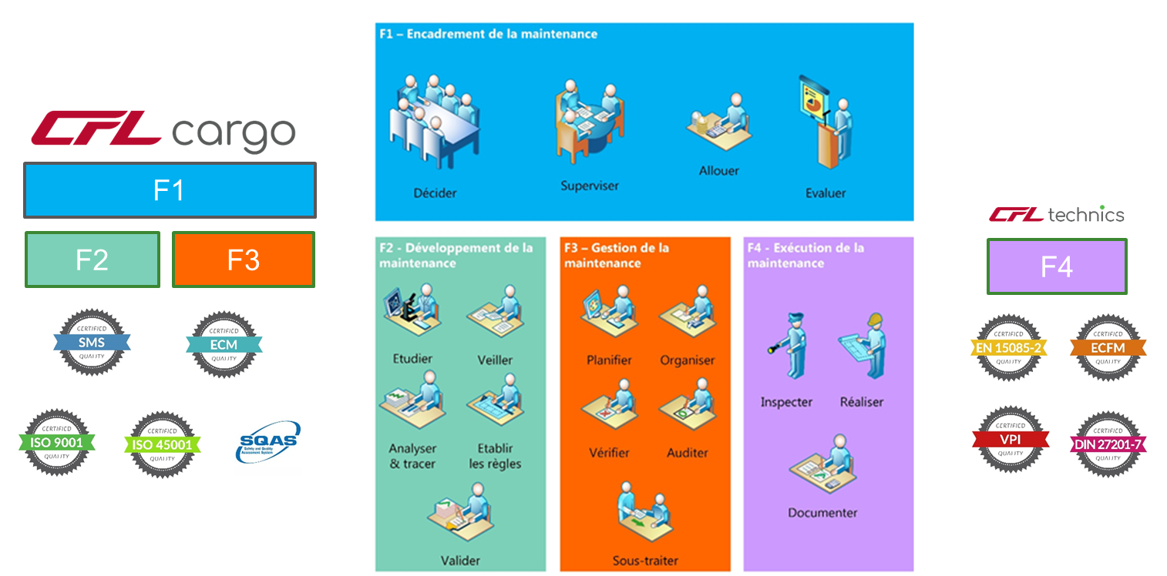
CFL cargo ‘s ROLLING STOCK ORGANISATION
Locomotives and freight wagons
➔ 79 locomotives (29 Elec + 50 Diesel) + ~3300 wagons under supervision, we are ECM for wagon’s fleet (+/- 2500wagons)
Maintenance Management function
Maintenance Development function
Fleet Maintenance Management function
Maintenance Delivery
function

Slide 22
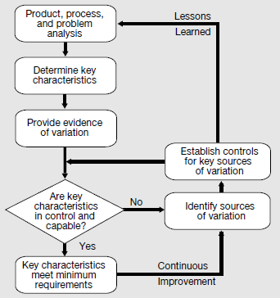
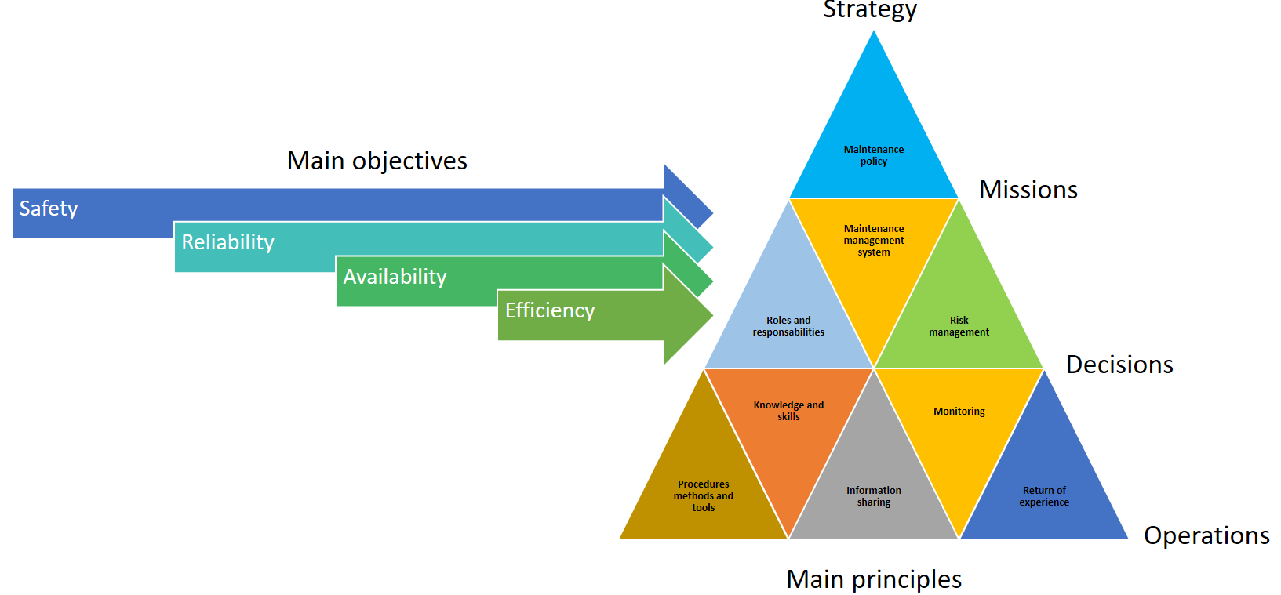
MAINTENANCE SYSTEM … HEAD AND ARMS
How it’s made … How we do …
CFL cargo + CFL technics = more than 220 people directly involved in rolling stock maintenance
F1
F3
F2
Maintenance delivery
F4

Slide 23








MAINTENANCE SYSTEM INTERACTIONS
ORGANISATION ? What is behind …
Nothing but HOF …
THEM / Their roles
What THEY know…
What THEY want…
What THEY can…
Their objectives …
Their limits …
HIM
HER
HER
External = Customers / Stakeholders
THEM
THEM
Internal =
Workshop
Our actions
Their actions
THEM
THEM
ME / My role
Common actions
to reach common goals
US
THEM
THEM
ME
What I know…
What I want…
What I can…
My objectives …
My limits
HER
THEM
THEM
THEM
HIM
HIM
THEM
ME
HIM
US / Our service
HER
What WE know…
What WE want…
What WE can…
Our objectives …
Our limits
Lots of cross-interactions, requests influences, directives …
ME / OTHERS
HER

Slide 24
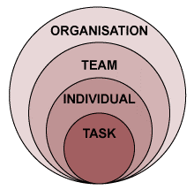
MAINTENANCE SYSTEM PERFORMANCE
HOF are everywhere !
SUCCESS !!!
Maintenance System Objectives
Safety
Reliability
Availability
Efficiency
As we want to be !
Decisions
Missions
Operations
Feedback
Strategy
Ressources
Knowledge
Means
ORGANISATION is a
structured group of people (INDIVIDUAL) working (TASK) together (TEAM) to achieve common set of objectives
Change Management
Continuous Improvement
Culture
Motivation
System (organisation)
As it is !
Maintenance Performance
is obviously a matter of
HUMAN and ORGANISATIONAL
FACTORS
The process …

Slide 25
MAINTENANCE ORGANISATION and HOF
Management of Key aspects for HOF integration in maintenance …
Cultural principles
Procedural means
Motivation enablers and barriers
Health
Cognitive mechanisms
Organisation schems
 | Scope | To be managed …
Human and Organisational Factors | Cultural | Values
 |  | Vision / objectives
 |  | Policies
 | Health | Ergonomics
 |  | Stress
 |  | Work environment
 |  | Physical work load
 | Procedural | Guidelines
 |  | Systems
 |  | Tasks
 |  | Feedback and REX
 | Motivation | Goals
 |  | Mood
 |  | Trust
 |  | Salary
 |  | Job interest
 | Cognitive | Awareness
 |  | Problem solving
 |  | Personal experience
 |  | Cognitive work load
 | Organisation | Governance
 |  | Structure
 |  | Means and tools
 |  | Skills

Slide 26

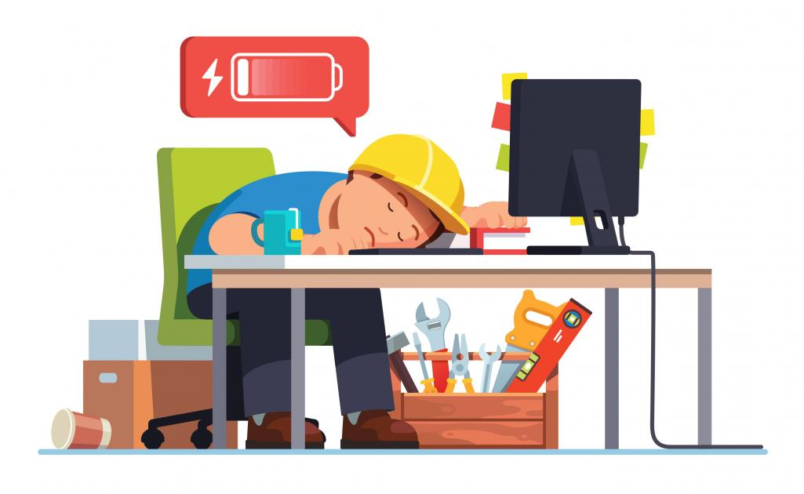
FATIGUE and STRESS IMPACTS
Small signals, big issues…
Fatigue and stress decreased …
Attention and vigilance
Decision making ability
Productivity
Communication skills
Memorisation abilities
Stress management
Risk taking decisions – Violations of rules
Errors
Absenteism
Quality of work
Fatigue and stress increased …
Unsafe behaviors
Missings

Slide 27
FATIGUE and STRESS PRECURSORS
What comes around …goes around …
Fatigue and Stress
Cognitive and Physical load of work
(complexity of tasks, intensity …)
Working conditions and environment
(light, noise, temperature, pollution, layout …)
Work planning and scheduling
(tasks allocation, pacing …)
Organisation and staff
(management vs operational functions, staffs involved)
Individual lifestyle and health
(food habits, sports, restings)
Individual skills and abilities
(knowledge, experience, stress handling …)
All precursors must be taken in account,
depending on the company features (several sites, different activities)

Slide 28
FATIGUE and WORKLOAD MANAGEMENT
What to do with it …
Fatigue and stress/workload management in maintenance entities consists in relevant actions in order to :
Improve awareness of people
Improve decision making
Improve efficiency of tasks performed
Improve quality of service
Improve safety of people in the facilities
Facilitate Teamwork
Facilitate Leadership
Avoid unacceptable errors during operations
Avoid misunderstandings between actors
Avoid additional delays
Avoid unacceptable behaviors
Main actions to engage
Regulate Workload
Evaluate Individual’s abilities
Establish Procedures, work-instructions and training
Facility and environment improvement

Slide 29
FATIGUE and WORKLOAD MANAGEMENT
How to manage it … some good principles
Regulate Workload
Avoiding excessive working hours
Taking into account reduced physical and mental capacity at night
Taking into account individual circumstances
Rotating shifts toward the biological day, i.e., rotate to later rather than earlier shifts
Minimizing night shifts through creative scheduling
Providing longer rest periods if night shifts
Allocating more critical tasks during day shifts when staff are likely to be more alert
Ensuring that appropriate checks are carried out after night shift work
Breaking up lengthy repetitive tasks into smaller tasks, with breaks in between
Evaluate Individual’s abilities
Physical fitness.
Physiological characteristics such as visual acuity, colour vision, hearing, etc.
Personality
Attitude, professional integrity, motivation.
Alertness, fatigue, tiredness, shiftwork.
Distractibility, attention span, concentration, multi-tasking ability, situation awareness.
Information processing capability, memory, perception, intelligence.
Procedures, work-instructions and training
Procedure design and changes should involve maintenance personnel who have a good working knowledge of the tasks.
All procedures, and changes to those procedures, should be verified and validated before use where practicable
Ensure procedures are accurate, appropriate and usable, and reflect best practice
Take account the level of expertise and experience of the user where appropriate provide an abbreviated version of the procedure
Take account of the environment in which they are to be used
Ensure that all key information is included without the procedure being unnecessarily complex
Where appropriate, explain the reason for the procedure
The order of tasks and steps should reflect best practice
Ensure consistency in the design of procedures and use of terminology, abbreviations, references, etc.
Provide training on the use of technology to access and print procedures and maintenance data. Ensure that printing and copy quality is good, and that there are enough printers, copiers, etc.
Facility and environment improvement
Temperature adequate for personnel to carry out work without undue discomfort
Lighting adequate to ensure each inspection and maintenance task to be carried out
Noise below distraction level, where possible; otherwise below distraction level with ear plugs.
Equipment/ tools all equipment, tools and material should be made available when needed

Slide 30
Thanks for your attention !!!
Geoffrey TRESONTANI
geoffrey.tresontani@cflcargo.lu

