Slide 1

Linking data for
BETTER ASSETS AVAILIBILITY
and maximum utilization of existing infrastructure.

Slide 2

2020

Slide 3
We created online online booking platform

Slide 4


Slide 5
with many solutions for railway industry
many
many
many
many
many
many

Slide 6





for...
Railway carriers
Rental companies
Forwarders
and more...
Industrial companies
Railway producers

Slide 7







Where sharing of available locomotives and wagons happens
31
%
rental & leasing
sale & purchase
locomotive routes

Slide 8













...all across Europe

Slide 9

Thanks to platform
you get everything,
you need EASILY on few clicks.

Slide 10





OFFER free capacities
Offer is visible
to all potential customers
on the railway market.
$

Slide 11


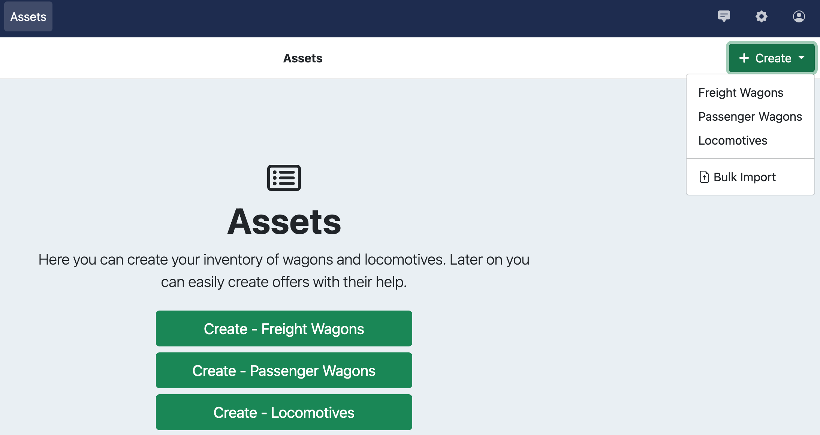


OFFER DOCUMENTATION – CURRENT SITUATION
RAILWAY COMPANIES CREATE MANUALLY THE OFFER:
1. EACH WAGON/LOCOMOTIVE OR SET INDIVIDUALLY - MANUALLY
2. POSSIBILITY TO IMPORT DATA TO RAILVIS FROM EXCEL

Slide 12
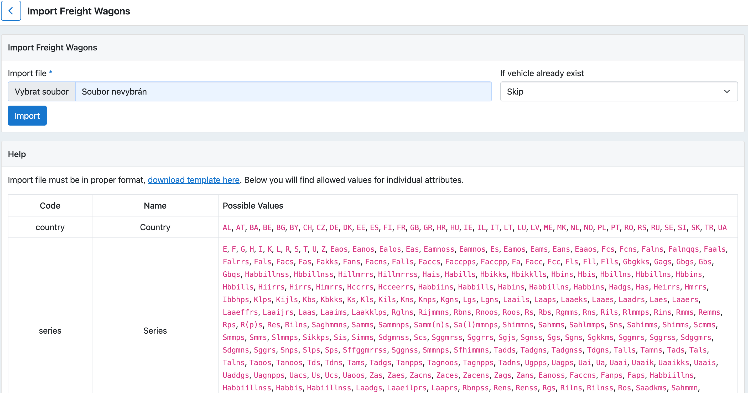
OFFER DOCUMENTATION – CURRENT SITUATION
IMPORT OF DATA FROM EXCEL – THERE IS UNITE EXCEL TEMPLATE FORMAT
TO BE USED:

Slide 13
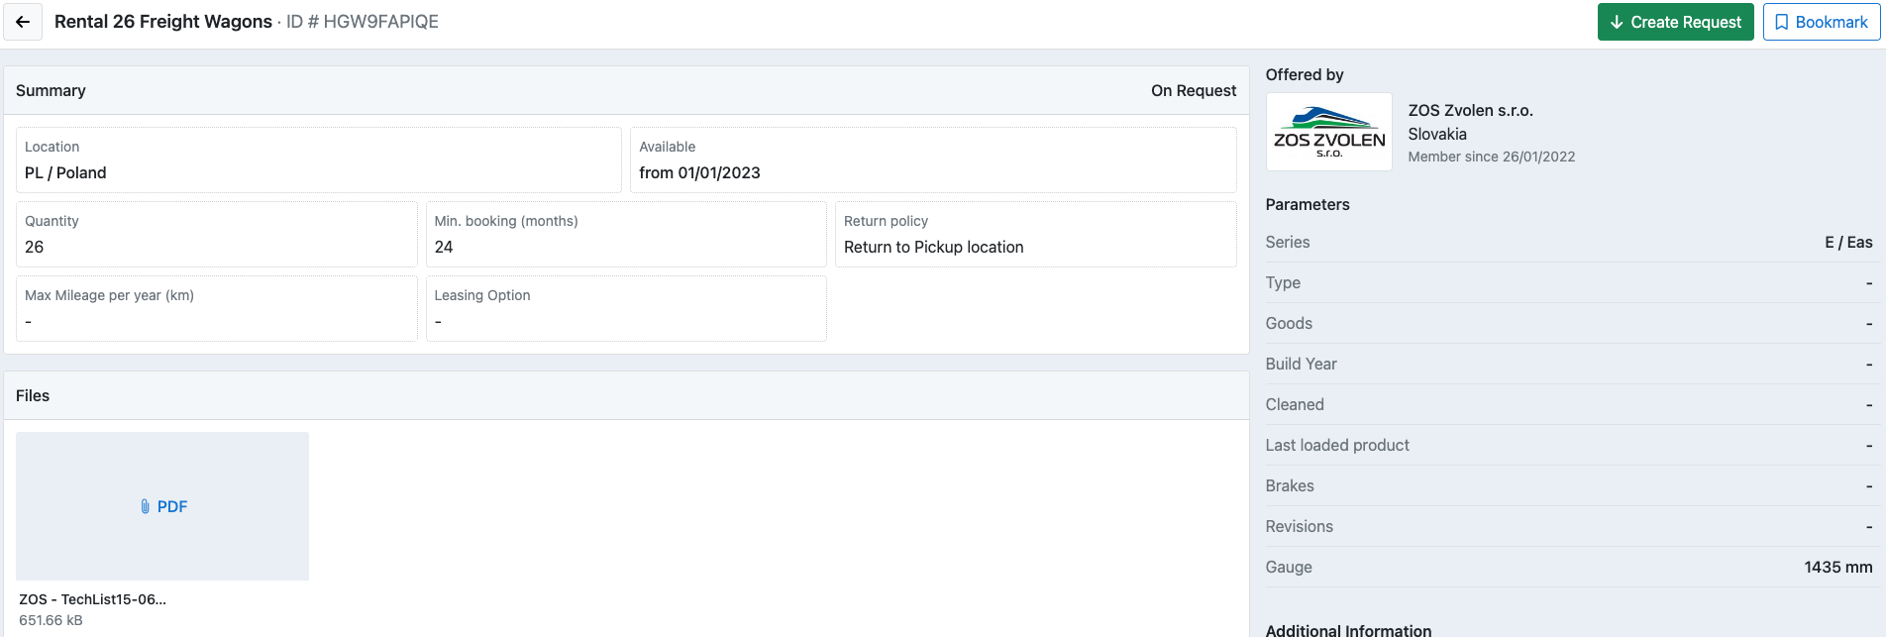

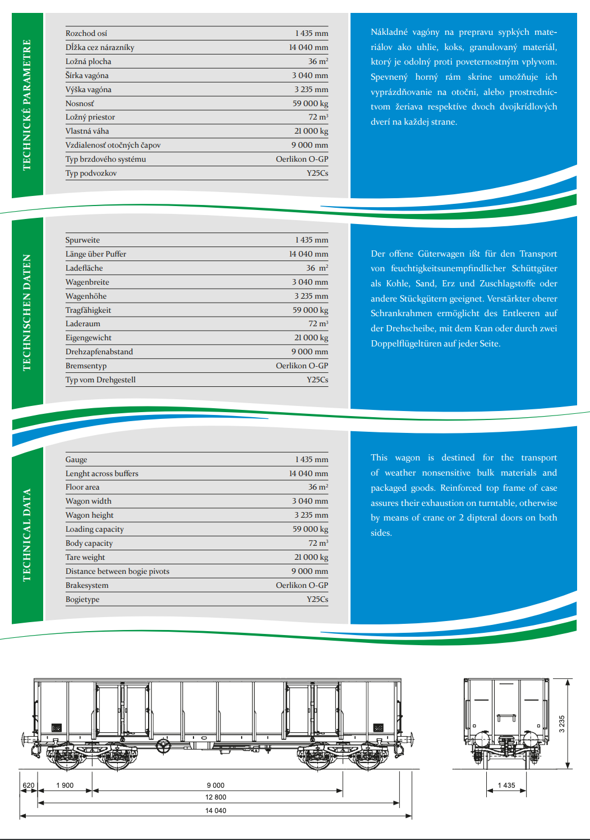

EACH OFFER / UNIT HAS ITS COMPLETE ATTACHED DOCUMENTARY
OFFER DOCUMENTATION – CURRENT SITUATION

Slide 14

OFFER DOCUMENTATION – ADVANCED OPTION
API CONNECTION WITH COMPANIE‘S INTERNAL SOFTWARE

Slide 15





just fill-in basic information about your OFFER and based on your parameters…
Sending offer
Offer sent
Send offer

Slide 16








…the offer connects with database
RAILMARKET.com

Slide 17
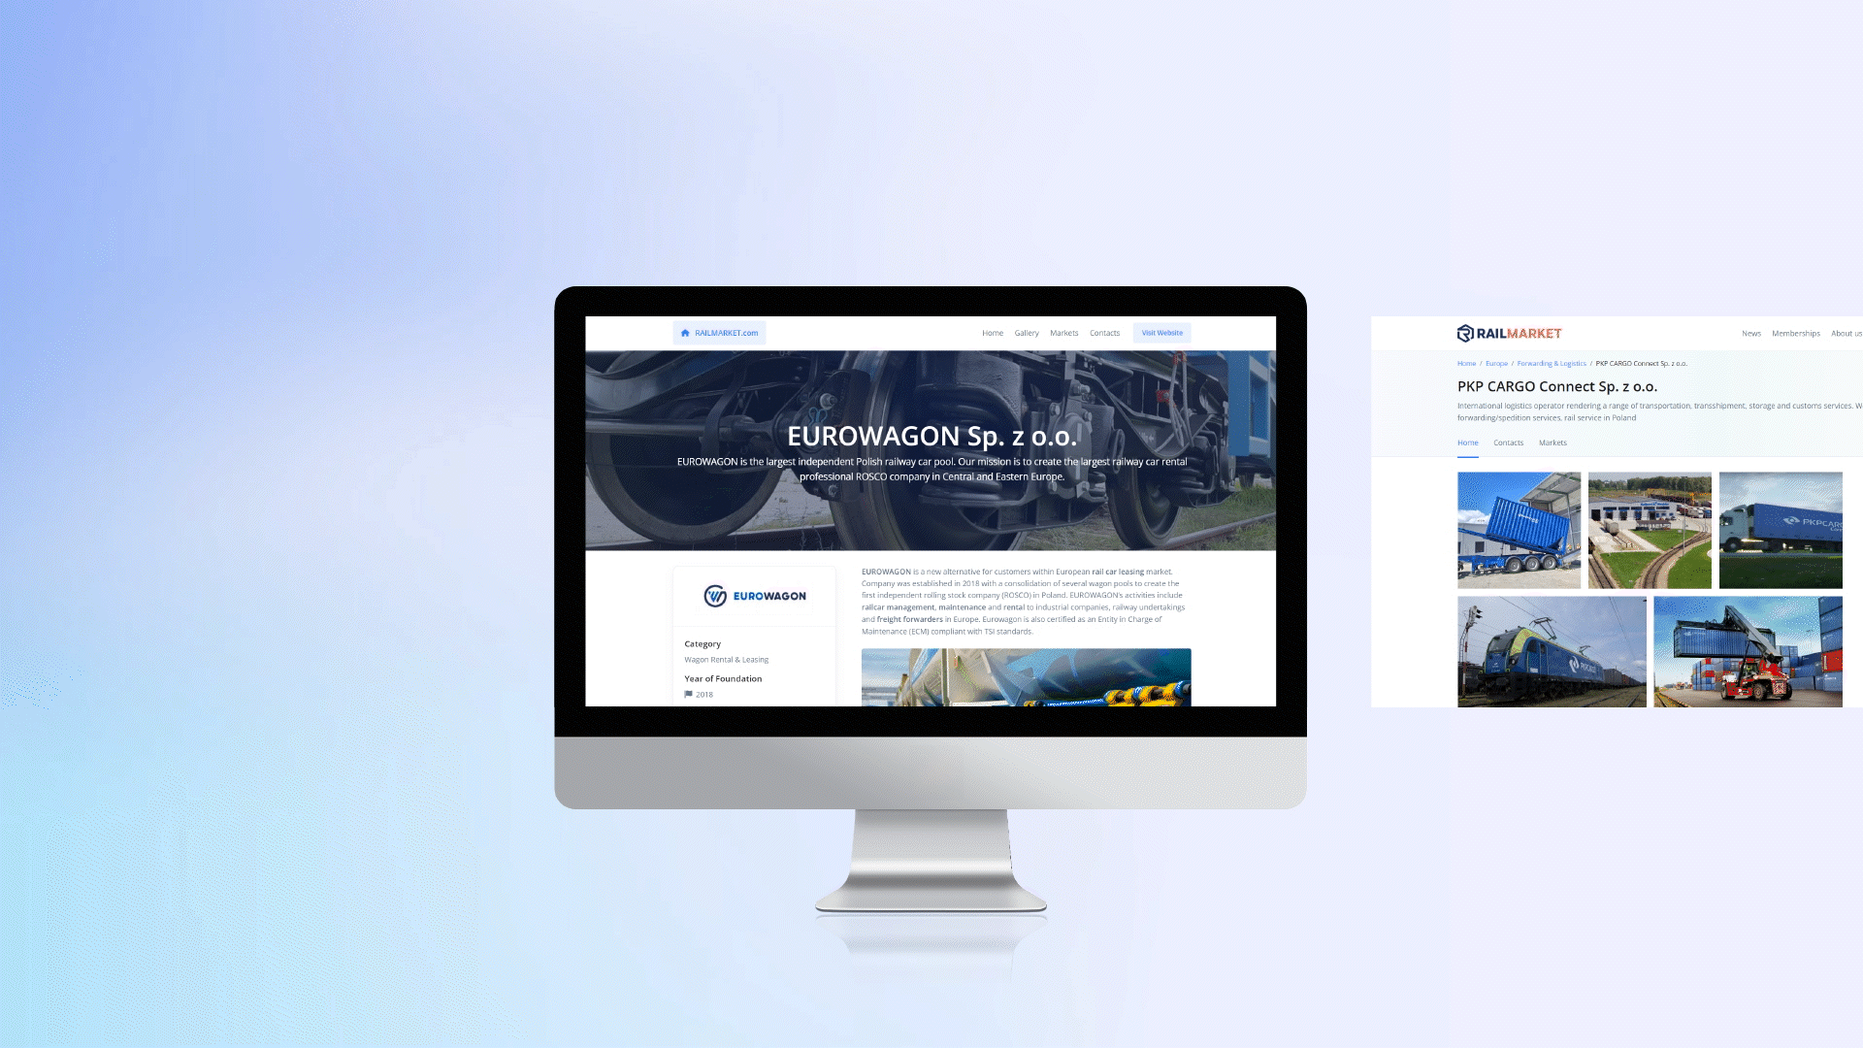
Database finds for your OFFER interested companies and their right contacts

Slide 18
Catalogue Requests Offers
Addressed companies check their needs
and send REQUESTS
1
2
3
4
5

Slide 19














Reference
350+
530+
10+
Member companies
published offers
Transactions per day

Slide 20
www.railvis.com | www.railmarket.com
info@railvis.com

