Slide 1
Attracting Talent to the Rail Sector
23 March 2022 – Free ERA Webinar

Slide 2
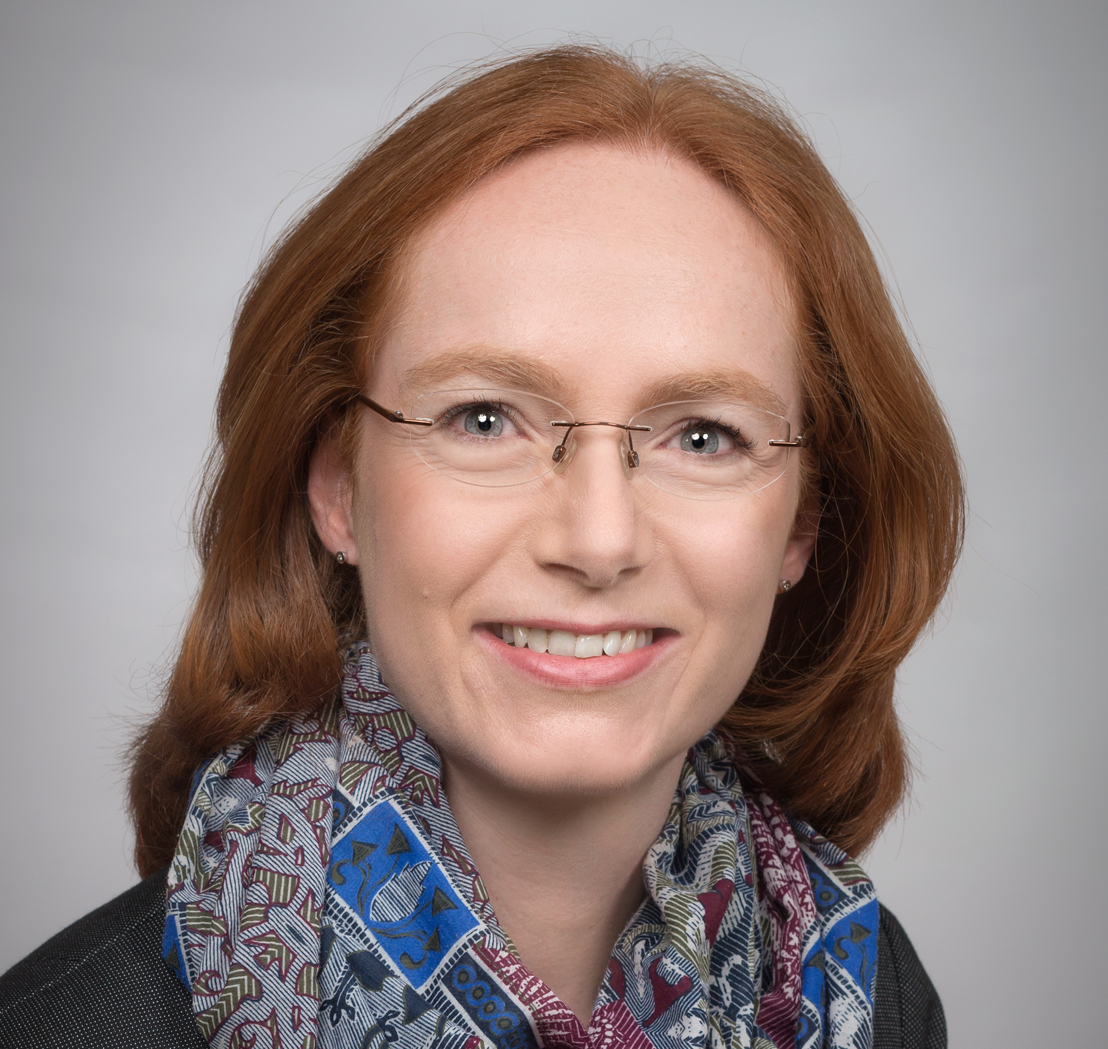
Speakers
Josef Doppelbauer
ERA
Christiane Brunn
Sabine Schneider
Schlummer Management Consulting GmbH
Siemens Mobility
Nicola Sacco
University of Genoa
Christian Wiechel-Kramüller
Bahnmedia Verlag

Slide 3
Speakers
Josef Doppelbauer
ERA
Christiane Brunn
Sabine Schneider
Schlummer Management Consulting GmbH
Siemens Mobility
Nicola Sacco
University of Genoa
Christian Wiechel-Kramüller
Bahnmedia Verlag

Slide 4
Speakers
Josef Doppelbauer
ERA
Christiane Brunn
Sabine Schneider
Schlummer Management Consulting GmbH
Siemens Mobility
Nicola Sacco
University of Genoa
Christian Wiechel-Kramüller
Bahnmedia Verlag

Slide 5
Speakers
Josef Doppelbauer
ERA
Christiane Brunn
Sabine Schneider
Schlummer Management Consulting GmbH
Siemens Mobility
Nicola Sacco
University of Genoa
Christian Wiechel-Kramüller
Bahnmedia Verlag

Slide 6
Discussion
Q&A

Slide 7
Speakers
Josef Doppelbauer
ERA
Christiane Brunn
Sabine Schneider
Schlummer Management Consulting GmbH
Siemens Mobility
Nicola Sacco
University of Genoa
Christian Wiechel-Kramüller
Bahnmedia Verlag

Slide 8
Hashtag Time
#Talent4Rail

Slide 9
Upcoming Free Webinar
17 May, 12h00-13h00 (Paris Time, CET - UTC+2)
To Maintain or not to Maintain
Give us your feedback

Slide 10
Give us your feedback

