Slide 1
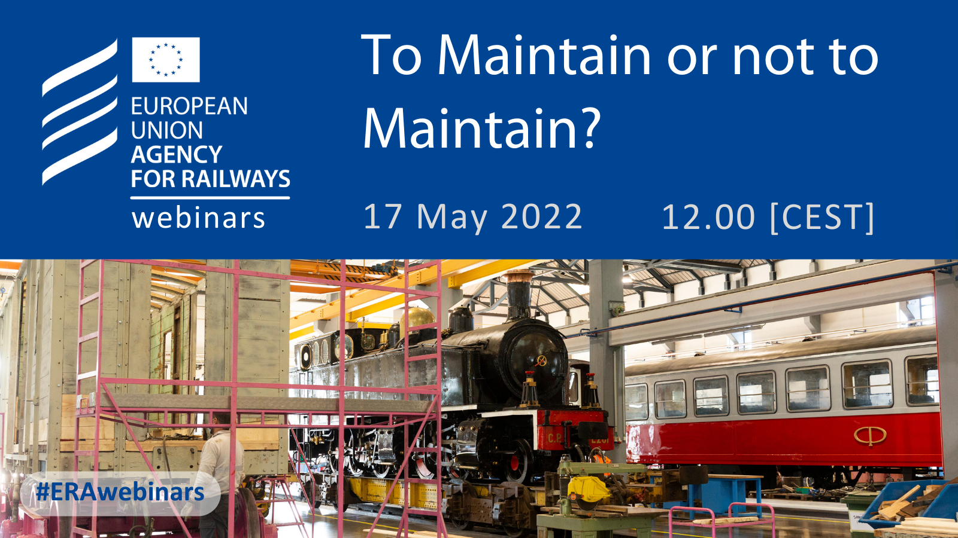
To Maintain or not to Maintain?
17 May 2022 – Free ERA Webinar

Slide 2








Speakers
Josef Doppelbauer
Nathalie Duquenne
Projet Officer
Jean-Marie Dechamps
Team Leader
Maud Allègre
ECM Manager
Geoffrey Tresontani
ECM Manager
João Januário
ECM Manager
Executive
Director

Slide 3
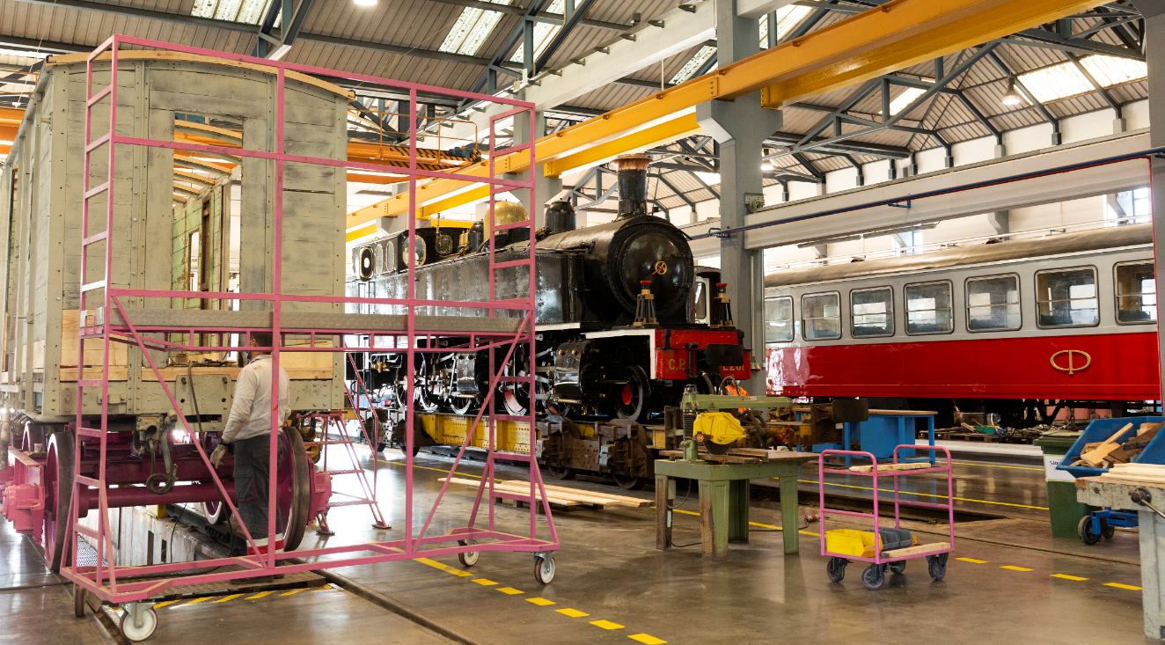
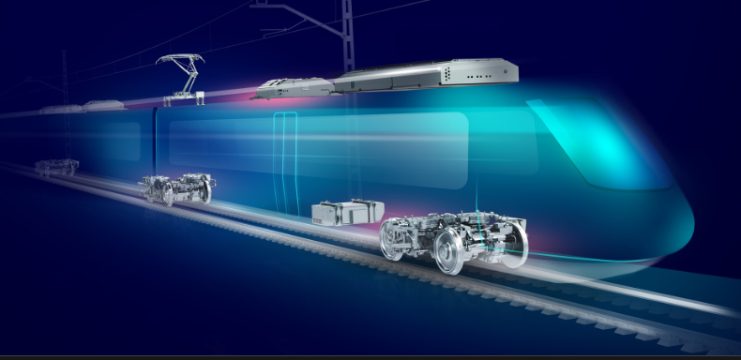
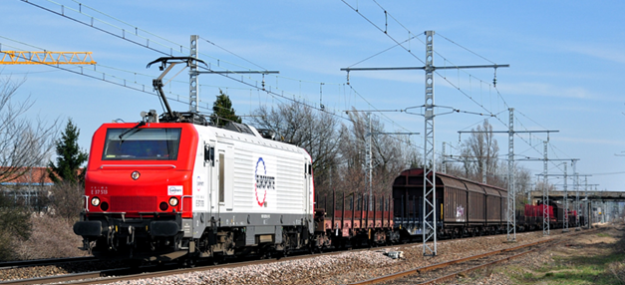
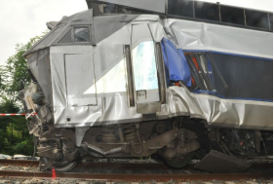
What does « maintenance » mean ?

Slide 4
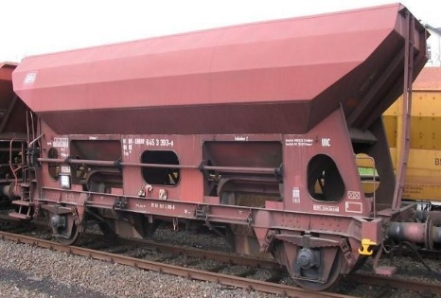
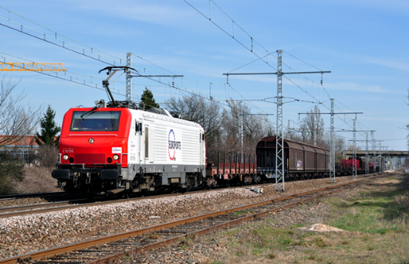
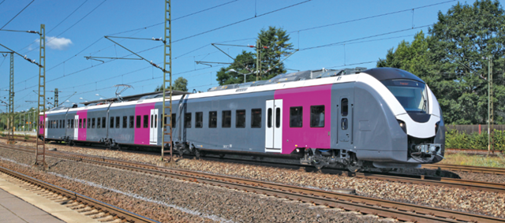
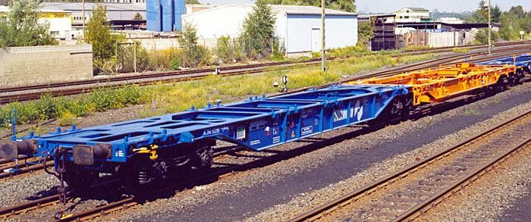
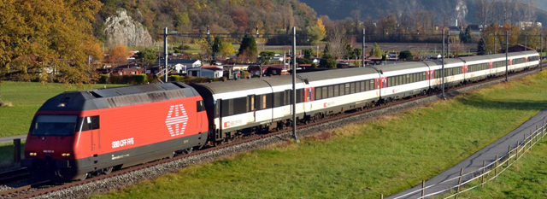
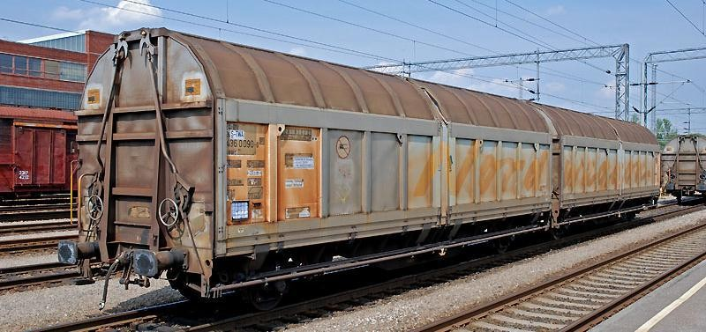
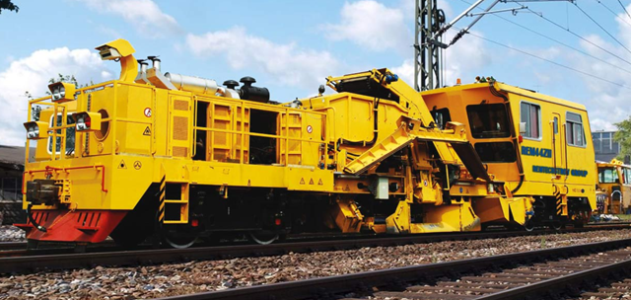
Maintenance of vehicles

Slide 5
ECM ?
ECM F3
ECM F1
ECM F2
ECM F4

Slide 6
Maintenance Management system

Slide 7
Geoffrey Tresontani
CFL Cargo

Slide 8
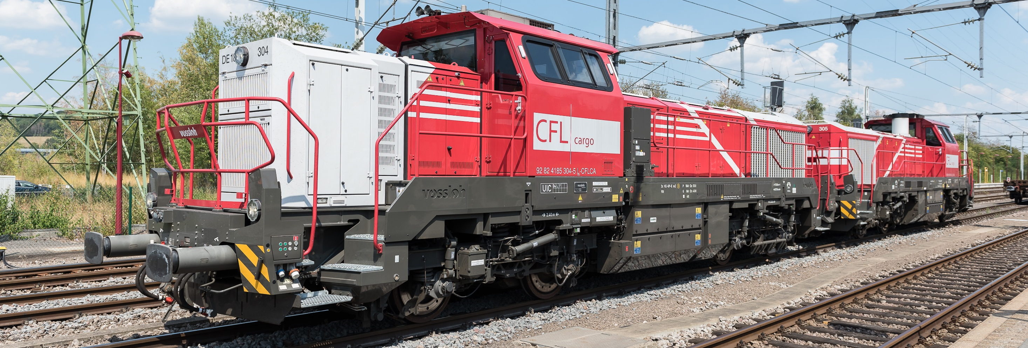
To Maintain or not to Maintain? ?
Geoffrey TRESONTANI
European Union Agency for Railway
17/05/2022

Slide 9
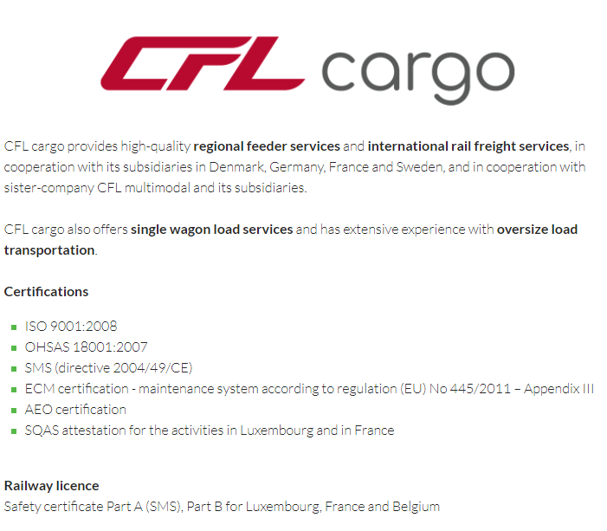
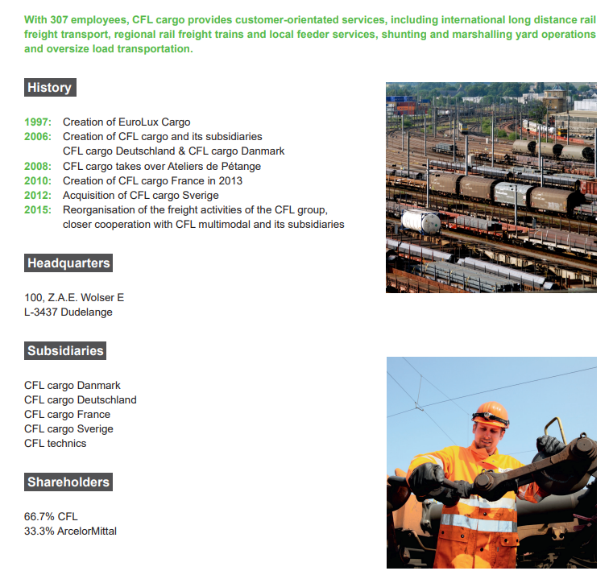
CFL cargo

Slide 10
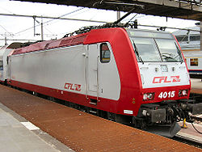
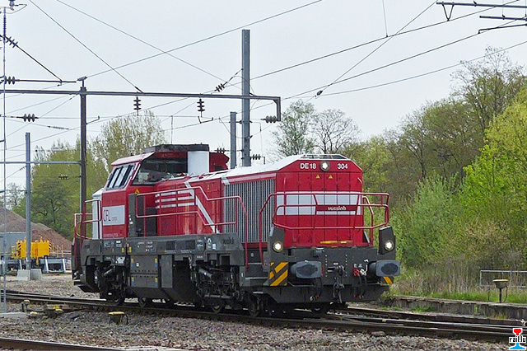




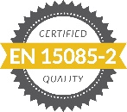




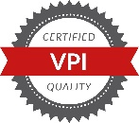
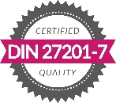
Our Rolling Stock Organisation
44 locomotives (12 Elec + 32 Diesel) + 2500 wagons
F1
F2
F3
F4

Slide 11
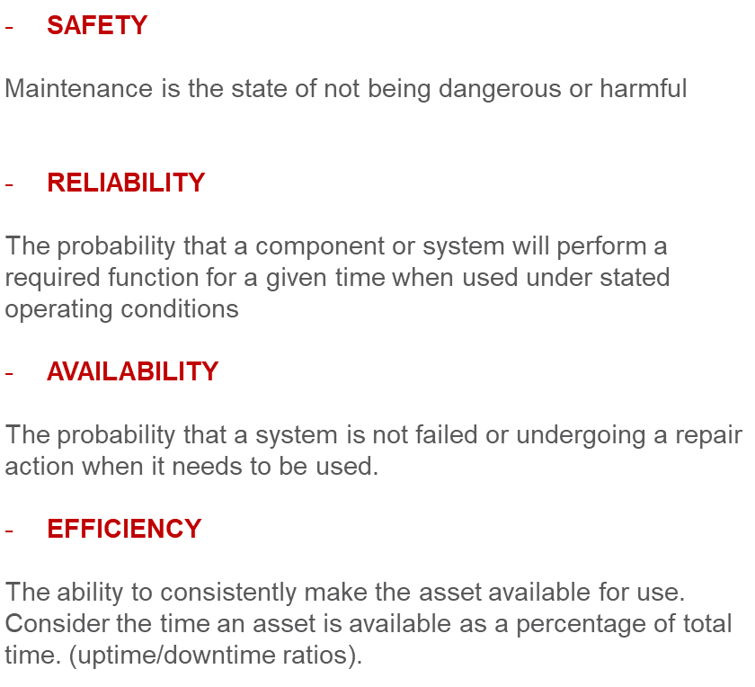


Why to make changes in a maintenance plan …
Maintenance plans evolution are engaged to improve or solve …
Maintenance main operational objectives
“MAINTENANCE PLAN”
=
RELEVANT
maintenance activities
Keep Vehicles SAFE in operations
Reduce Vehicle Operating Costs
Maintain Vehicle Value
Compliancy with Regulations
+
UNRELEVANT maintenance activities
Do not improve SAFETY or RELIABILITY
Reduce Availability of the vehicle
Waste money for nothing
Waste maintenance capacities

Slide 12
How to make changes in a maintenance plan …
Maintenance Developement (F2)
Core activities
What are the goals for Maintenance Developement (F2) ?
Understand wear factors, identify failure and damages causes
Improve technical features of wagons according real conditions of use and issues !
Define the better maintenance plan and changes to keep the vehicle in the safer state of service !
Increase fleet availability and reduce service costs !
Streamline maintenance plan to avoid wasting time or money !
Risk assesment
Information sharing
Monitoring
Return of Experience
What are the steps to follow to get a streamlined maintenance plan?
Do a status of reform’s causes (frequency of failure, root cause, ranking…)
Do a status of actual maintenance actions done (qualitative, quantitative)
Assess relevancy of maintenance actions planed vs reform’s causes
Assess relevancy of maintenance intervals vs real use of wagon
Define technical possibilities actions according to streamlining goals
Assess the risks due to changes planned
Evaluate expected cost savings
Define implementation plan : targets, actions roles and responsibilities

Slide 13
Change in Maintenance Plan : common expectations …
Review of maintenance intervals to avoid to overhaul or replace parts that still have potential of running (wheelsets, brake systems, draws, coupling …)
Relevancy of actions : do maintenance to increase safety level not just because it’s planned – condition based maintenance instead of systematic maintenance
Improve quality and resistance of parts that are often damaged or under wearing limits (wood, stanchions …)

Slide 14
Change in Maintenance Plan : main difficulties to handle …
Get relevant data about real conditions of use of wagons
Get relevant data about damages due to use and rea wearing situations
Establish PAIN/GAIN balance of change
(Initial investment)
Convice stakeholders to get required resources for deployement of change
Accept to step back if changes lead to unexpected effects
Take people out of their comfort zone
Rely on risk based maintenance instead of ruled base maintenance

Slide 15
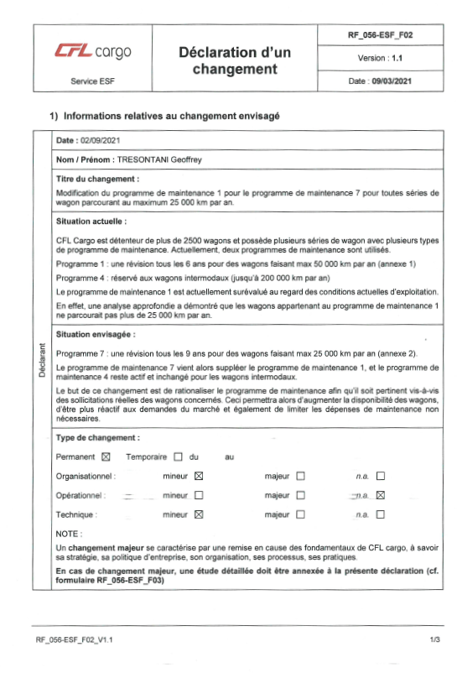
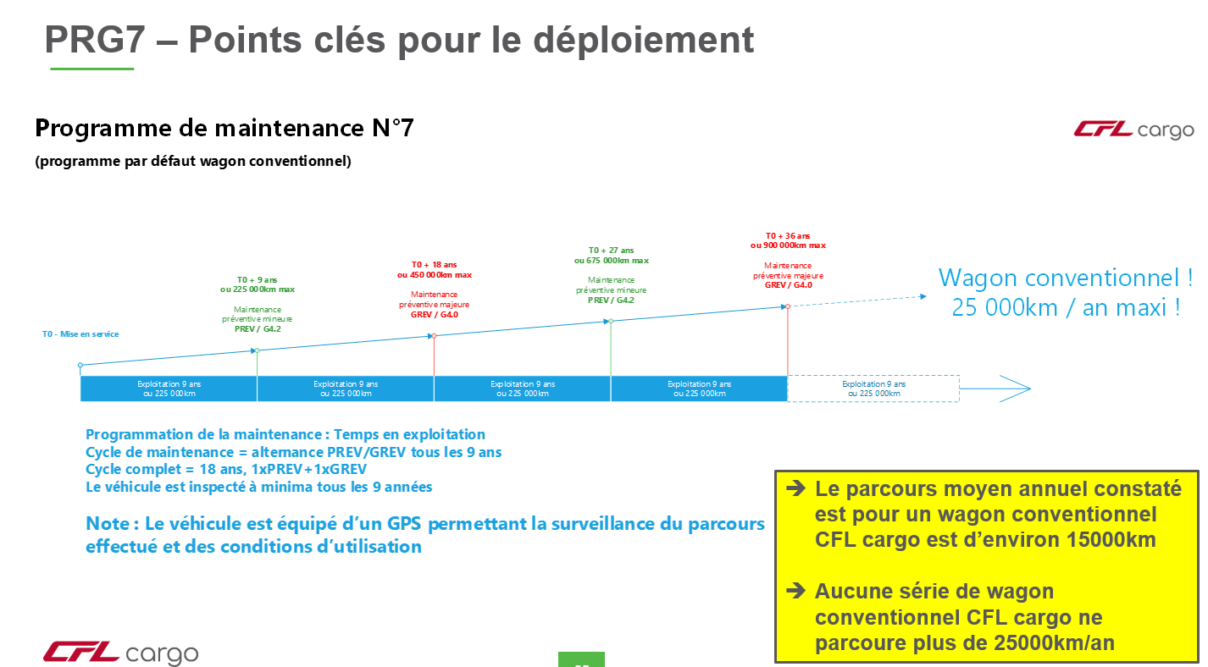
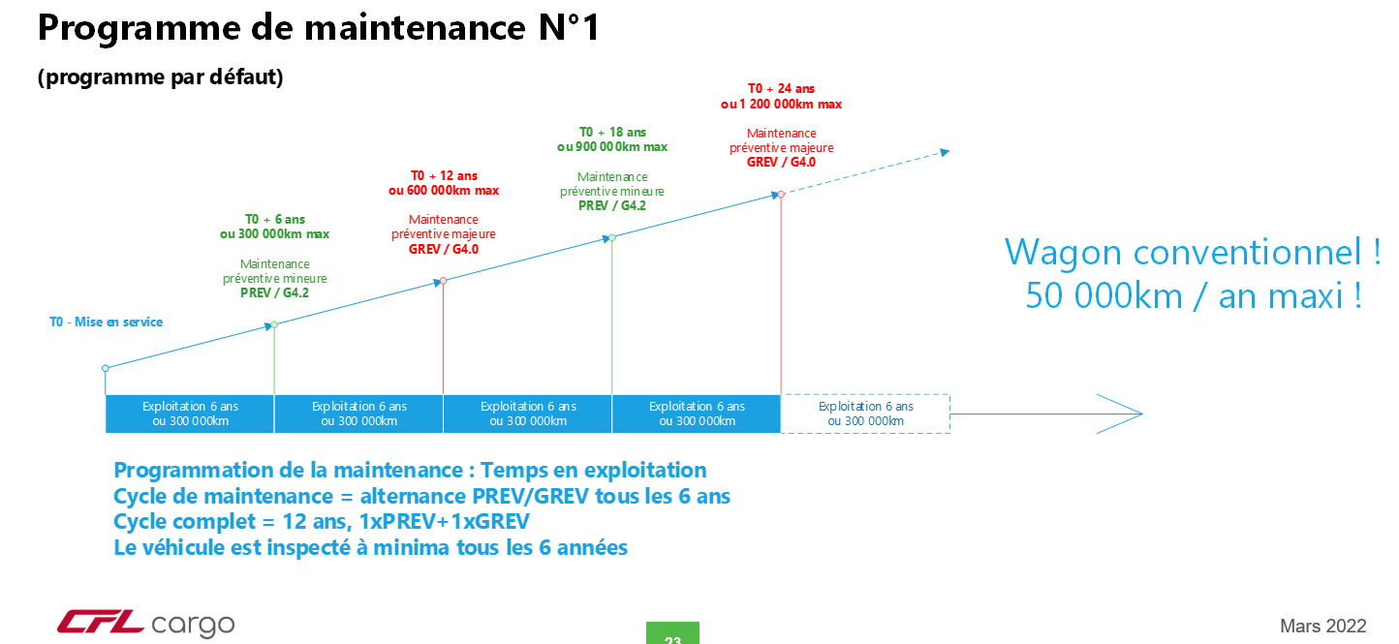
Change in Maintenance Plan : main things to think before …
Assess Risk of changes projected (best case, worst case, most likely …)
Plan how to come back to old maintenance plan in case of severe issues or unexpected effects
Define how to overview and manage vehicle maintenance planning …
Set what are the actions to do in order to keep it under control during implementation (resources, actions, budgets …)
Find how to identify the vehicles concerned by new maintenance plan
CURRENT
EXPECTED

Slide 16
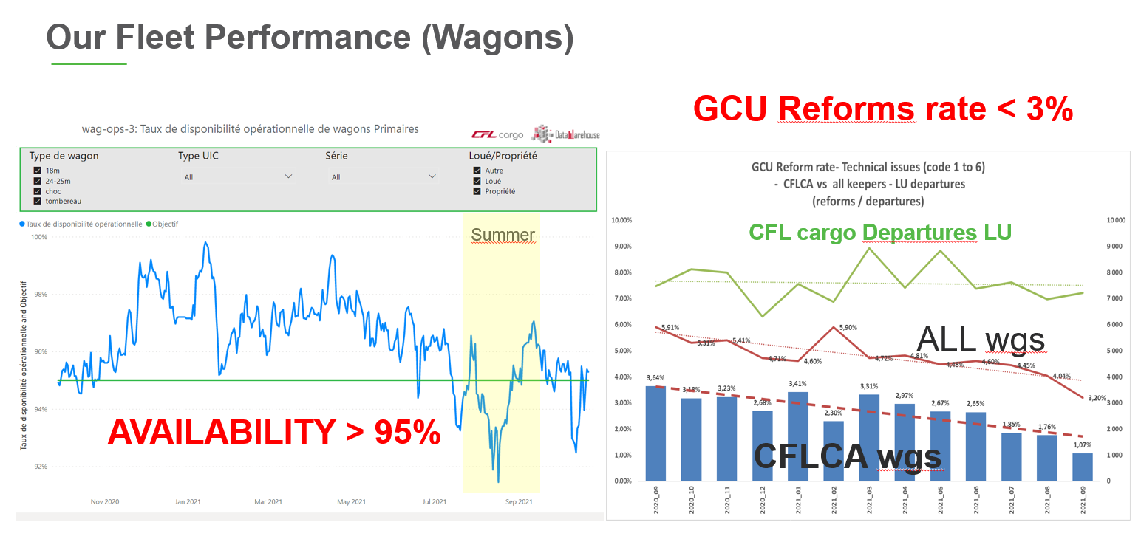
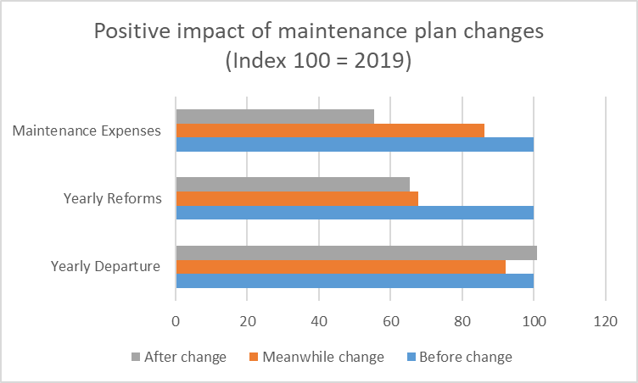
Change in Maintenance Plan : What about money … Success story
From
Ruled Based Maintenance
to
Risk Based Maintenance
Same Fleet Performance
$avings :
Maintenance expenses are reduced by 40%

Slide 17
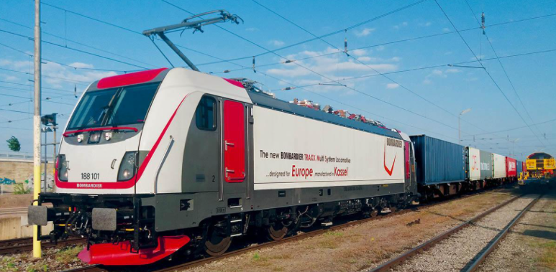
Thanks for your attention !!
Geoffrey TRESONTANI
CFL cargo
geoffrey.tresontani@cflcargo.lu

Slide 18
João Januário
CP

Slide 19
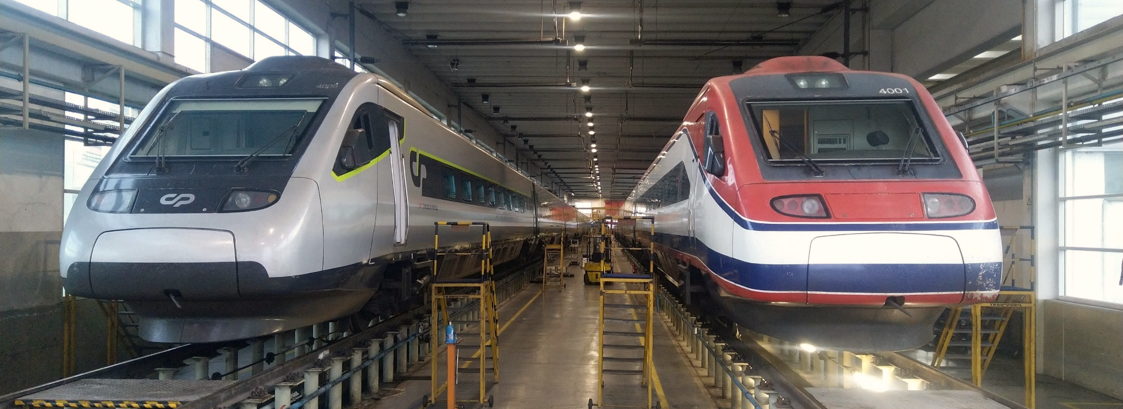


To Maintain or not to Maintain?
A journey through Reliability-Centered Maintenance on the Portuguese Pendolino Fleet
17 May 2022 – ERA Live Webinar

Slide 20
Agenda
The RCM Project - From the sketch to the key on the CPA maintenance
Operational context for implementation
RCM analysis and approval
RCM field implementation
Achievements
Online RCM - the new step forward

Slide 21
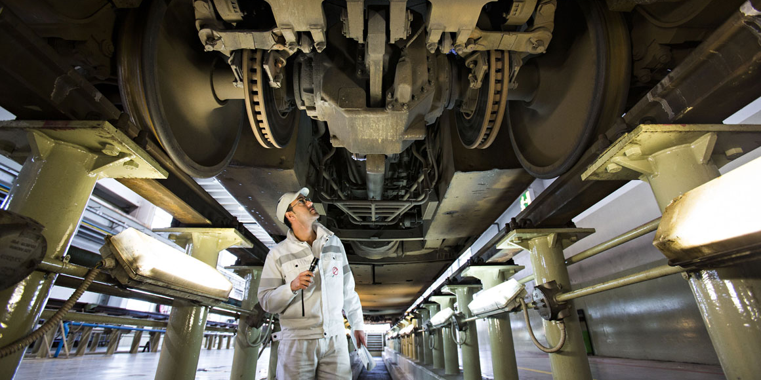
The RCM project
1 - Operational context for implementation

Slide 22


The RCM Project - Beginnings
Started in 2003, after expiring the manufacturer warranty period
Developed in close cooperation between CP (Train owner and Operator) and EMEF (ECM)
Served as a testbed for an integrated new way of thinking, organizing, executing and managing all rolling stock maintenance activities of the CP fleet

Slide 23
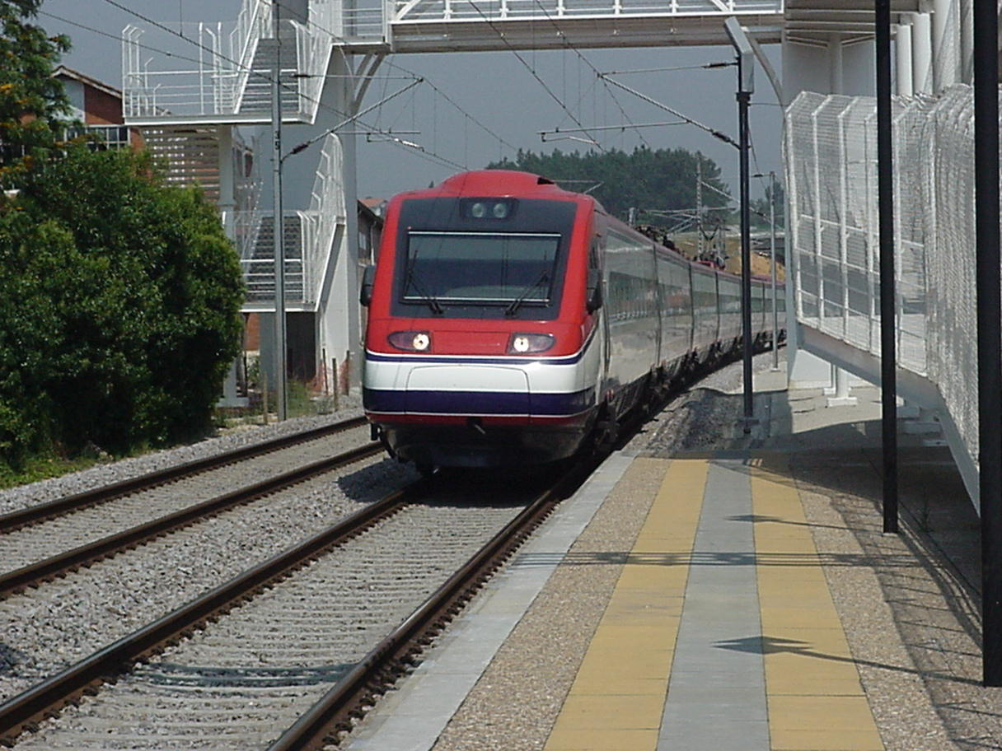
The RCM Project - Beginnings
CPA4000 – Comboios de Pendulação Ativa
10 Intercity-type 6-car EMU’s with Active Tilting Technology
Started operation in 1998
Length of 160m
Top speed of 220 km/h
Consortium built (Fiat/Alstom, Siemens, AdTranz)
Distributed traction
High equipment density
Non-conventional due to complexity

Slide 24
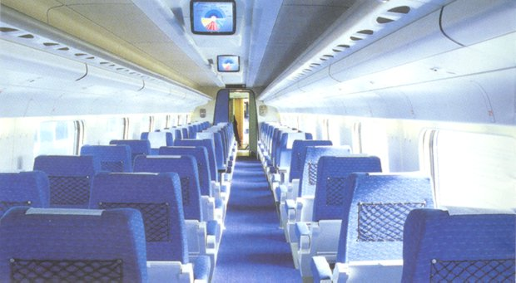
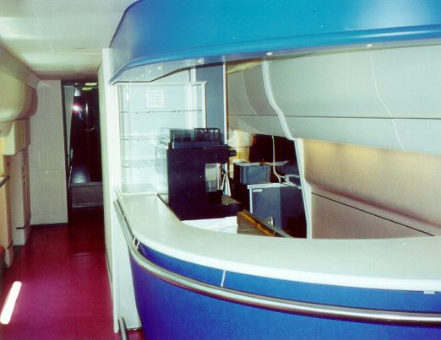
Passenger Confort
Active tilting system with active lateral suspension
Air Conditioning
WC with vacuum toilets and warm water supply
Bar/Bistro with cooled compartments, ovens and coffee machine
Reading lights with steward/stewardess call system
Electric curtains
Passenger information system (speed, weather, train stops)
Passenger entertainment system (on-board TV, individual audio modules and WIFI)
230V individual power outlets
…

Slide 25
The RCM Project - Beginnings
As of 2003:
Traditional Maintenance Approach
Manufacturers are integrators of systems from different sources!
Standard Manufacturer Maintenance Plans
Light Maintenance Activities + Periodic System Overhauls

Slide 26
The RCM Project - Beginnings
Traditional Maintenance Approach:
Compilation of generic sub-supplier plans
Doesn’t take account the train configuration (external doors)
Independent of operating context
Unaware of failure consequences
Costly
Ineffective

Slide 27
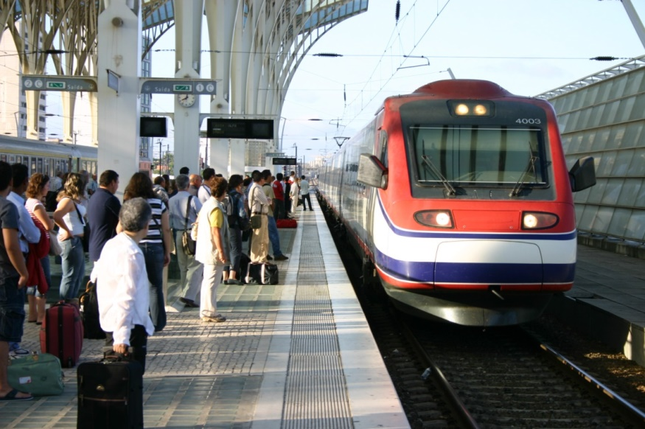
The RCM Project - Beginnings
As of 2003:
From the train operator point of view:
Low availability
Poor reliability
Constant service disruptions (delays)
Suppressions
Poor commercial performance

Slide 28
The RCM Project - Beginnings
As of 2003, what the experience said?
This Traditional Maintenance Approach was not adapted to our operational context:
  Complex trains in a small and inflexible fleet, with high service performance demands
The workshop dealt mostly with:
  Random failure modes with infant mortality
  Intrusive maintenance problems
Conditional
probability
of failure
Conditional
probability
of failure
Conditional
probability
of failure
Time
Time
Time
Random failure
Random failure with infant mortality
Intrusive maintenance

Slide 29
The RCM project
2 – RCM Analysis and Approval – A new “Whole System Approach”
Seeking consequence mitigation rather than failure avoidance

Slide 30
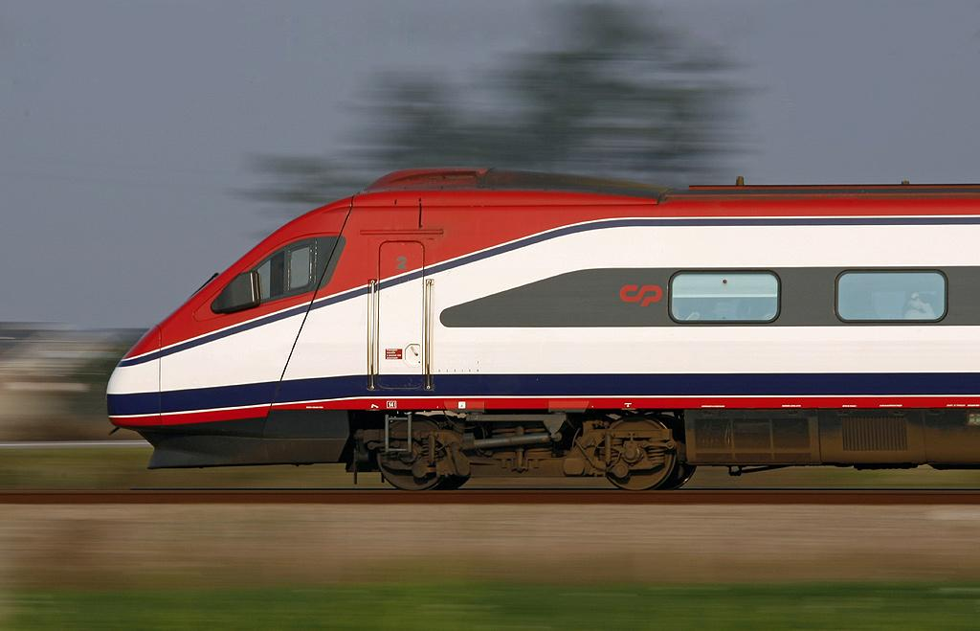
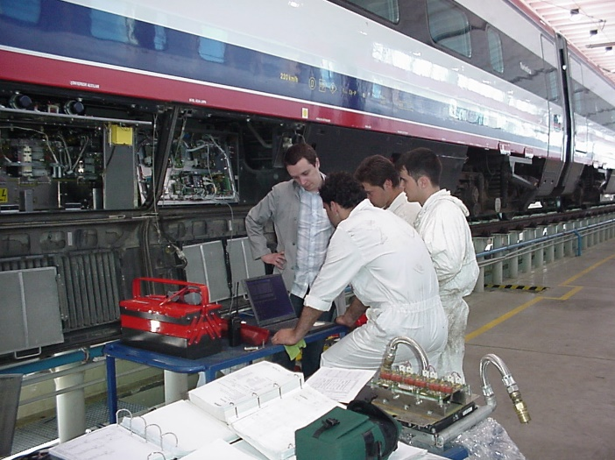
The RCM Project – Analysis and approval
The challenge:
Increase availability
Create and environment of safety and reliability
Increase fleet annual mileage
Reduce life cycle costs
Update EMEF maintenance business for newer and more complex trains
Improve competitiveness of CP as an operator and EMEF as a maintenance provider (ECM)

Slide 31
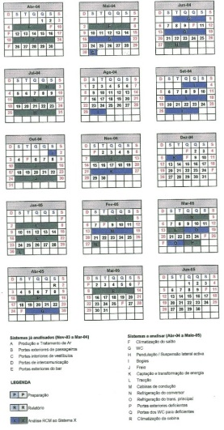
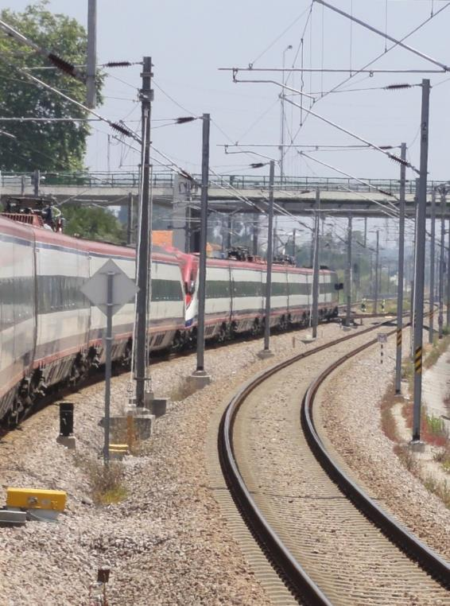
The RCM Project – Analysis and approval
Project preparation:
RCM methodology training course (3 day course to everyone at the workshop)
RCM facilitators training
Definition of systems to be studied
Schedule arrangement
Air production
External doors
Gangway doors
Vestibule doors
HVAC
Tilting System
Bogie
Brake system
High voltage system
Driving cabin air conditioning
WC
Traction

Slide 32
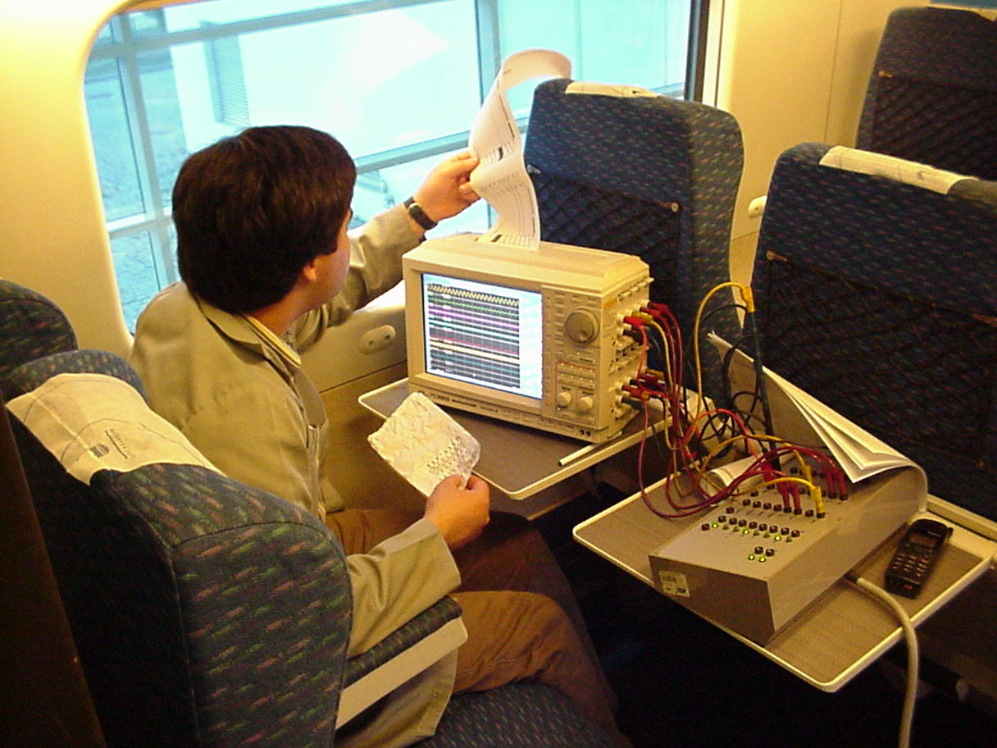
The RCM Project – Analysis and approval
RCM Analysis:
Selection review groups
Collection of relevant documentation (manuals, statistical data, technical data…)
Definition of system boundaries and operating context
FMEA - Failure Modes and Effects Analysis
  Application of the RCM decision diagram
  Definition of appropriate maintenance tasks
Preparation of the final analysis report
Final audit (management commitment)

Slide 33
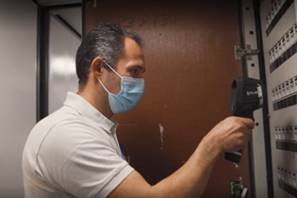
The RCM Project – Analysis and approval
As result:
70% of the maintenance tasks were new or changed
A new maintenance cycle was sketched
A new quality plan was sketched
Safety and work procedures were improved
Some numbers from the analysis:
Failure modes without maintenance – 49%
  Corrective maintenance when a failure occurs
Failure modes with maintenance – 47%
  Hidden failure finding tasks – 23%
  On-condition tasks (CBM) – 56%
  Scheduled overhaul – 12%
  Scheduled discard – 6%
  Task combination – 2%
Redesigns – 4%

Slide 34
The RCM project
3 – RCM Field Implementation

Slide 35
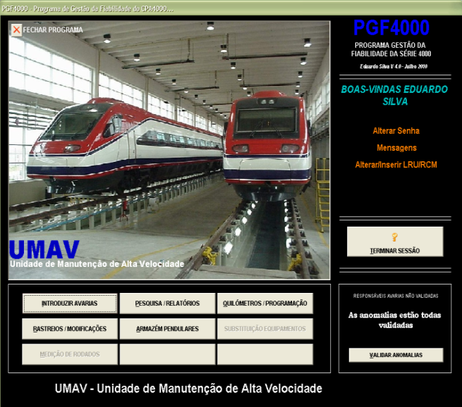
The RCM Project – Field Implementation
Changes on the management and work procedures:
Introduction of LRUs (Line Replaceable Units) on the maintenance management
Preparation of new maintenance documentation (Work orders, …)
Implementation of new maintenance plans approved by the regulator
Introduction of “Wait And See” approach and “Life Exploration Programs”
Introduction of new policies for spare parts repairing and overhauling
Design of a new RCM-oriented maintenance information system, in-house – PGF4000
Implementation of feedback improving process
LRU structured
Feeded with reliable data
Provides on-time fleet status overview
Helps managing the P-F curve and CBM tasks

Slide 36



The RCM Project – Field Implementation
Phase I
Phase II
Phase III
Management of WAS (Wait and See) and LEP (Life Exploration Program)
Analysis
Implementation
RCM analyses validation by practice
- Failure modes
- Consequences of the failure modes
- Maintenance tasks
- Maintenance periodicities
RCM analyses improvement
RCM
Analysis
Redesign
Program
New maintenance procedures
New policy to spare part repair/overhaul
RCM analysis Output
RCM Training
New RCM oriented Maintenance Management Software
Maintenance needs
New Maintenance Cycle RCM Based
Project Roadmap
Operating Teams RCM training
New LRU/SRU
definition
Feedback
Validates by practice
Updates with new failure mode consequences
Facilities, Tools and LRU/SRU
Reworking

Slide 37
The RCM project
4 – Achievements

Slide 38
The RCM Project - Achievements
CPA4000 – Comboios de Pendulação Ativa
Reliability: occurrences* decreased 50%
Availability: increase 20%
LCC: system lifespan extension
*Occurrence – Delay of more than 10 minutes caused by train faults
Average availability
Occurrences per million km

Slide 39

The RCM Project - Achievements
Our experience:
It is more effective to seek consequence mitigation than to seek failure avoidance
Corrective maintenance is the most effective action for about half of the failure modes
80% of all maintenance tasks are condition based or hidden failure finding tasks
Successfully eliminated trainset “strip downs” until mid-life refurbishment (after 20 years of service)

Slide 40
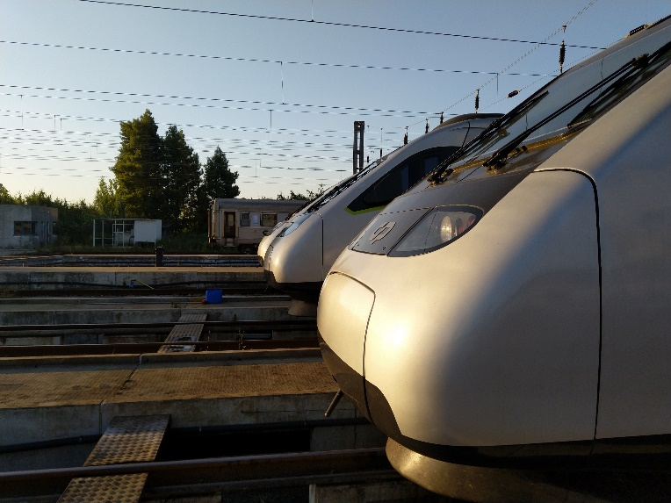

The RCM Project - Achievements
Combined benefits:
RCM does work and provides important service and business improvements:
Operation – Increased reliability, decrease downtime and increase availability
Cost – Reduced costs with optimized maintenance
Risk – Reduced probability of failures with safety and environmental consequences
People – Positive culture shift. Increased culture of reliability, proactive thinking, cooperation and knowledge of the system
Documentation – Provides a new robust maintenance design justification file. Maintenance decisions are justified, recorded, traceable and auditable, preserving valuable corporate knowledge
Optimized list of spare parts – Improved inventory management
Drives subsequent updates based on experience

Slide 41
The RCM Project - Achievements
Start of mid-life intervention
Annual Km
Max. 9 trainsets from 2017 on

Slide 42
The RCM Project - Achievements
Availability
Railway crossing collision with truck
Start of mid-life intervention
Railway crossing collision and Soure accident
End of mid-life intervention

Slide 43
The RCM Project - Achievements
Reliability – Occurrences* per million km
2 major accidents with immobilization
End of mid-life intervention
*Occurrence – Delay of more than 10 minutes caused by train faults

Slide 44
The RCM Project - Achievements
Life cycle costs:
Air Production Units: 1.2Mkm → Condition based and overhaul @1.8MKm
Bogies: 1.2Mkm → 3MKm (Life Exploration Program)
External doors: 1.2Mkm → No overhaul
Passenger HVAC: 1.2Mkm → No overhaul
Turbofans: 0.6Mkm → Condition based and overhaul @4MKm
Hydraulic Tilting: 0.6Mkm → Condition based and overhaul @1.2MKm
Pneumatic System and Braking: 1.8Mkm → Mainly CBM
High Voltage System: 1.8Mkm → Mainly CBM
Traction motors: 1.8Mkm → 5.5Mkm (Life Exploration Program)
Cardan shafts: 1.2Mkm → Balance every 0.6MKm and discard @3.6Mkm

Slide 45
The RCM project
5 – Online RCM – The next step forward

Slide 46
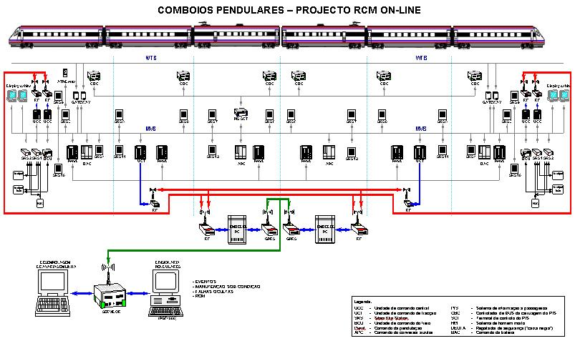
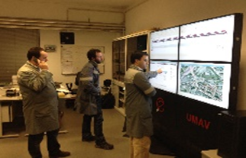
The RCM Project – Online RCM
Online RCM:
Defined in 2009 as key project
Driven by the RCM maintenance strategy, helps feeding data to the process
Redesigns the train diagnostic system
Enables online hidden failure finding tasks
  Cabling and accelerometers
Enables online condition-based tasks
  Track monitorization
  Helps planning wheel reprofiling
Enables faster remote troubleshooting

Slide 47
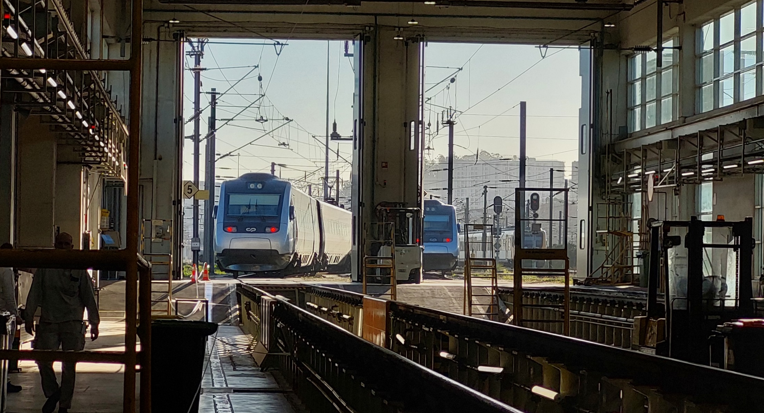
Thank you!!

Slide 48
Maud Allègre
SNCF Fret

Slide 49
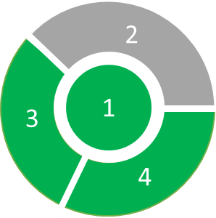



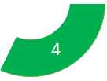
Fret SNCF Maintain is own VEHICULES
1
Owner / Keeper / ECM
261 Electric traction units
13
types of vehicles
395 Thermal traction units
12 passenger coaches
We supervise and coordinate the maintenance functions.
We manage the vehicle’s removal for maintenance and its return to operation.
We subcontract maintenance file updating throughout vehicle's lifecycle.
We realize the required technical maintenance including the release to service documentation

Slide 50

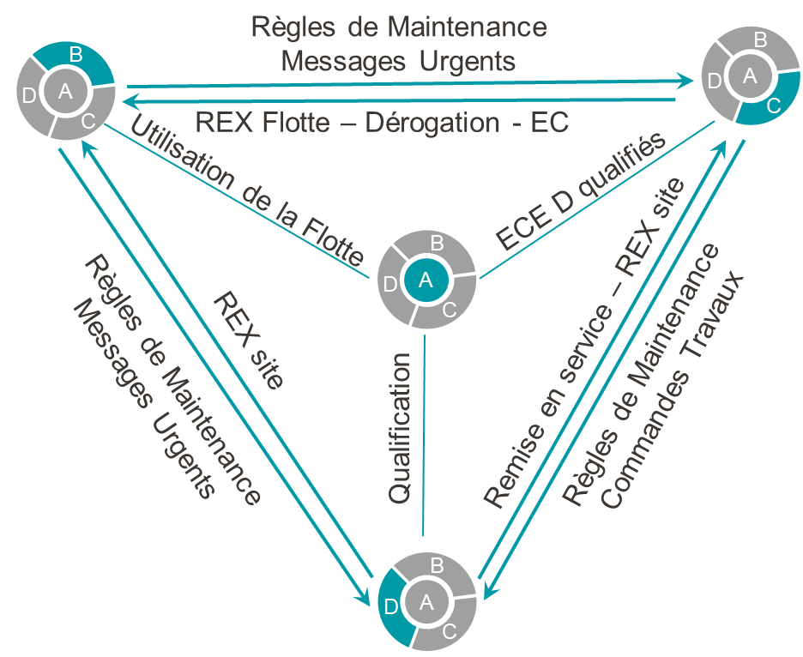
Interactions between ECM’s function
2
Maintenance Life Cycle
Maintenance interactions
Maintenance file updated throughout the lifecycle of a vehicle
End-of-life management
Authorized Types of Vehicles
Initial maintenance files
Synthetic Maintenance Plan
Urgent information
2
2
4
1
4
1
3
Feedback & urgent information
3
2
4
1
3
Feedback & urgent information
Work instruction
urgent information
2
4
1
3

Slide 51
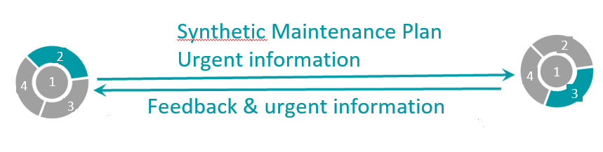





Interactions between ECM’s function
2
2 → 3
Updates maintenance file :
Plan of maintenance
Logistic management
Maintenance due date
Level and type of maintenance
Work instruction
Emergency measure
Evolution of the maintenance plan
Regulatory improvement
Modification of vehicle
Maintenance file improvement
Spare parts / Material
Skills / Equipment & Tools
Operation incident
Regulatory recommendation (SAIT)
Anomalies detection during maintenance execution
3 → 2
Maintenance strategy :
Feedback regarding operation
Emergency informations on safety-related issues identified during operating conditions
Feedback regarding performance
Restrictions of use or specific operating conditions
Articulation of maintenance level due to operation constraint

Slide 52
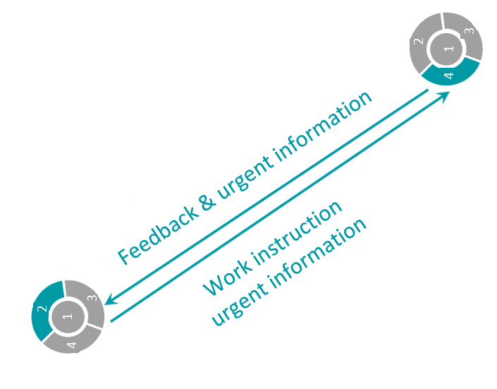








Interactions between ECM’s function
2
2 → 4
4 → 2
Logistic management
Work instruction
Skills / Equipment & Tools
Spare parts / Material
Emergency information
Evolution of the maintenance plan
Regulatory improvement
Modification of vehicle
Maintenance file improvement
Operation incident
Anomalies detection during maintenance execution by another workshop
Regulatory recommendation (SAIT)
Maintenance delivery and traceability of executed work
Configuration applied
Communication about failures and anomalies noticed during the maintenance work execution
Proposal of deviation
Proposal of evolutions on work instruction

Slide 53

Give us your feedback

Slide 54



Upcoming Free Webinar
16 June, 12h00-13h00 (Paris Time, CET - UTC+2)
Human and Organisational Factors:
From Busting Myths to Practical Tools
Give us your feedback

