Slide 1
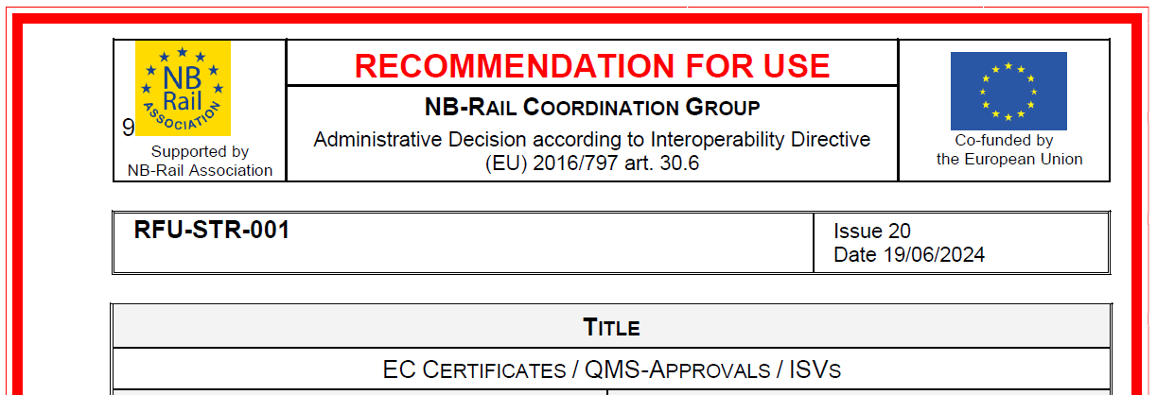
Digital Certificates at Notified Bodies
Rail Data Forum 2025
Cluj-Napoca, Romania
12 June 2025
Emilio Cosciotti (Vice-Chairman NB-RAIL Association)

Slide 2
Digital Certificates at Notified Bodies
ERADIS+ is under definition by ERA with the scope to make machine readable the information of the NoBo’s Certification Level Documents, making them available for applications/processes using CLDs.
ERA is developing knowledge graphs with open SPARQL-endpoints (allowing users to read without any proprietary tools).
NB Rail is participating to some workshops with ERA and contributing to share which are the results of the NoBo’s assessment that can be made available, considering the NoBo responsibilities provided by the Legal Framework.
This presentation describes the proposed solutions.

Slide 3
NB Rail proposal
Considering:
current data flow between Applicants and NoBos in the context of SSs and ICs certifications
that ERA trusts the work of NoBos and would like to make their results available for other types of authorizations as well
that digitalisation needs to optimize the data entry avoiding multiple entries and make data entered by the responsible entity available for the other involved entities.
NB Rail proposes the following flowchart called Object of Assessment definition because this is the pivot aspect that can streamline all the data flow.

Slide 4
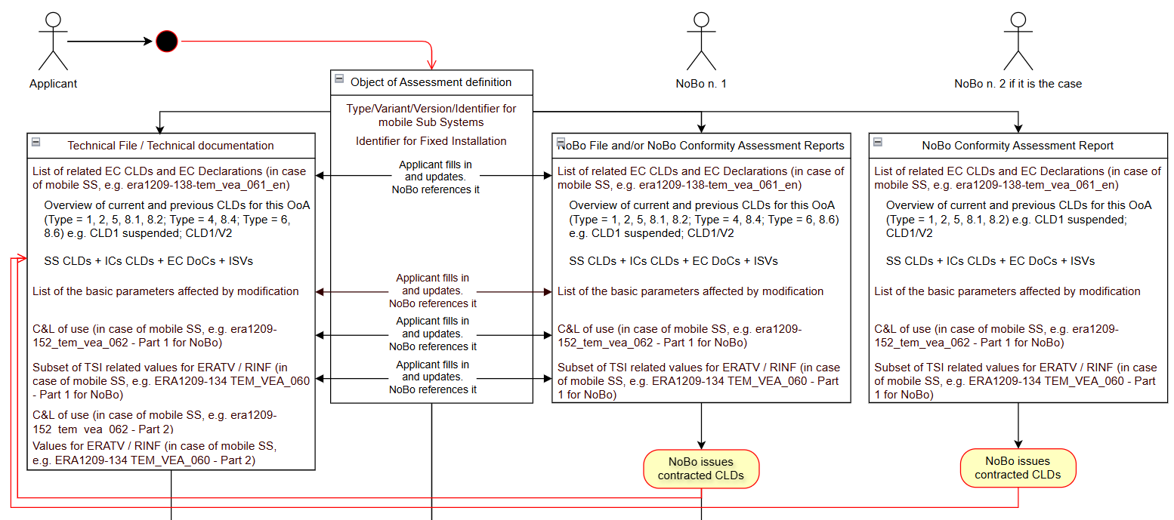
Object of Assessment definition overview

Slide 5
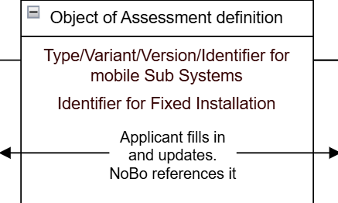
Object of Assessment definition 1/3

Slide 6
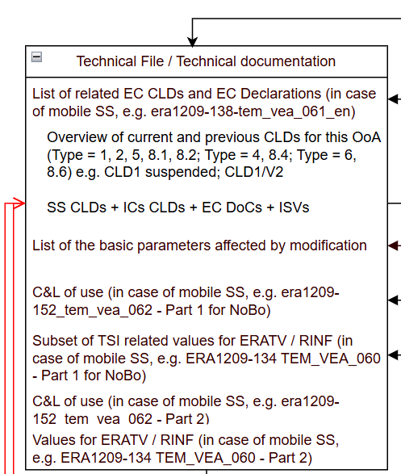
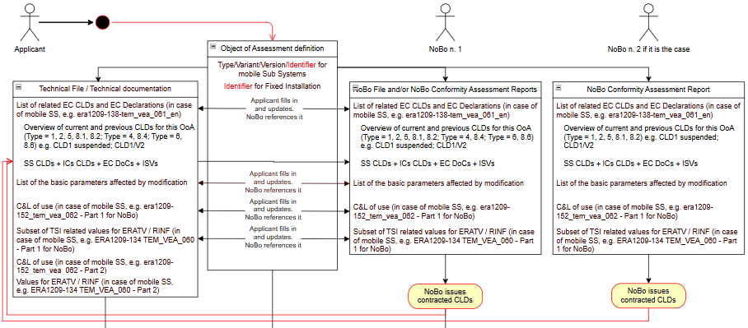
Object of Assessment definition 2/3

Slide 7
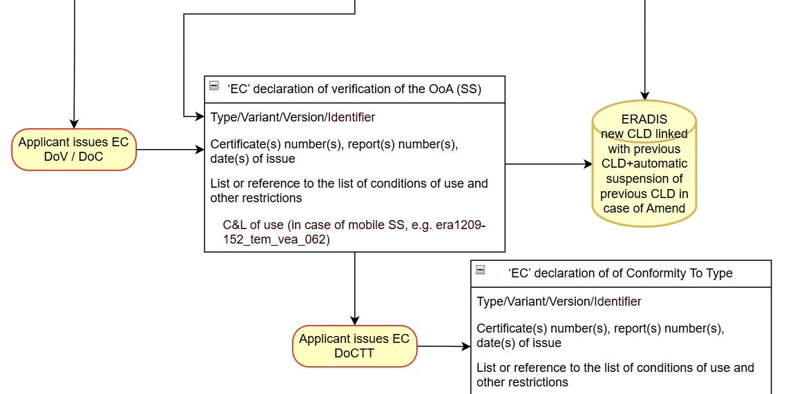
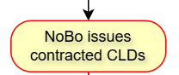
Object of Assessment definition 3/3
All the information provided by
Reg. 250/2019
All the information provided by
Reg. 250/2019

Slide 8
CLD state diagram and Use Cases 1/3

Slide 9
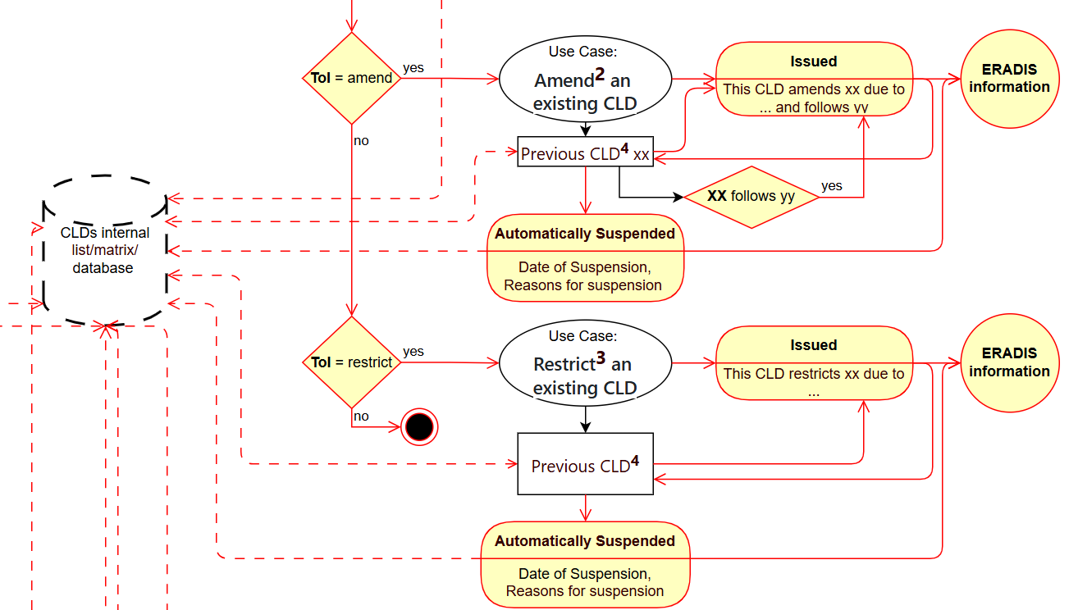
CLD state diagram and Use Cases 2/3

Slide 10
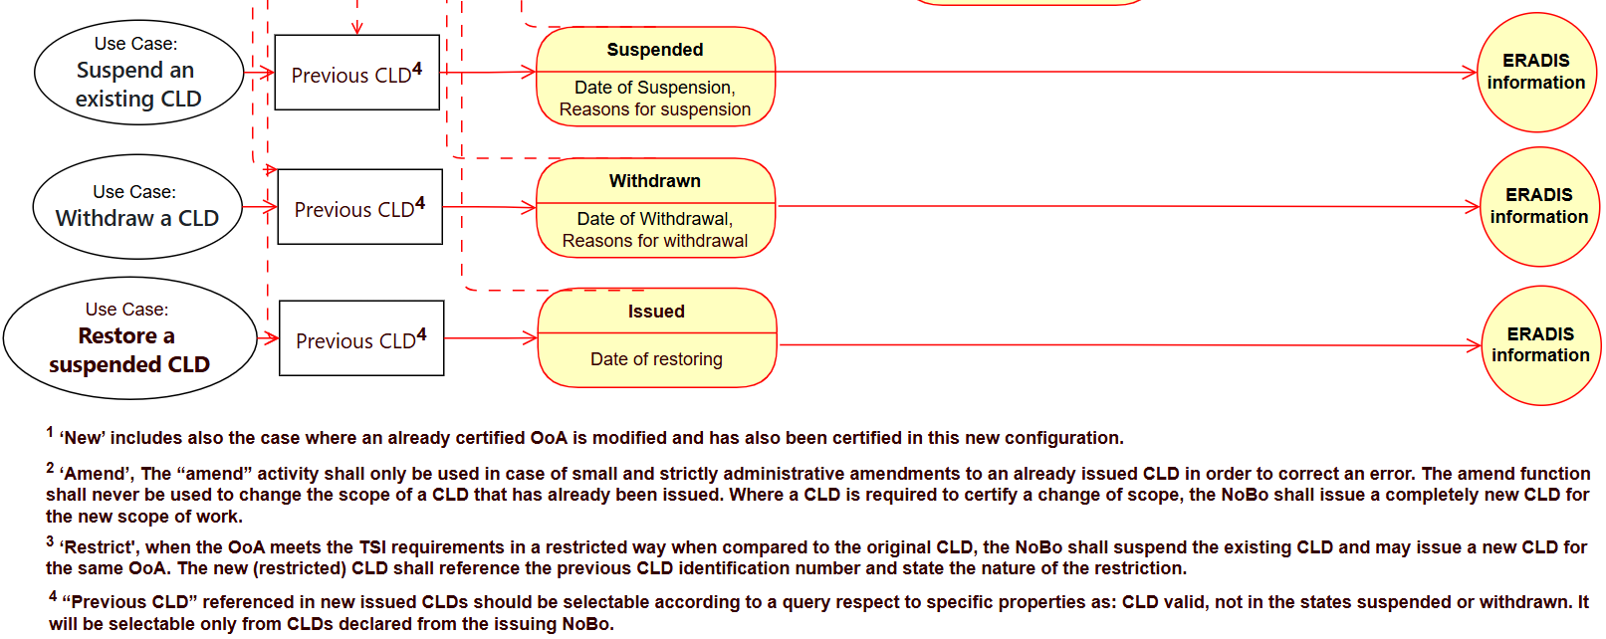
CLD state diagram and Use Cases 3/3

Slide 11
Summary 1/2
NB-RAIL proposes
An Object of Assessment definition that for Mobile SSs shall include a complete definition of the Type/Variant/Version/Identifier by specifying all the sub elements: T/V/V/C
Making available to NoBos the relevant parts of the same documents/templates, or linked data, the Applicant has to submit later to Authorizing Authorities, in order to facilitate their consistency checks
Selecting/Identifying the information related to NoBo’s Assessment from the ERA templates for:
C&L of use (e.g. era1209-152_tem_vea_062 – Part 1 for NoBo for VA)
ERATV / RINF (e.g. ERA1209-134 TEM_VEA_060 - Part 1 for NoBo for VA)
Same approach for FIs, Mobile SSs, their ICs and SSs recommending in the long-term 2 separated diagrams/data models, 1 for ICs and 1 for SSs

Slide 12
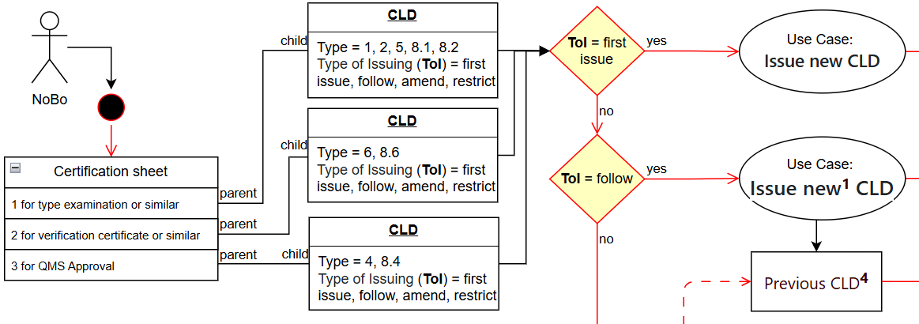
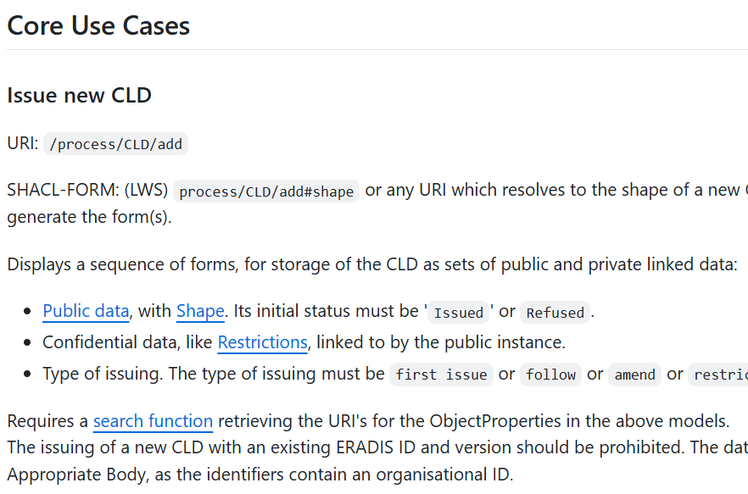
Summary 2/2
NB-RAIL proposes
CLDs state diagram providing the flow of information to be provided in the ERADIS+ and the relationships/links between new issued CLDs and the previous CLDs in case the NoBo has to amend, follow, restric, suspend, withdraw, restore previous CLDs
A revised description of the possible Use Cases a NoBo could face and should be available in the new ERADIS

Slide 13
Homepage: www.nb-rail.eu
E-Mail: chairman@nb-rail.eu or emilio.cosciotti@nb-rail.eu
Tel: +39 346 256 7056
Address: Rue Joseph Stevens 7, 1000 Brussel, Belgium

