Slide 1

NSA BE challenges for ETCS-only operations
ERA ERTMS 2026 Conference , 22nd April 2026
Depuydt Julien| info@nsarail.fgov.be

Slide 2
Biggest NSA challenge:
2011
Masterplans to reach ETCS-only operations approved
2015
Full corridor from Antwerp to Luxembourg border operational in ETCS
12th December 2016
Start of decommissioning of old class B system
Forced transition for all RU to move to ETCS (or TBL1+ in specific cases)
5th July 2018
Legally binding migration path ending all main line class B operations > 2027 (except HSL1)
Let’s keep it on track! (with < 8 FTE)

Slide 3
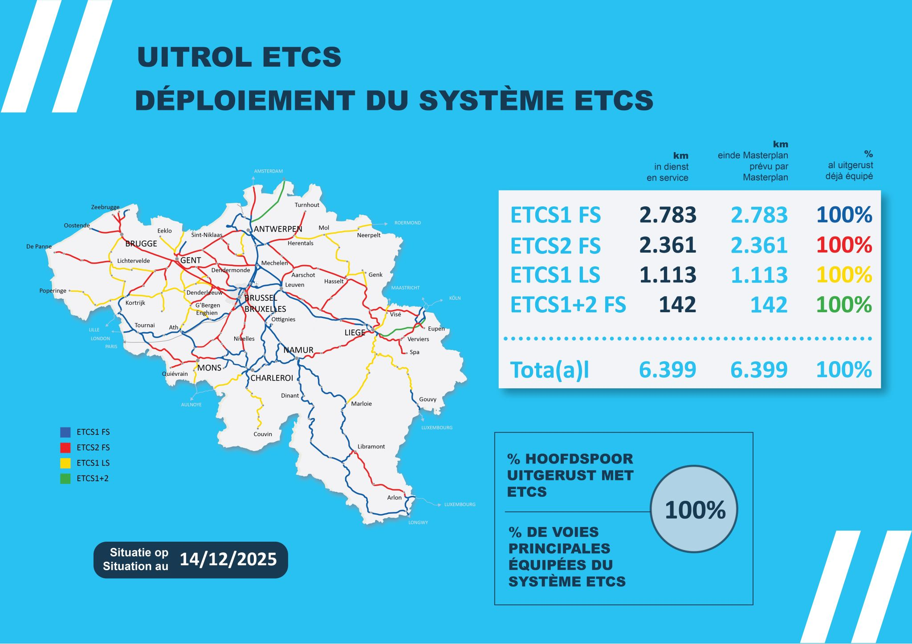
Today in Belgium

Slide 4


Belgium: 5 shades of ETCS trackside
ETCS 1 FS
SV1.1
Conventional Network
2012 -- 2025
ETCS 2 FS
SV 1.1
Conventional Network
2018 -- 2025
ETCS 1 LS
SV 2.0
Conventional Network
2020 - 2025
ETCS 2/1 FS
SV 1.0
High Speed Lines L3, L4
<2016
ETCS 1 FS
SV 1.1
High Speed Line L2
2017

Slide 5
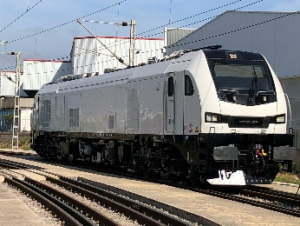
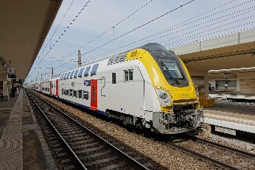
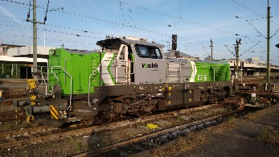
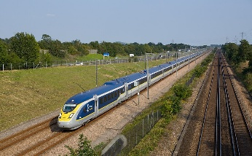
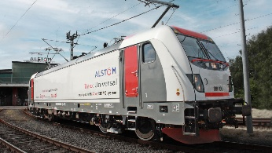
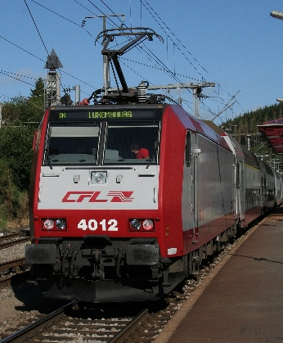
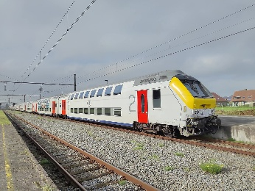
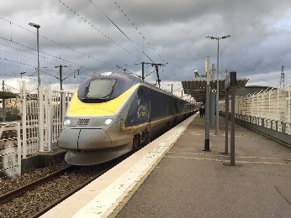
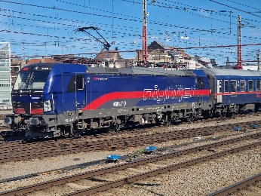
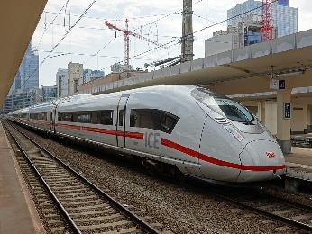
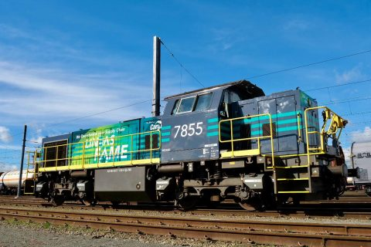
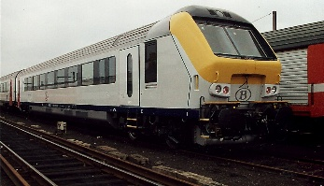
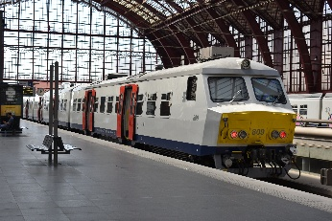
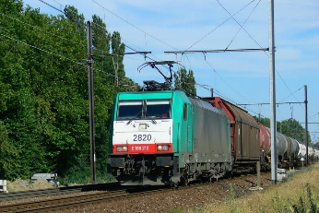
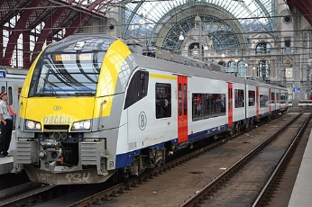
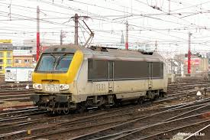
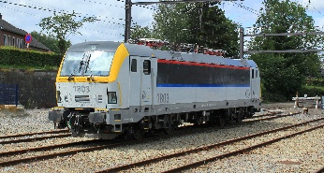
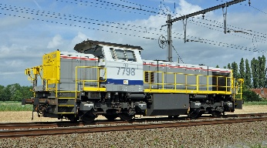

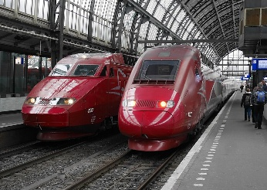
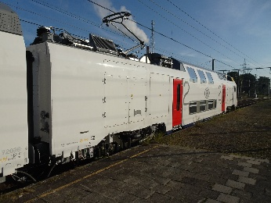
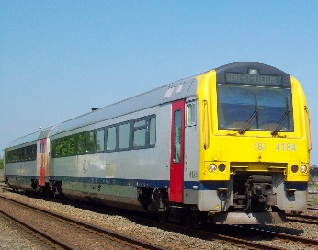
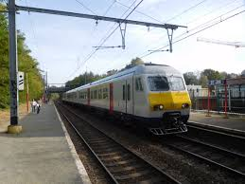
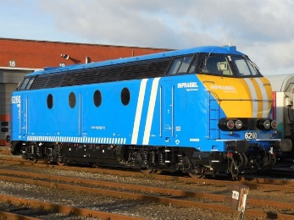
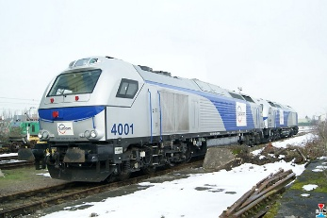
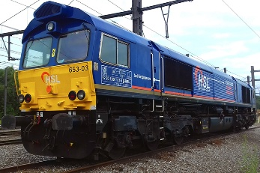
RS in Belgium with ETCS
> 150 type authorisations delivered

Slide 6
No time to waste – 100% availability upon request
Lean forecasting
Sector welcome to share its projects / wishes / challenges long before application
Create flux
Continuous exchanges with the future applicants during design and certification
Pull value
Target breakdowns from easy to complex situations
Remark: NSA BE is not bound to any planning / contract / budget
Let’s keep it on track! (with < 8 FTE)

Slide 7
No time to waste – « no surprises » policy
Infrastructure
Generic design approval
Mandatory APIS when significant change(s) according to CSM
Continuous exchanges with the IM
Operational instructions defined
Alignment of operational instructions with ETCS migration
APIS
Almost 0 (zero) disruption for the transition LSS to LSS+ETCS
Almost invisible from an external point of view
Let’s keep it on track! (with < 8 FTE)

Slide 8
No time to waste – « no surprises » policy
Rolling Stock
3RP: Mandatory APIS for significant/safety related change(s)
4RP: Need for APOM defined by the sector
Continuous exchanges with the future applicant upon request (“Comité de Mise en Service”) long before application (too late to discuss when in OSS)
Promotion of smart strategy for testing as allowed by the regulatory framework
APIS/APOM
3RP APIS often limited in time to allow integration of coordinated changes between infra and RS
APIS linked to the real operations with extensive helpful CfU
4RP APOM “who can do more can do less”, APOM linked to the specifications, no CfU
(shift to the sector)
Let’s keep it on track! (with < 8 FTE)

Slide 9
Appetizers and first bites
NSA BE support for introduction of:
OSS application for type authorisation
OSS application for C2T
EVR application
Let’s keep it on track! (together)

Slide 10
Thank you!

