Slide 1



ERA ERTMS CONFERECENCE, Workshop #5
How can the deployment of ERTMS for Trackside and On-board be accelerated?
Christoph Gralla, Scheidt & Bachmann
Jaime Pereira, Adif
Victoria Campos, UNIFE
Vladimír Kampík, AZD

Slide 2





Agenda:
1h30
20 min
Introduction
10 min
Questions to be tackled
Division of the group into subgroups
45 min
Contribution of the attendees
(30mins brainstorming, 15 mins for groups result presentation)
15 min
Conclusions

Slide 3


Situation today
Starting with the Idea of ERTMS for more than 20 years now we are in the following situation:
There is ETCS technically available.
Each of the European Countries has a European deployment plan for ERTMS.
There is a commitment of the Countries to deploy ERTMS:
  to overcome the national class B Systems
  to harmonize the operational rules
  to gain the capacitive and performance effects out of ERTMS
  to use all the issues for a digital railway

Slide 4
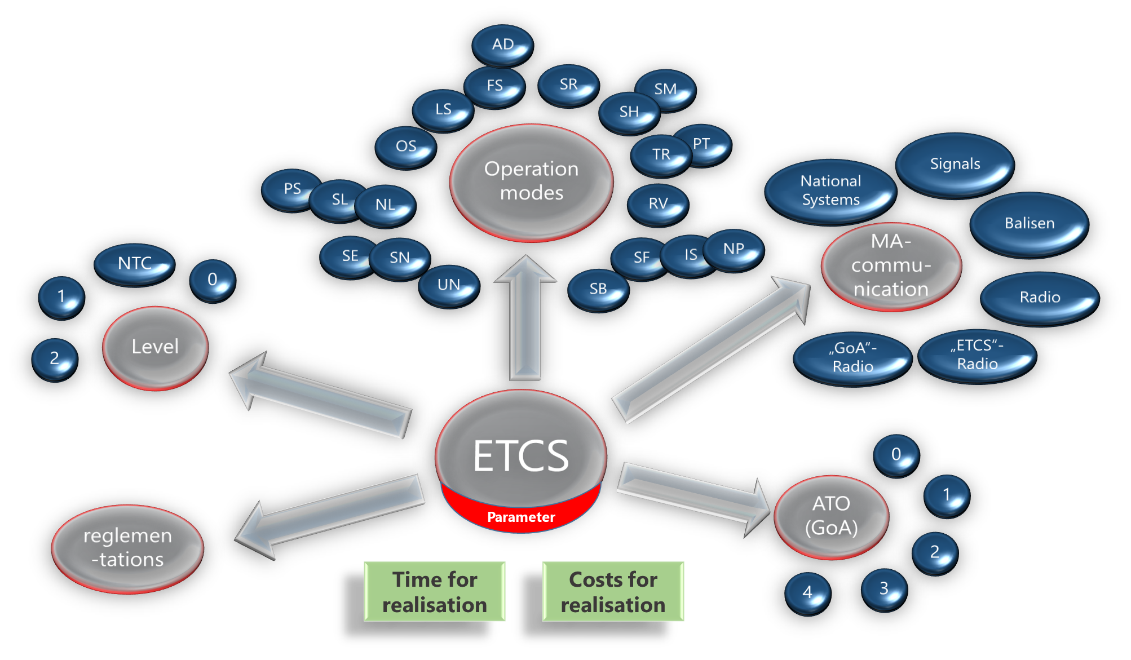
The Multi Tool ETCS
One of the mighty tool to achieve the European goals is the multitool ETCS which all its possibilities.

Slide 5
Anyhow there are still issues with the speed of deployment
  Identify obstacles to
Goal of the Workshop
  Speed up the deployment of ERTMS
  in a systematic way on your perspective.

Slide 6




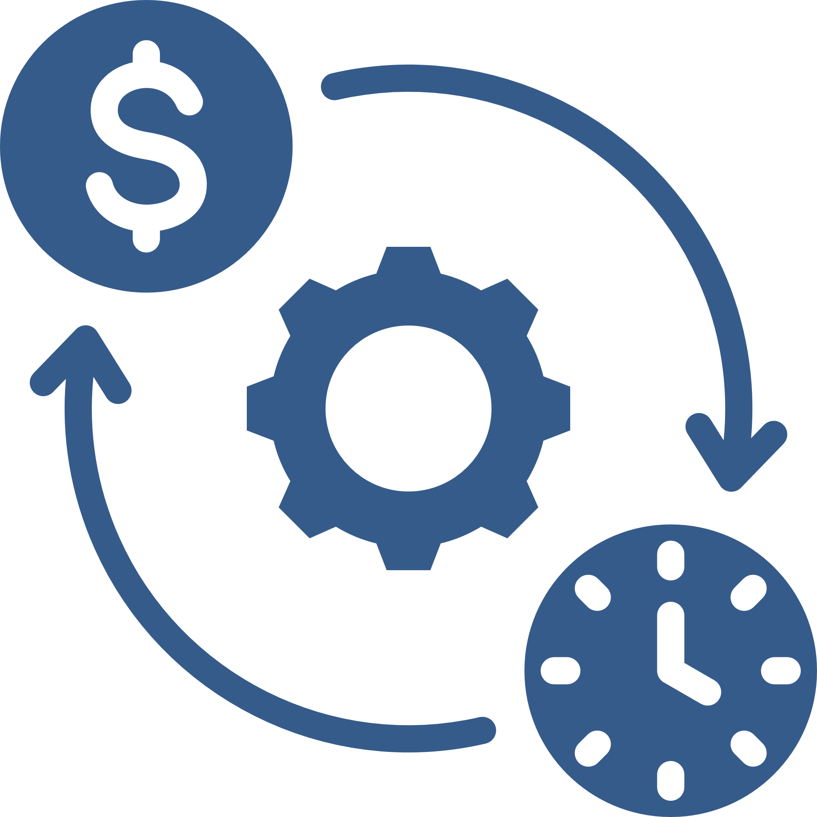


Introduction
TECHNICAL
ADMINISTRATIVE
Categories
POLITICAL
SOCIAL
FINANCIAL

Slide 7
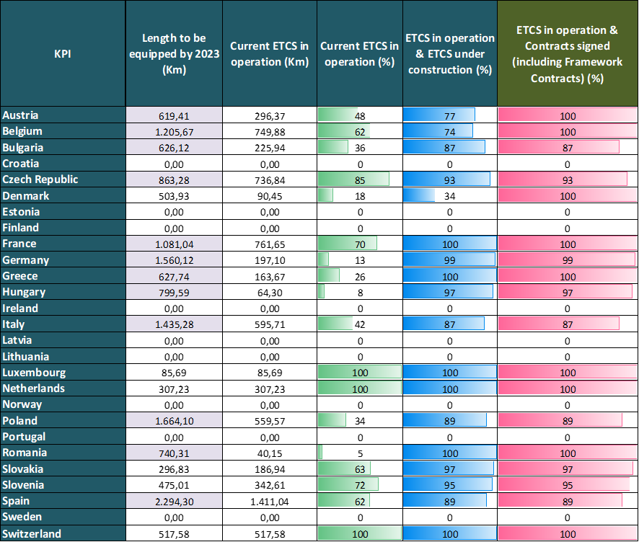
ETCS Deployment.
The ETCS status by Member State, including Norway and Switzerland, expressed in terms of number and percentage of km to be equipped on the CNC (Core Network Corridor) by 2023.
The data represents the situation at the end of 2023.
It does not consider the new definition of the corridors and network levels under the revised TEN-T Regulation which will enter into force in June.
Source: Second Work Plan of the European Coordinator, July 2022. Updated to the end of the year 2023.
ETCS Status by country end 2023 – Core Network Corridor sections planned in the EDP by 2023

Slide 8
Workshop organization
The subgroups work for 30 mins
Each subgroup have to appoint a representative to present the final conclusions
Use the prepared table:
  Please try to assign category to each identified OBSTACLE and SOLUTION
  Feel free to add comments / explanations
Each subgroup will present their work at the flipchart to the rest of the workshop participants (5mins)
At the end we will discuss the results and make consolidated outputs

Slide 9
CATEGORY* | TS / OB | OBSTACLE | SCORE** | PROPOSED SOLUTION | SCORE**
*CATEGORY (Technical, Administrative, Political, Social. Technical)
** SCORE of impact (1 – lowest, 2- low, 3 – medium, 4 – hight, 5 – highest)

Slide 10
CATEGORY* | TS / OB | OBSTACLE | SCORE** | PROPOSED SOLUTION | SCORE**
TECHNICAL | TS | Backward compatibility with older OB | 3
ADMINISTRATIVE | OB | Low interest in installing of OB
 |  | Increasing costs for vehicle authorization | 4 | Simplify Authorization by … | 5
POLITICAL | TS, OB | Low support of railway from polliticians | 4 | Change political direction in general elections | 4
SOCIAL | TS, OB | Low social acceptance of driverless trains by sociaty | 2 | Wide public debate, exapmples of operations | 5
FINANCIAL | OB | Low track kms for operation | 4
 | OB
FOR E X A M P L E ONLY
*CATEGORY (Technical, Administrative, Political, Social. Technical)
** SCORE of impact (1 – lowest, 2- low, 3 – medium, 4 – hight, 5 – highest)

Slide 11



Contribution of the attendees
Division of the group into subgroups

Slide 12
Contribution of the attendees
GROUPS WORK – 30 mins
END at 14:30

Slide 13
Contribution of the attendees
GROUPS WORK – 30 mins
END at 16:15

Slide 14
Contribution of the attendees
GROUPS WORK – 30 mins
END at 18:15

Slide 15
  THANK YOU VERY MUCH

